Slide 1
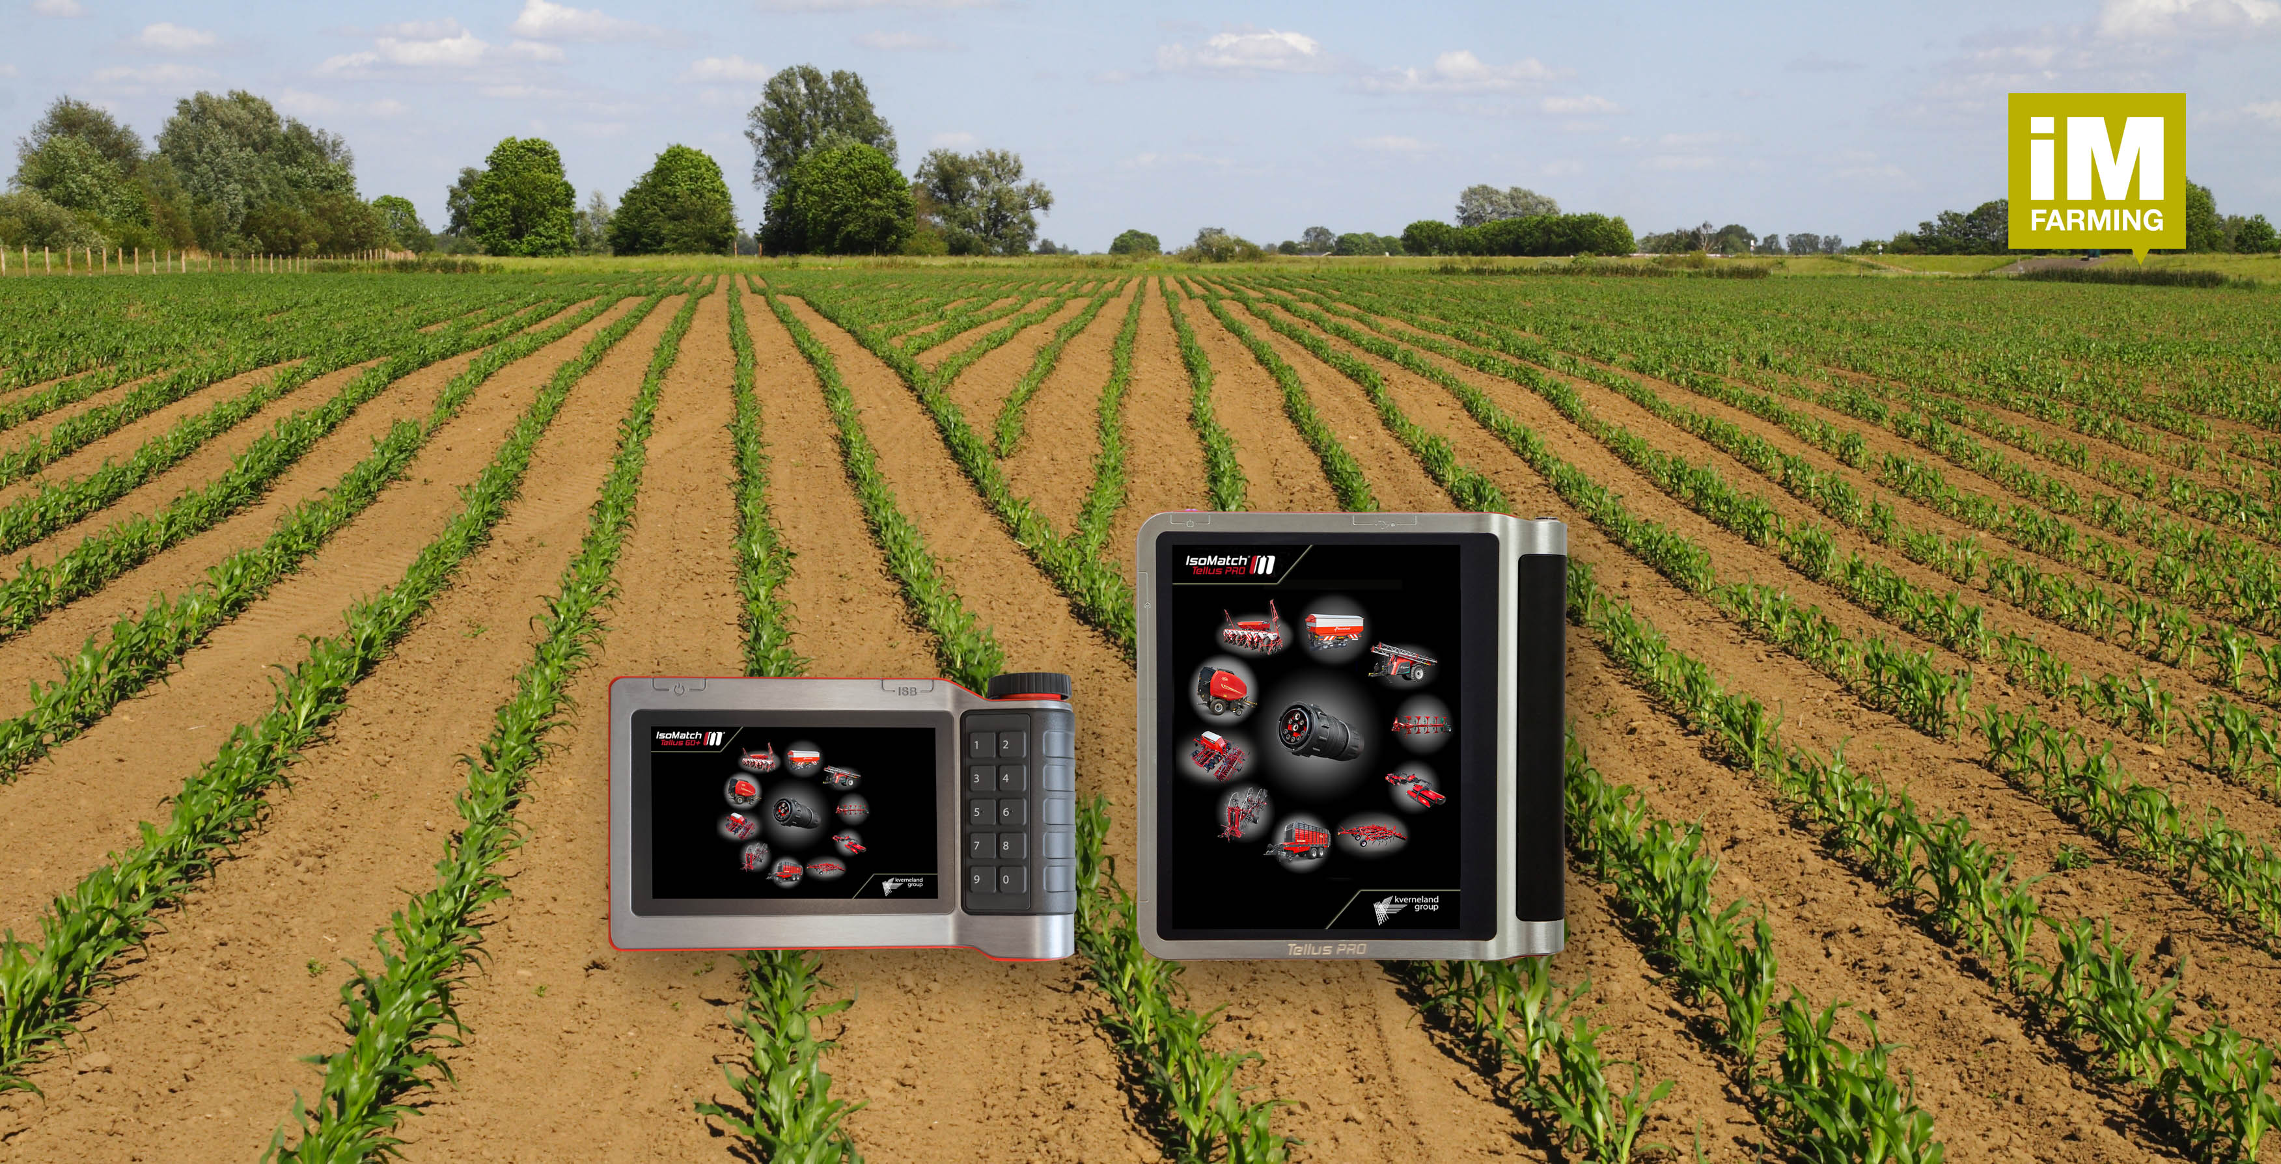
IsoMatch Product Range
Kverneland Group Mechatronics B.V
2021/22

Slide 2
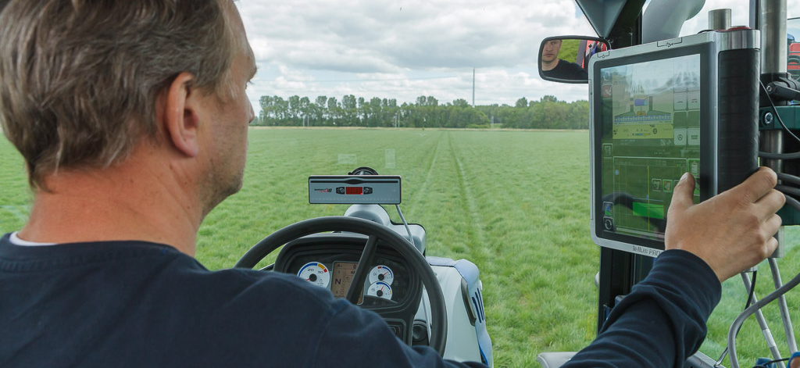

In this PowerPoint you can find commercial texts & USP’s for each IsoMatch products.

Slide 3




iM FARMING
What is it?
iM FARMING is KvG’s commercial concept (independent) for precision farming, representing KvG’s offering of electronic solutions and ISOBUS implements. Commercially explained from a Customer/Farmer point of view (what can I do with it? benefits?)
iM FARMING originates from IsoMatch Farming (our Mechatronics solutions converted into Marketing Verbs)
iM FARMING is the umbrella marketing-communication concept, fully covering our competitive advantages of our electronic solutions (IsoMatch Products), communicated as one face to the market.
iM FARMING concept of Kverneland Group combines and presents its competitive advantages of the ISOBUS machine offering in combination with all electronic solutions, simply explained to the customer to help him to find the right solution for his machine, based on his real needs, to carry out the work in a smarter, more efficient and easier way.
  iM FARMING guidelines:
  Corporate
  Kverneland
  Vicon

Slide 4
IsoMatch Product Range overview
Terminals
IsoMatch Tellus GO+
IsoMatch Tellus PRO
Accessories
IsoMatch Power
IsoMatch Global 2
IsoMatch InLine
IsoMatch Eye/MultiEye
IsoMatch Wireless
IsoMatch Grip
Apps & Systems
IsoMatch GEOCONTROL
IsoMatch FarmCentre
Sales & Service Tools
IsoMatch InDemo
IsoMatch DemoCase (GO)
IsoMatch TopService
IsoMatch TopRemote (*)
IsoMatch Simulator
*not released yet

Slide 5



Marketing Material Available
All of our products have several marketing materials available. These can either be found on the Download Centre, or you can contact Maria Vasbotten (Maria.Vasbotten@kvernelandgroup.com) who will be able to assist.
Logo’s and Icon’s can be downloaded here
Logo’s
Icon’s

Slide 6
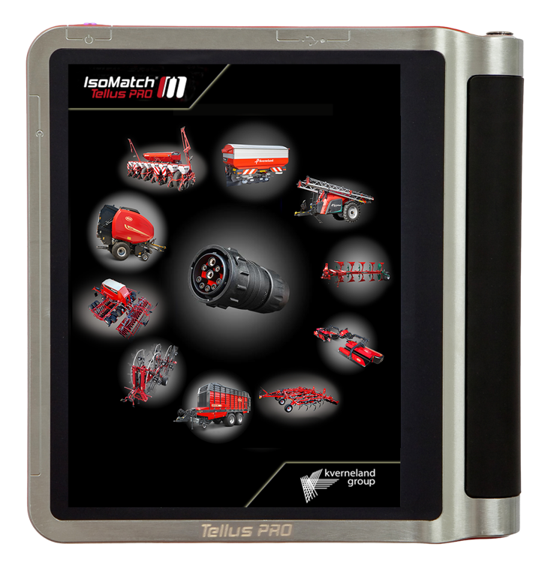
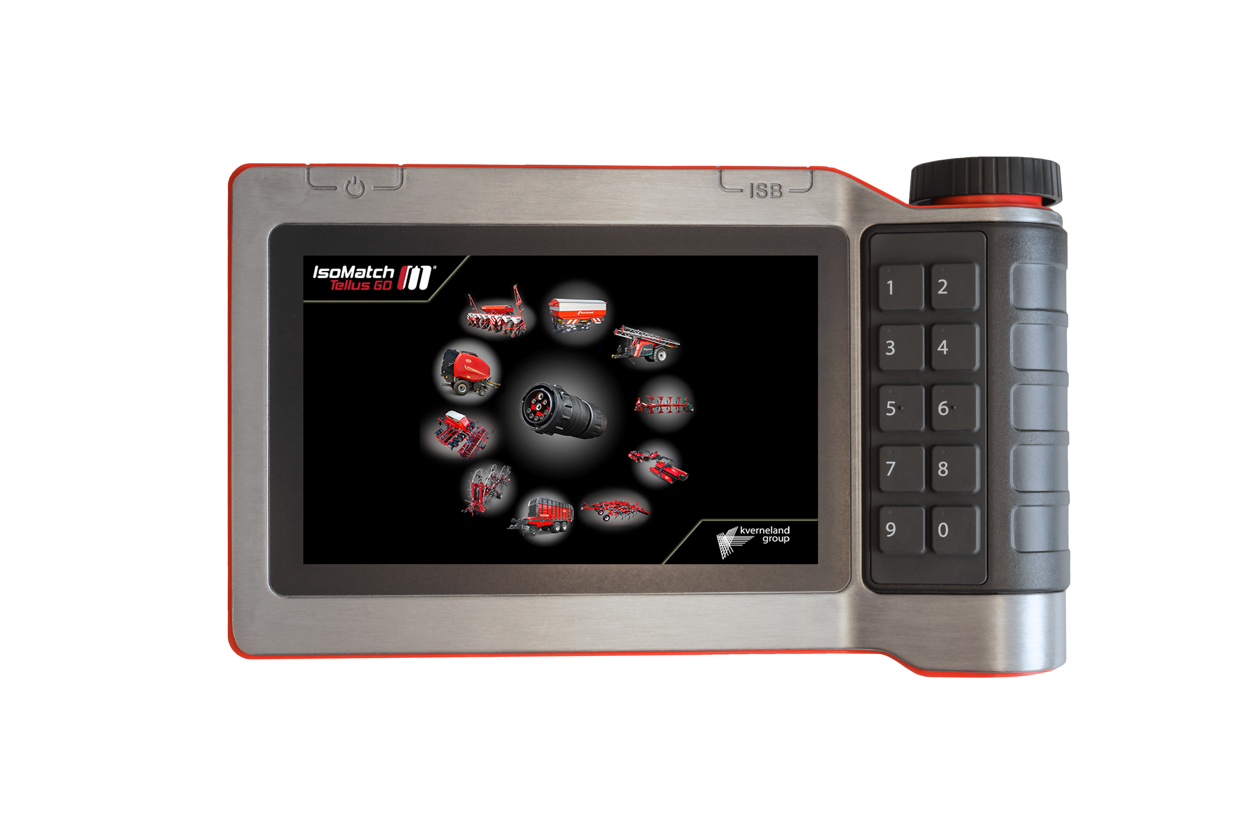
Terminals – IsoMatch Tellus Series
The IsoMatch Tellus terminals can communicate with all ISOBUS machines and are equipped to drive with GPS systems.
The easy-to-use touch screens is designed for long working days. An excellent overview allows you to monitor the performance of both the implement and the tractor or task.
Two different packages are available, an ISOBUS package and a NON-ISOBUS package.
IsoMatch Tellus PRO
IsoMatch Tellus GO+

Slide 7
IsoMatch Tellus PRO
Commercial text
With its advanced hardware and software features, this 12-inch terminal provides the optimal solution for an all-in-one control system inside the tractor cabin. It is the centre for connecting all ISOBUS machines and a platform for running precision farming applications and IsoMatch FarmCentre. It offers everything you need to get the maximum out of your machines and crops, as well as cost savings in fertilizer, chemicals and seeds by using automatic section control and variable rate control. With the unique dual screen functionality it gives you the opportunity to view and manage two machines and/or processes simultaneously.
Time is money and to get the highest productivity, no time can be wasted. That is why fast is the keyword for this new terminal in the IsoMatch range. With state of the art hardware, you experience a fast responding terminal which can handle more demanding applications. With the IsoMatch Tellus PRO you are ready to work with innovative functions, features and apps. One important advantage is the possibility to connect this terminal to IsoMatch FarmCentre, our new telematics solution and smart web application. The maximum working range for the task controller is increased to 10 km from the starting point. This leads to extremely big fields being handled in a fully professional way. And with the new high brightness screen, you experience even greater operator comfort. Visibility is increased during the day and dimmed to just a glowing display in dark conditions.
USP’s
• Powerful processor and glossy dual screen
• 12 inch total screen size
• User friendly
• All in one control system
• Dual screen functionality
• Ready for Telematics applications
• IsoMatch GEOCONTROL license available

Slide 8
IsoMatch Tellus GO+
Commercial text
When deciding what equipment to purchase, it is not always easy to find the optimal solution in the broad market offering of today. Technology is developing fast with tractors and implements increasingly being equipped with high-tech electronics. We understand this complexity and are committed to providing you with easy yet advanced farming solutions. Therefore the ISOBUS Universal Terminal, the IsoMatch Tellus GO+, is made for easy machine control and efficient farming.
The new IsoMatch Tellus GO+ offers a more powerful processor, allowing for significantly faster responsiveness and increasing the ease of navigation. The IsoMatch Tellus GO+ can now handle demanding applications like IsoMatch FarmCentre, allowing advanced features and remote connection to your implement for a higher yield at less cost.
Ease of setting up the machine with the soft keys and simple use of the hard keys and rotary switch for optimal control while driving remains the trademark of the IsoMatch Tellus GO+ terminal, and is testimony to our commitment to bring farmers the most advanced technologies to improve productivity and efficiency. Separate licenses for specific functionality are available, allowing you to tailor your investment to your personal needs.
USP’s
• Powerful processor and glossy screen
• 7 inch screen size
• User friendly
• Rotary control and physical buttons
• Ready for Telematics applications
• IsoMatch GEO-SC and GEO-VR licenses available

Slide 9
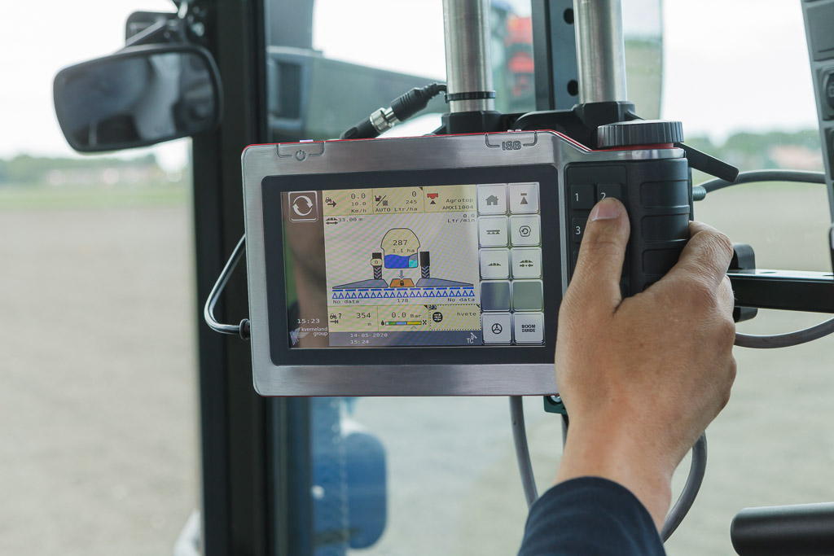

Slide 10
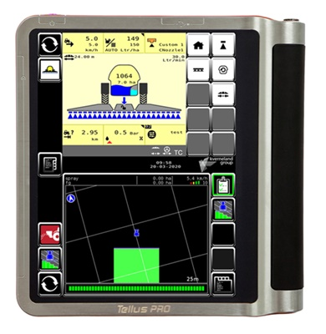
IsoMatch GEOCONTROL
Commercial text
Realising the full potential of farming is about growing and developing your business. When there is work to be done, you need the optimal setup and solutions to work as efficiently as possible. IsoMatch GEOCONTROL, an advanced precision farming application within the IsoMatch Tellus PRO and IsoMatch Tellus GO+, helps you to control all ISOBUS compatible machines. Combined with a GPS receiver it fulfils the future needs towards an easy and profitable way of working.
Section Control (SC)
The Section Control makes sure that the implement’s sections will be switched on and off automatically. This avoids undesired overlap and operation outside the field border.
• Shut off sections when driving over previously covered areas
• Shut off sections when driving outside field boundary
• Shut off sections when driving backwards
• Headland control
• Manual override possibility
Variable Rate (VR)
The Variable Rate will automatically adjust the rate of your machine based on Variable Rate maps. It enables you to vary the rate of for example seeds, fertiliser and chemicals.
• Forward place specific rate from task to machine
• Record applied rate from machine to task
USP’s
• Section control – Control up to 88 sections
automatically
• Variable rate control – Always use the exact
amount of fertilizer, chemicals or seeds needed
• Manual guidance – Stay within your guidance
lines in the field
• Reports – with IsoMatch FarmCentre you can download reports remotely

Slide 11
IsoMatch GEOCONTROL
Commercial Text continued
Easily integrated set-up
Setup and full operation is conveniently controlled by one single application: IsoMatch GEOCONTROL. Precision implement control and tractor steering on one screen. Recording of (pre-recorded) straight or curved guidance lines can be done simultaneously with the field boundary registration. Multiple lines can be stored per field. Specific configurations and settings for a tractor – implement combination can be saved in tractor profiles, which can be recalled at any time. Reduce overlap and save up to 15% on input costs with IsoMatch GEOCONTROL
Free of charge features
• Documentation: Save all operational job data and field maps for exchange via USB to farm management information systems or the new IsoMatch FarmCentre telematics solution.
• Manual guidance: advised driving direction using guidance lines in the field and on headlands. Perfect to use in combination with the IsoMatch InLine.
• Smart field boundary recording: independent from the working width, even without an implement connected.
• Boundary shrinking: create inner boundaries by setting the desired width of the headland.
• Multiple Guidance Lines: add a maximum of 20 guidance lines per field.

Slide 12
IsoMatch FarmCentre
Commercial text
Today’s farming has evolved from individual craftsmanship to precision agriculture. Driven by advanced technology,
precision agriculture will have a huge impact on traditional farming approaches across the world. To allow for a better
overview in farm management, Kverneland Group Mechatronics has developed the IsoMatch FarmCentre application, the first of a series of telematics solutions. IsoMatch FarmCentre is applicable for Kverneland ISOBUS machines in combination with an or IsoMatch Tellus PRO. Whether you wish to control your fleet, manage tasks remotely or analyse machine performance data, IsoMatch FarmCentre provides this in a simple web application, linking implements, tractors and terminals in one continuous flow of data and connectivity.
Remote task management
To improve efficiency and save time, the farmer or contractor can send tasks to the terminal remotely. Once the work is done, the operator can send back that same task directly from the field. Exported data on finished tasks can be downloaded, analysed and used for reporting and invoicing purposes, decreasing your admin time.
Keep track of your machines – location, alerts & data insights
Whether you are a farmer or contractor with a fleet, IsoMatch FarmCentre gives you a complete overview of your business. You can track the movement of your fleet in real time or verify later where your machines have been operating. Keeping track of multiple machines spread over vast areas has never been so easy! Additionally, all alerts and notifications are sent directly to the IsoMatch FarmCentre web application, and the history of alerts is saved. Allowing dealer to access your account for remote support will decrease the risk of downtime and increase your productivity. With IsoMatch FarmCentre, machine performance parameters can be tracked and analysed for optimal performance. Actual information about quantity of pressed bales, fertiliser consumption and more is shown in the application. All this you can check remotely from a computer or even a tablet or smartphone.
Create precision farming maps
One of the tools available in IsoMatch FarmCentre is MyDataPlant, an application to create accurate prescription maps based on biomass development. Combining current condition of your crop and historical data allows you to improve your farming results by tailoring fertiliser, seed and crop protection maps.

Slide 13
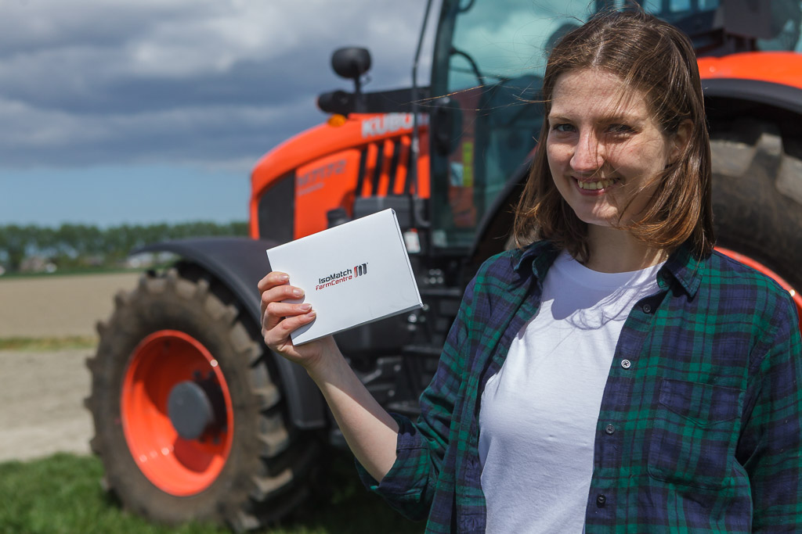
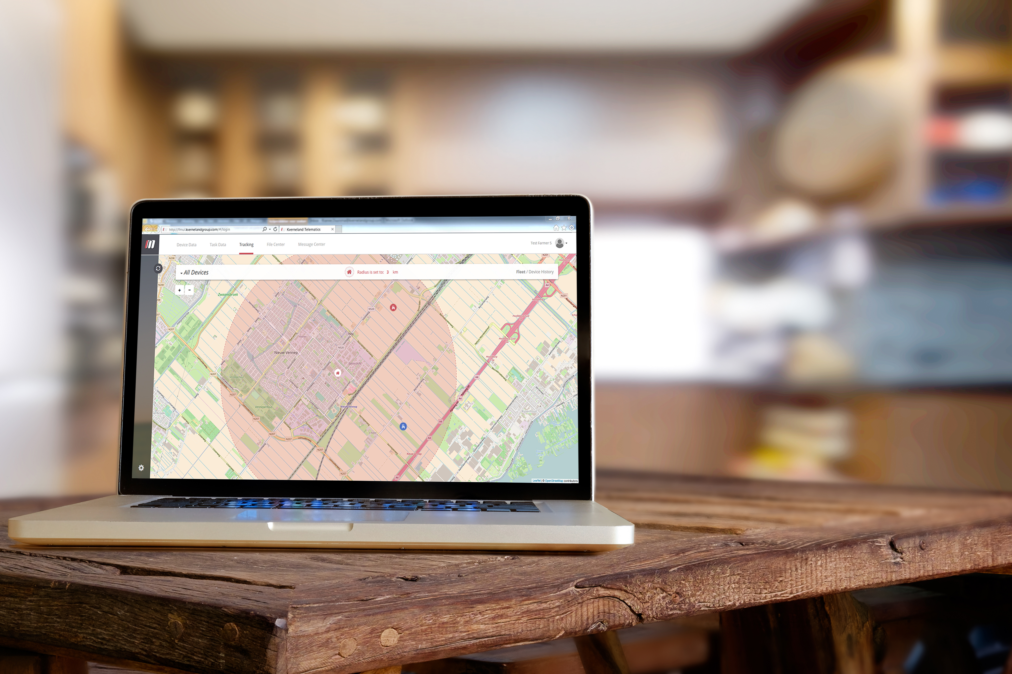
IsoMatch FarmCentre
USP’s
Easy To Use
Intuitive interface that is easy to navigate
I’m in Control
Stay informed with trustful insights
Gives me Peace Of Mind
Every detail is recorded in the system, from alert history to finished tasks
Saves Time
Increased efficiency as less time is spent on administrating tasks
Supports Decision Making
Optimise usage of machine and make decisions based on historical data
Always Connected
With your device, stay fully up to date on what is happening on your farm

Slide 15
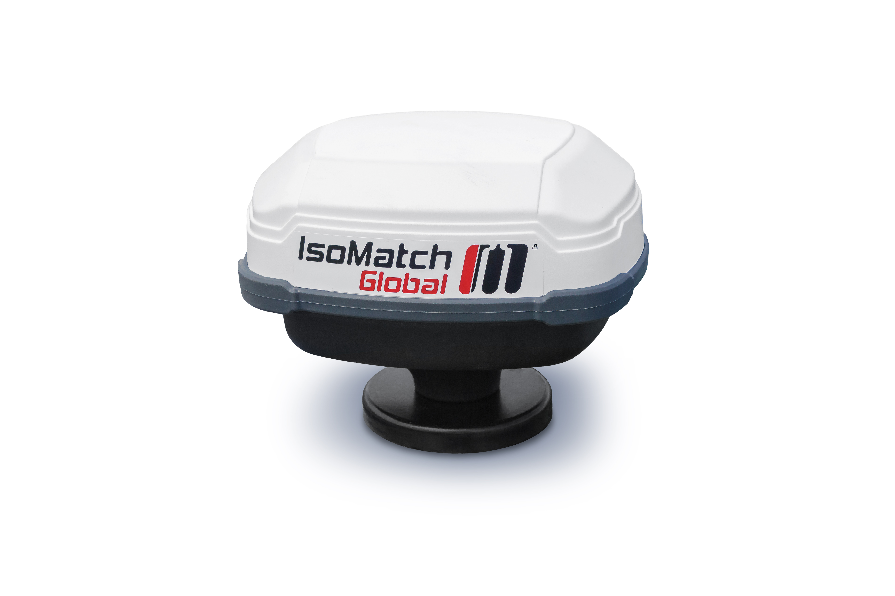
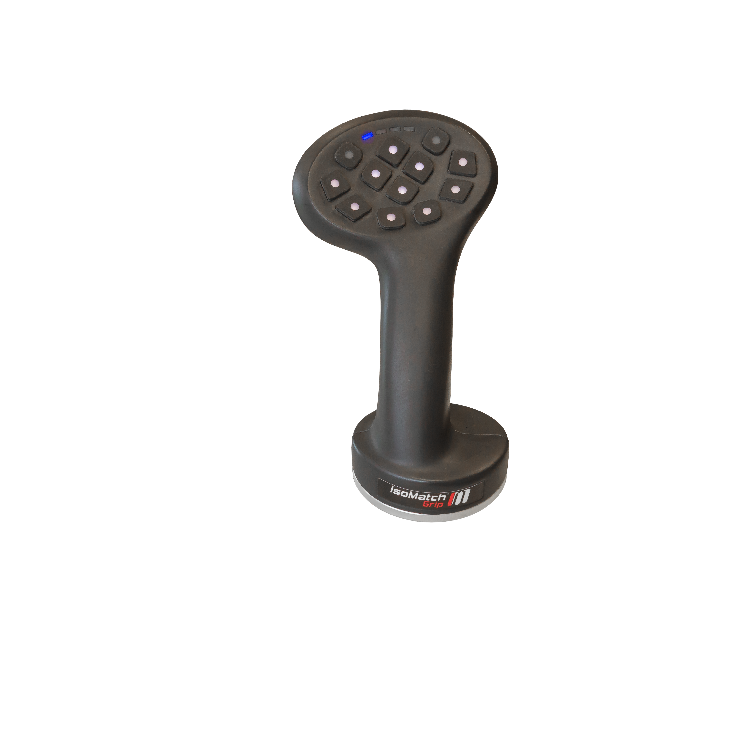
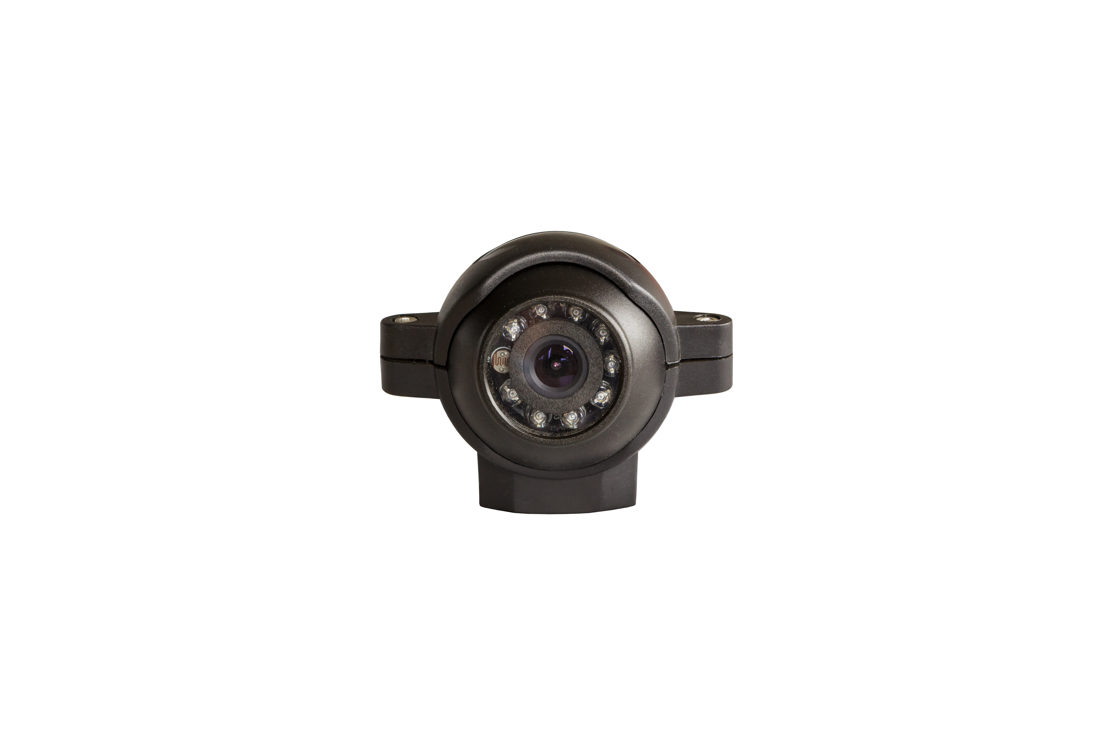
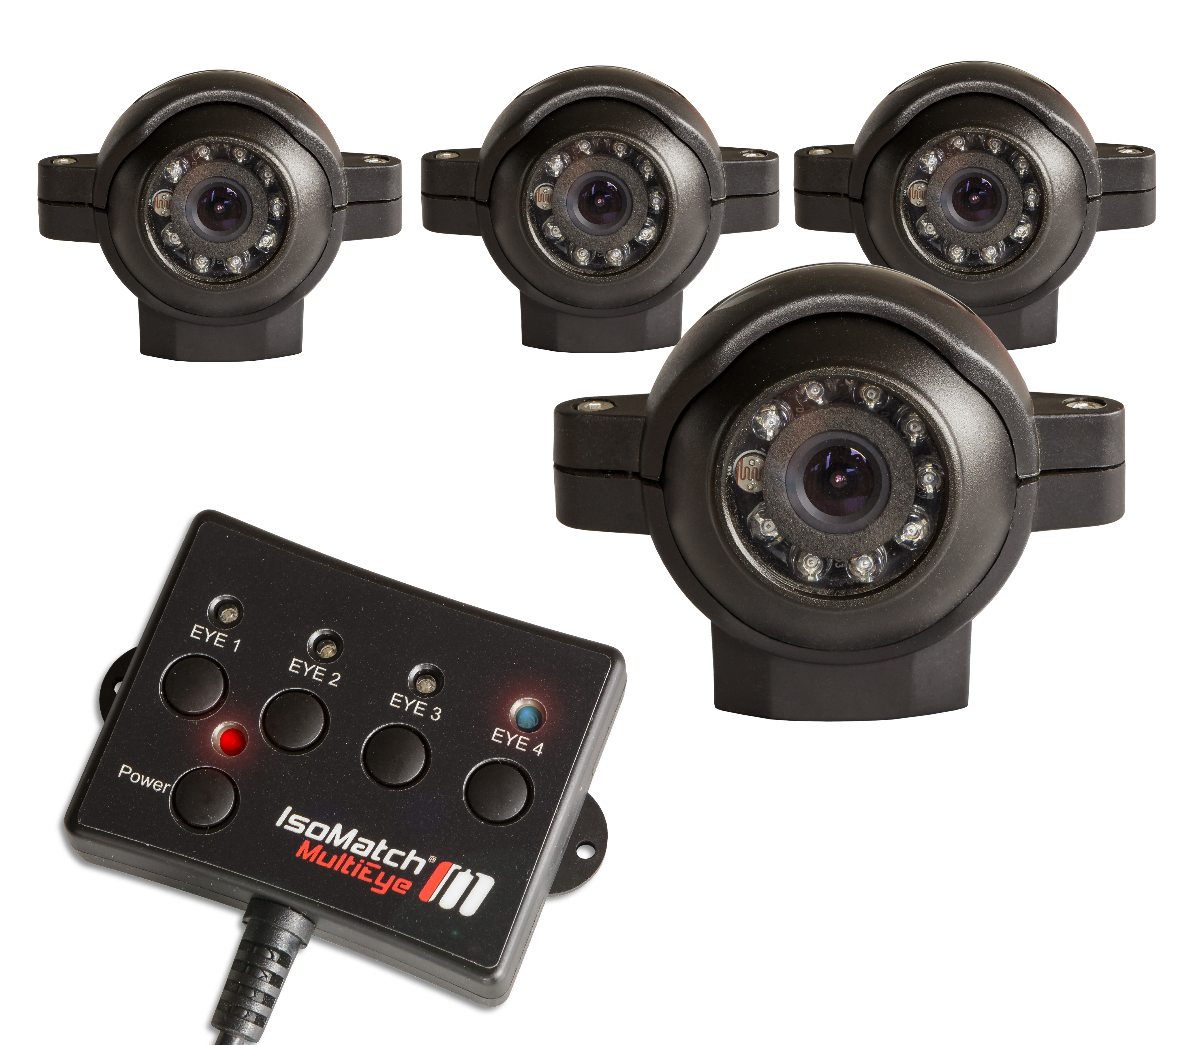
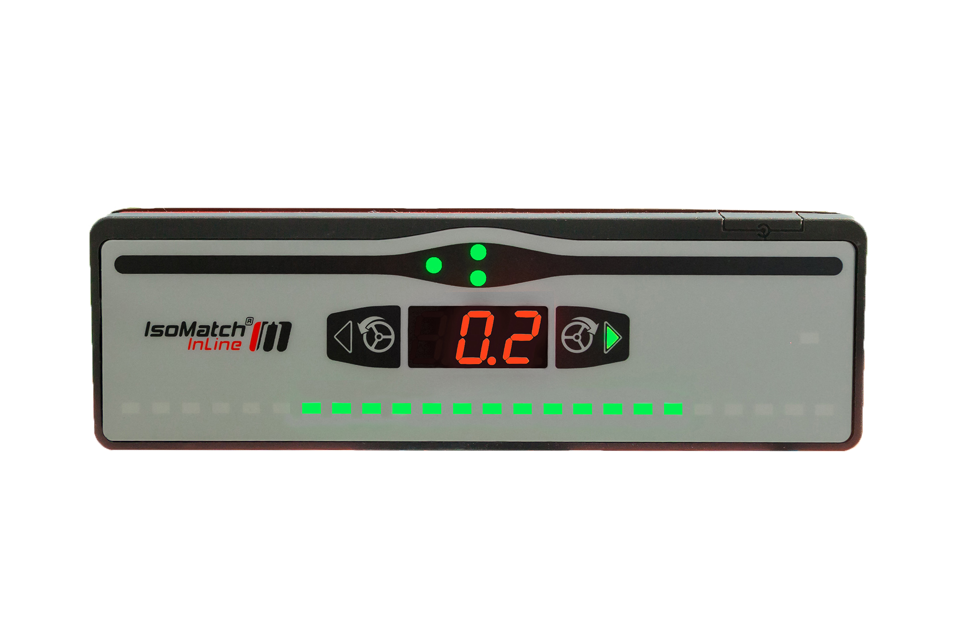
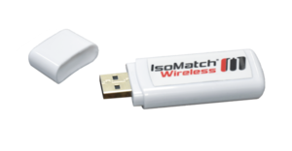
IsoMatch Accessories
IsoMatch accessories is a group of products that you can use together with your IsoMatch Terminal.
Each of these products will help the farmer be more efficient and save on costs on the long term.
IsoMatch Global
IsoMatch Grip
IsoMatch Eye
IsoMatch MultiEye
IsoMatch InLine
IsoMatch Wireless

Slide 16
IsoMatch Global / 3
Commercial text
Kverneland Group’s precision farming offering consists of
innovative and custom made solutions, designed for optimal
use of your tractor and implements.
IsoMatch Global is one of the essential accessories for
IsoMatch GEOCONTROL. The IsoMatch Global is a GPS
antenna with DGPS accuracy, that enables the farmer to do
the navigation for site specific section control, use variable
rate application, manual guidance, and field registration
Following up our successful IsoMatch Global, we now have the IsoMatch Global 3. A GPS antenna system with DGPS accuracy (30-50 cm) for the best precision possible. It adds precision to manual guidance, automatic section control, variable rate control in combination with IsoMatch GEOCONTROL.
USP’s
Allows manual guidance, automatic section control and variable rate in combination with IsoMatch GEOCONTROL
DGPS accuracy without additional subscription fees
Easy to fit with mounting brackets included.
Fast and steady satellite signal

Slide 17
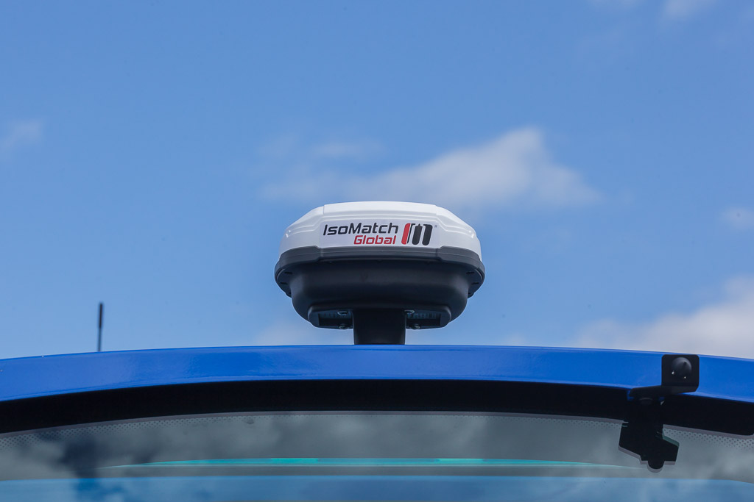

Slide 18
IsoMatch Inline
Commercial text
The IsoMatch InLine is a light bar for manual guidance including section status information. Mounted in the line of sight, you can easily see the distance from the guidance line and to which direction you should steer for the ideal position (accuracy: DGPS 30-50 cm, RTK 2 cm).
USP’s
Distance to A-B line with LED indication and a numeric display
Manual guidance in combination with IsoMatch GEOCONTROL
Displays status of machine sections
Keeps you on track in the field

Slide 19
IsoMatch Eye/ MultiEye
Commercial text
Connect up to 4 cameras to the IsoMatch Universal Terminals. You can easily switch between the cameras without the need for an additional screen in your tractor cab. It gives you full control and overview of the entire machine operation during day and night, because of its night vision by integrated LEDs. This increases safety when reversing the machine or maneuvering around obstructions.
USP’s
You can connect up to four IsoMatch Eye cameras and easily switch between the cameras with the remote control box which is standard included.
Full control and overview of entire machine operation from every side you want.
Night vision by integrated LED’s which increases the safety when reversing the machine or maneuvering around obstructions.

Slide 20
IsoMatch Wireless
Commercial text
This IsoMatch Wireless (USB-stick) is complementary to the IsoMatch Tellus terminals and makes it easy to connect to a local wireless network, such as your phone’s hot spot or home network. For this reason, it is not necessary to get an additional SIM card and there are no new cost from an internet service provider.
When connected via the IsoMatch Wireless, you can use our new platform IsoMatch FarmCentre and track your machines from your computer at home.
USP’s
Internet connection to any available wireless network
No additional costs with an internet service provider
Browsing on the spot

Slide 21
IsoMatch Grip
Commercial text
This ISOBUS auxiliary device is made for great operator comfort and efficient machine control. Its ergonomic shape and the complete freedom of assigning and controlling a total of 44 implement functions from one device is unique in the market today. From your fingertips you have endless possibilities to operate all machine functions as desired. Assignments are saved per machine making it even more applicable to your needs.
USP’s
In total 44 function assignments can be mapped to the IsoMatch Grip’s buttons
Supports up to four work modes, each identified by a colored LED
Full control at your fingertips
AUX-N certification (AEF)

Slide 22
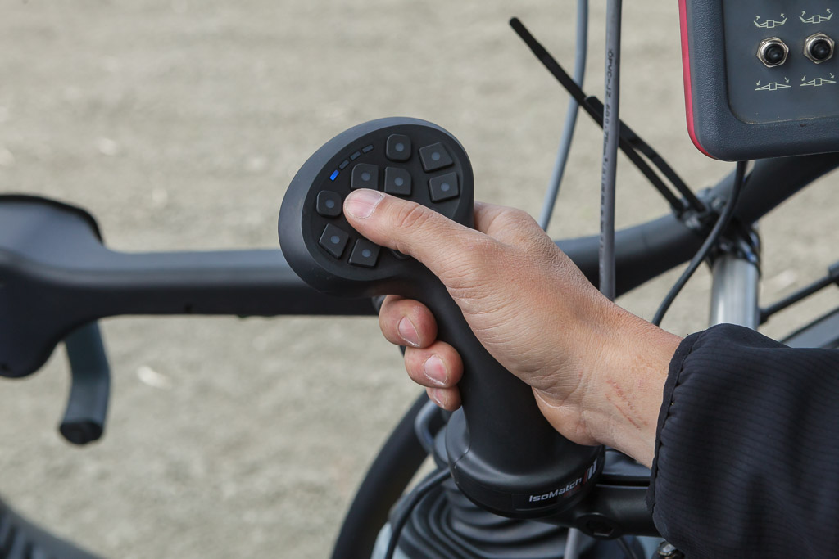

Slide 23

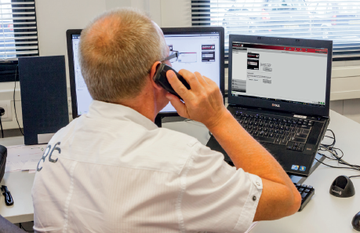
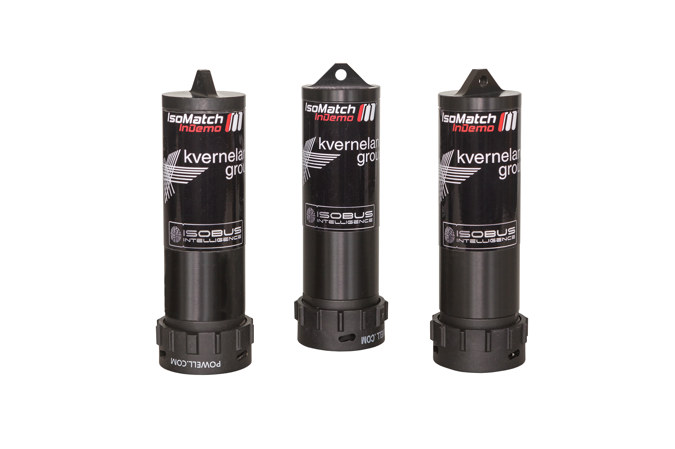
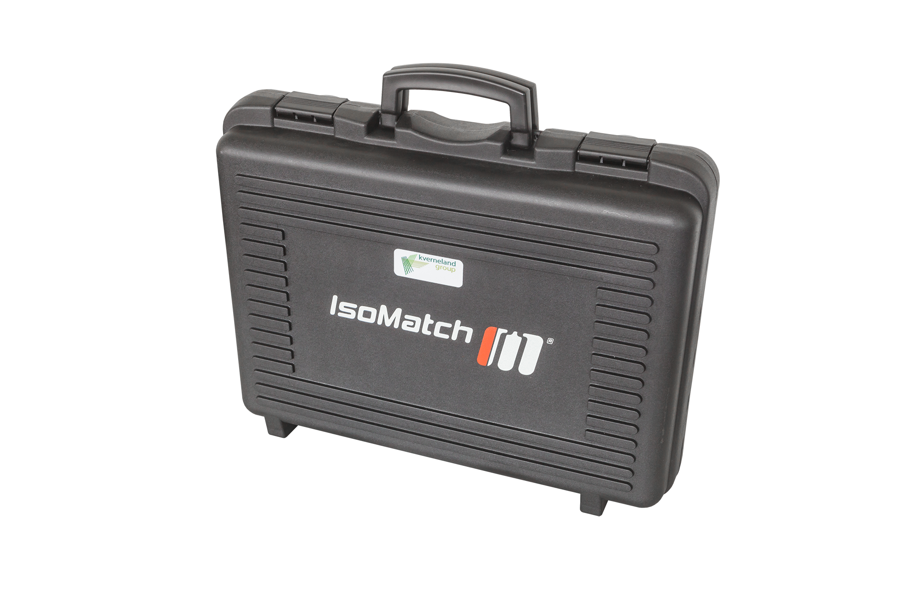
IsoMatch Sales, Telematics
and Service tools
IsoMatch Sales and Service tools are innovative solutions that help the dealers sell our products and the farmer to be more digitally advanced.
IsoMatch Simulator
IsoMatch InDemo
IsoMatch TopService
IsoMatch TopRemote
Image coming soon
IsoMatch Democase

Slide 24
IsoMatch InDemo
Commercial text
ISOBUS is all about compatibility. Whether you would like to show a customer your machines' compatibility to their ISOBUS tractor or demonstrate functionality on the IsoMatch Tellus PRO or IsoMatch Tellus GO+, the IsoMatch InDemo is the perfect solution. The IsoMatch InDemo has won a silver medal of innovation at Agritechnica 2013.
Just plug and play
Plug the IsoMatch InDemo plug into the tractor's ISOBUS connector and you are ready. Every IsoMatch InDemo plug is programmed with a particular machine software. The virtual terminal functions as if the plug was a real machine. This compact solution is applicable to any ISOBUS tractor type.
Demonstration on the desk?
Connect the leg stand to the IsoMatch Tellus PRO or IsoMatch Tellus GO+. Place the terminal on your desk. Connect the plugs and the connector box and you are ready to demonstrate the machine's functionality. It is as simple as that.
USP’s
A compact solution for demonstrating ISOBUS compatibility
Fully operational, without the need for machines
Just plug and play

Slide 25
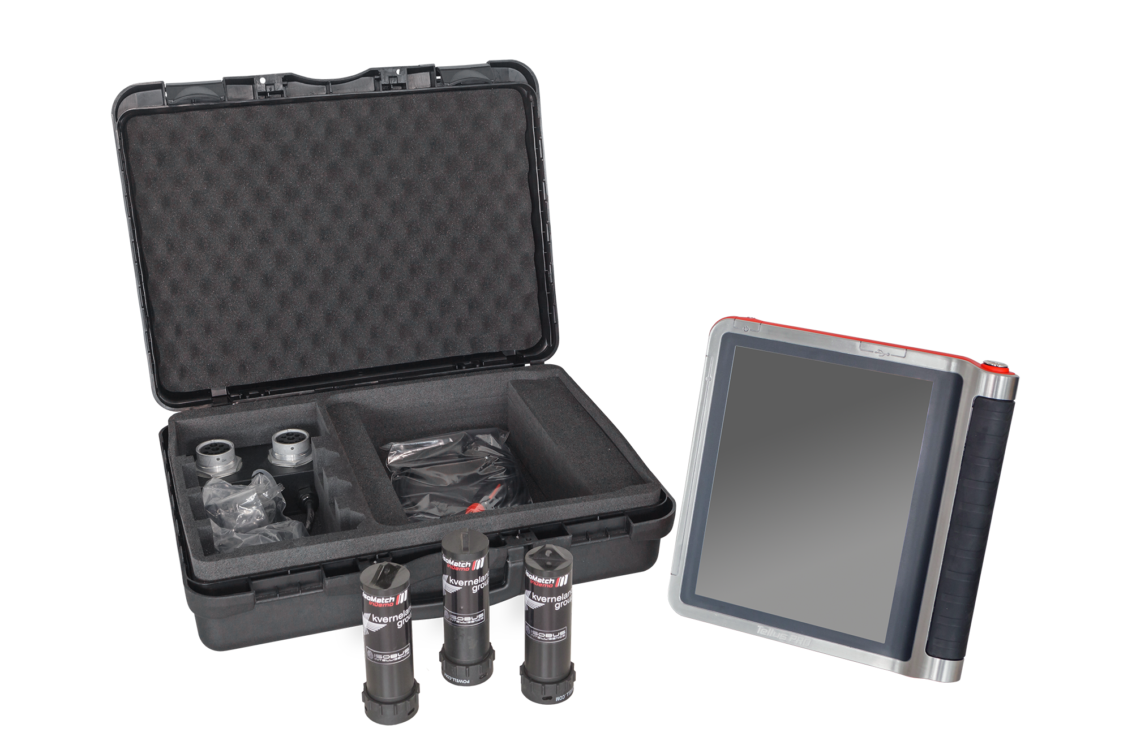
IsoMatch DemoCase
Commercial text
The IsoMatch DemoCase provides you with a professional set to impress your customers with IsoMatch products' capabilities.
It enables you to demonstrate the operation of the ISOBUS machine in various ways at any location. You can take this compact solution with you to your customers and show how the spreader, sprayer, seeder or any other machine will operate with the IsoMatch Tellus PRO or IsoMatch Tellus GO+ terminal. Let them see it with their own eyes.
The IsoMatch DemoCase PRO contains
IsoMatch Tellus PRO
3 IsoMatch InDemo plugs (of your choice)
Connector box, connects the plugs to the IsoMatch Tellus PRO
Desk stand for the IsoMatch Tellus PRO
Power adapter for IsoMatch Tellus PRO
3 sticker pages with the ISOBUS machines' pictures
The IsoMatch DemoCase GO+ contains:
IsoMatch Tellus GO+
3 IsoMatch InDemo plugs (of your choice)
Connector box, connects the plugs to the IsoMatch Tellus GO+
Desk stand for the IsoMatch Tellus GO+
Power adapter for IsoMatch Tellus GO+
3 sticker pages with the ISOBUS machines' pictures
USP’s
Impress customers with IsoMatch product capabilities
Demonstrate the operation of the ISOBUS machine in various ways at any location.
Compact solution for on the go
Easy to showcase how machines work

Slide 26
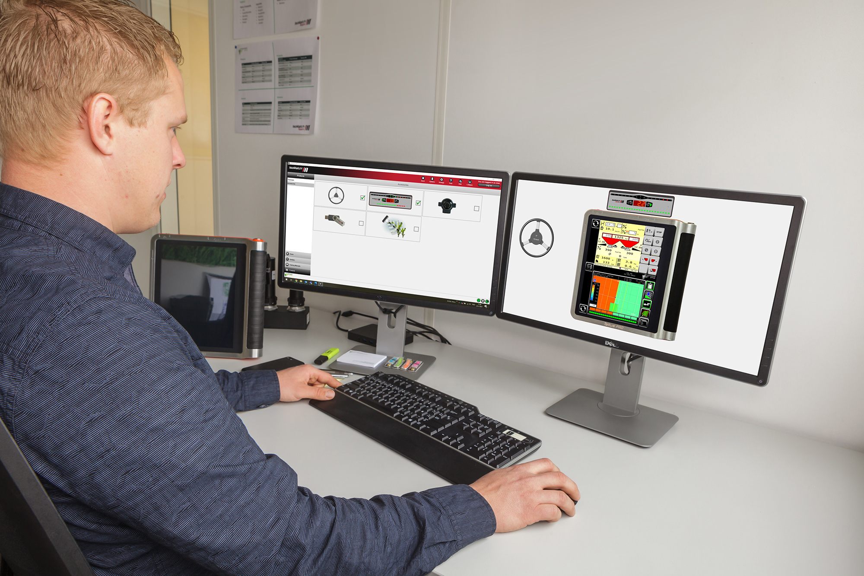
IsoMatch TopService
Commercial text
With the increase of technology in precision farming and electronic solutions, you need fast and effective service and support. When you face a problem in the field you expect a solution as fast as possible from the dealer or manufacturer. In some cases the response can be delayed due to traveling time and communication between different stakeholders, which causes you loss of time and money. With the unique position of Kverneland Group having its own electronic solutions for both its machines and universal terminals, it was possible to develop a service solution for the complete ISOBUS range in order to solve your problem in an efficient way.
IsoMatch TopService is a professional service tool for Kverneland Group’s electronic products to provide diagnostics and software update capabilities in addition to many other advanced features. It helps the dealer to diagnose and find solutions on the spot, faster and in a simpler way. The tool includes clear and user friendly design, multi-language support, automatic software downloads, release notes, documentation and many other features.
USP’s
Electronics service solution
Available for complete ISOBUS range
Solve problems in an efficient way
Clear and use-friendly design
Available in multiple languages

Slide 27
IsoMatch TopRemote
Commercial text
We understand your frustration when a machine does not work anymore and you fear having to go to the dealer, loosing out on valuable farming time. We have therefore developed a new module to our TopService solution which lets you easily report problems and provides the possibility to receive service on the spot, called IsoMatch TopRemote.
With IsoMatch TopRemote, you can easily allow your dealer direct access to your terminal and machines via Internet in order to solve the problem in a quick and cost efficient way without you having to go anywhere. Making sure you do not loose out important weather windows or events.
Images coming soon
USP’s
Save costs as no travel is needed
Time saving
Help on the spot
No breakdown during high season

Slide 28
IsoMatch Simulator
Commercial text
Learn about precision farming with e-learning
The IsoMatch Simulator is a virtual training program and the perfect tool to learn more about ISOBUS and precision farming. It is available for free and downloadable for Windows personal computers. It simulates the full functions of the IsoMatch Tellus PRO, IsoMatch Tellus GO+ and ISOBUS machines.
There is even a GPS system included as if you are using it in the actual field. This makes it easy to learn and practice with all the functions before using the actual product. Now it is possible to go through complicated operations in advance, to avoid errors and reduce the working hours.
In this way dealers, potential customers or students can learn about precision farming and ISOBUS technology on a laptop and even use their own field maps.
USP’s
Virtual learning program for precision farming
Works on Window’s computers
See how products work in the field
Free of charge

Slide 29
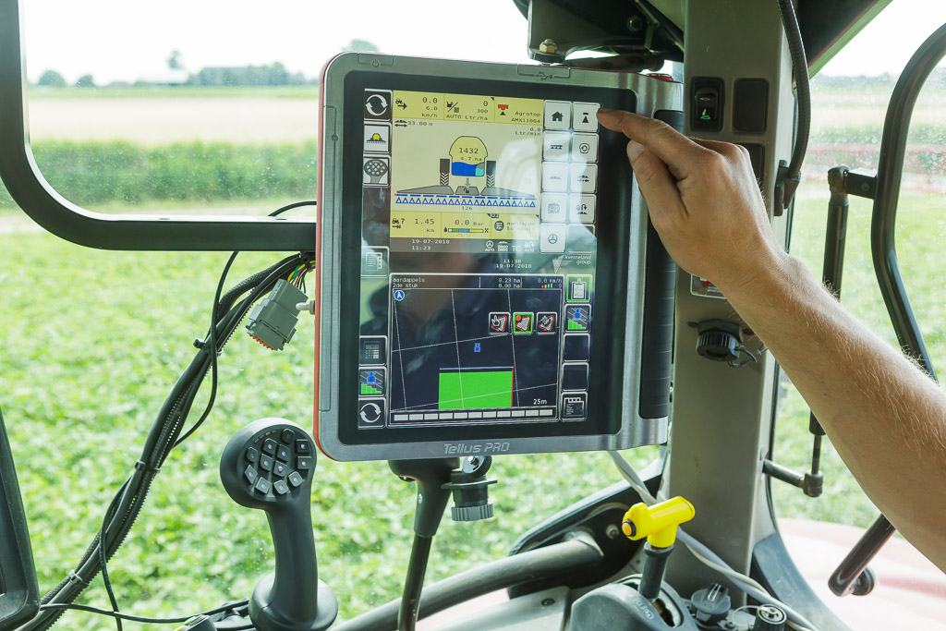

Slide 30
Contact
On the Download Centre you can find images of all of our products. Excel version of this PowerPoint, can be found here.
For more information please contact:
Xavier Tros de Ilarduya, Senior Product Manager Ruud Zwirs, Product Manager
xavier.tros@kvernelandgroup.com ruud.zwirs@kvernelandgroup.com
+34 6 0966 7498 +31 6 1023 4961
Gijsbert Heemink, Product Manager Maria Vasbotten, Marketing Coordinator
gijsbert.heemink@kvernelandgroup.com maria.vasbotten@kvernelandgroup.com
+31 6 2563 9336 +31 6 8270 4175
Anna Barsukova, Product Manager
anna.barsukova@kvernelandgroup.com
+31 6 8253 5491
Kverneland Group Mechatronics BV - Nieuw-Vennep - The Netherlands

