Slide 1
IsoMatch InDemo
Sales & Marketing Information, SMI-01-22-M
September 2022

Slide 2
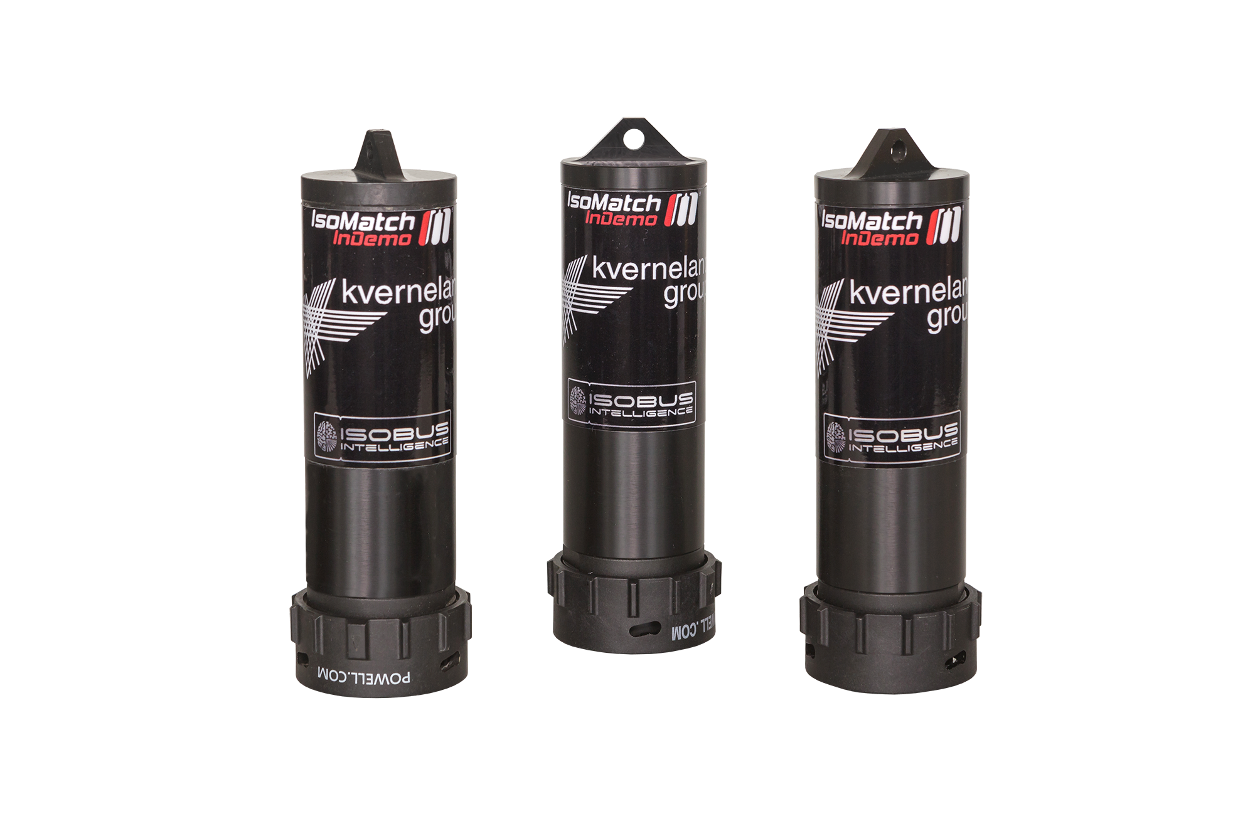
IsoMatch InDemo
With more and more implements being available in an ISOBUS version, the amount of IsoMatch InDemo’s with dedicated implement software has exploded. For Kverneland and Kubota together we have had almost 40 different types in the portfolio. This has become undoable to maintain and update, where some of the them were only sold in single units.
To make this a workable situation again Kverneland Group Mechatronics has decided to stop with the delivery of pre-flashed IsoMatch InDemo’s. We only will sell non-flashed InDemo’s which can be programmed with the desired implement software by the dealer or service technician with the IsoMatch TopService tool.

Slide 3
IsoMatch InDemo
For Kverneland/Vicon these are the available IsoMatch InDemo’s per September 1st 2022:
A136215800 IM InDemo A-type KvG
A136215900 IM InDemo B-type KvG
A136216000 IM InDemo C-type KvG
A136216100 IM InDemo D-type KvG

Slide 4
IsoMatch InDemo
Following Kverneland/Vicon flashed InDemo’s cannot be ordered anymore at regular order desk:
A136007700 | Type A | IM InDemo butterfly KvG
A136153900 | Type A | IM InDemo butterfly (NG) KvG
A136016000 | Type A | IM InDemo e-drive (NG) KvG
A136153500 | Type A | IM InDemo e-drive micro KvG
A136216600 | Type A | IM InDemo e-com double KvG
A136042900 | Type A | IM InDemo e-com u-drill KvG
A136056200 | Type A | IM InDemo x-fold KvG
A136088300 | Type A | IM InDemo i-plough KvG
A136155300 | Type A | IM InDemo 4 rot/15m rake KvG
A136182300 | Type A | IM InDemo i-tiller KvG
A136155100 | Type B | IM InDemo sprayer front t. KvG
MT00002489 | Type B | IM InDemo weighing spread. KvG
MT00002491 | Type B | IM InDemo PW/RW KvG
MT00002494 | Type C | IM InDemo FMA2 mounted KvG
A136141900 | Type D | IM InDemo FastBale KvG
A136153200 | Type D | IM InDemo iXtra Life KvG
A136153400 | Type D | IM InDemo e-com single KvG
A136153600 | Type D | IM InDemo IsoBaler SGE KvG
A136182900 | Type D | IM InDemo iXspray KvG
A136186100 | Type D | IM InDemo 4 rot/12.5m rake KvG
A136215500 | Type D | IM InDemo GEOSPREAD KvG

Slide 5
IsoMatch InDemo
In the exceptional case a customer cannot program the desired implement software himself because he does not have the IsoMatch TopService tool, there is the option to order the InDemo inclusive implement software from our technical support team.
Procedure:
Send your purchase order send to our Knowledge&Service Centre colleagues at mechatronicstechnicalsupport@kvernelandgroup.com
Indicate in your order:
Article number of which type of plug you need to have flashed KvG A/B/C/D
What implement software has to be flashed
A fixed additional fee for flashing software will apply on top of regular purchase price

Slide 6
Marketing material
You can find a lot of different marketing material on the Download Centre. By clicking on the icons below, the hyperlink with that specific material will open.
Website
Brochures
Photography
Updated website information
Updated brochures and 1-pager
Different images to use online or offline
Entire Package Kverneland
Entire Package Vicon
Click on this image to download the entire marketing material package
Click on this image to download the entire marketing material package

Slide 7
Contact us
P.O.’s and information requests regarding delivery lead times can be sent per email to: customercare.mechatronics@kvernelandgroup.com
For more information please contact:
Xavier Tros de Ilarduya, Senior Product Manager Ruud Zwirs, Product Manager
xavier.tros@kvernelandgroup.com ruud.zwirs@kvernelandgroup.com
+34 6 0966 7498 +31 6 1023 4961
Gijsbert Heemink, Product Manager Maria Vasbotten, Marketing Coordinator
gijsbert.heemink@kvernelandgroup.com maria.vasbotten@kvernelandgroup.com
+31 6 2563 9336 +31 6 8270 4175
Ariadna Tost, Product Manager
ariadna.tost@kvernelandgroup.com
+34 6 8869 6667
Kverneland Group Mechatronics BV - Nieuw-Vennep - The Netherlands

