Slide 1
“How-to-Demo” – Tips and tricks for practice
IsoMatch FarmCentre
Accompanying booklet for Italy Training Event 2022

Slide 2
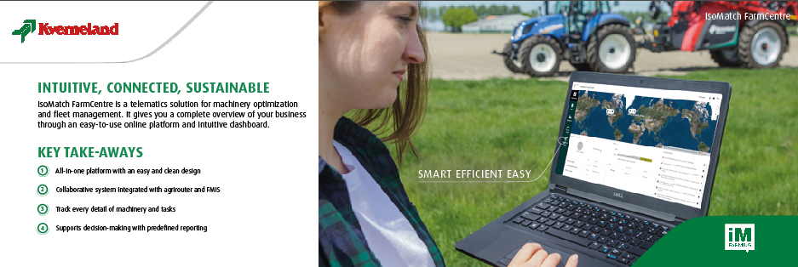
IsoMatch FarmCentre – Key take-away’s

Slide 3
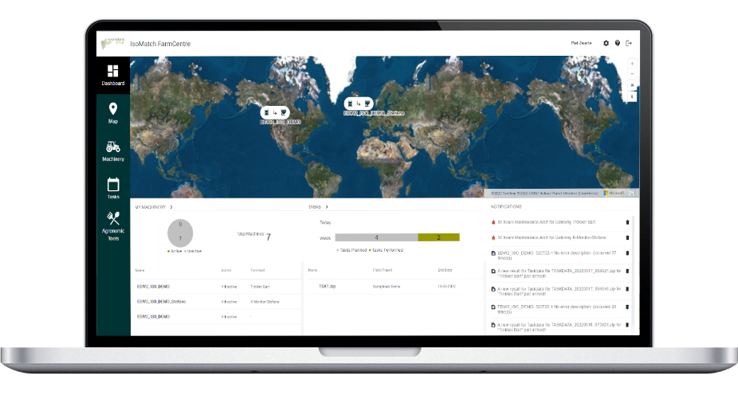
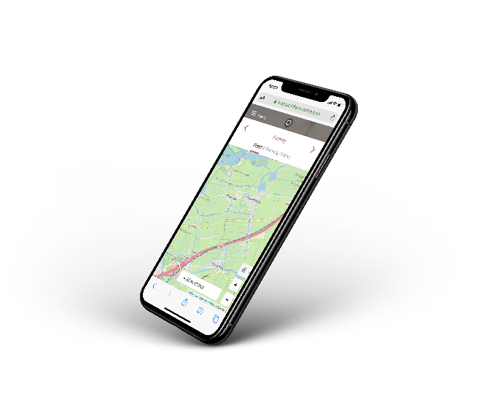
IsoMatch FarmCentre
Intuitive, Connected, Sustainable
Telematics solution for optimized machinery and fleet management, suitable for all Kverneland and ISOBUS machines.
IsoMatch Tellus PRO / GO+ as gateways for cloud connectivity
Data live Visualization, Analytics & Reports, Send and receive tasks (terminal - cloud), notification alerts
Agronomic Tools module for integrated software on demand (MyDataPlant, agrirouter)

Slide 4
Connectivity through the cloud – How does it work
IsoMatch FarmCentre

Slide 5
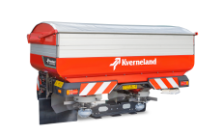
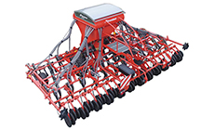
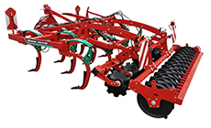
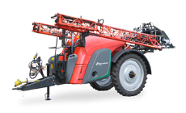
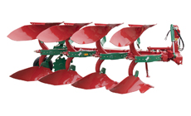
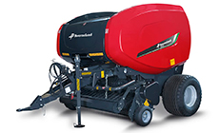
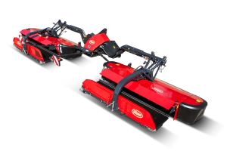
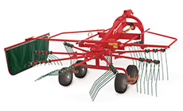
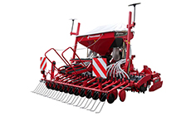
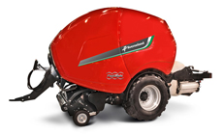
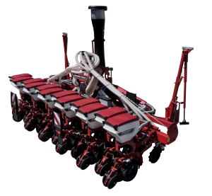
Implements ready for IM FarmCentre
Implementation completed
Planned (2022-23)
Testing and final approval pending ( Q3 2022)

Slide 6
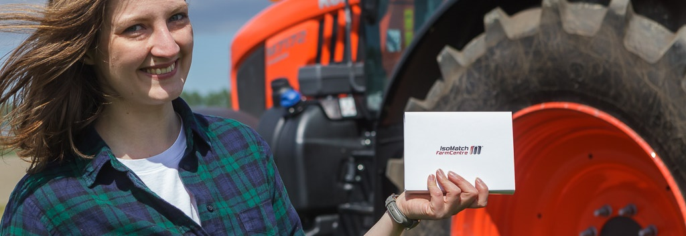
How to sell IsoMatch FarmCentre?

Slide 7
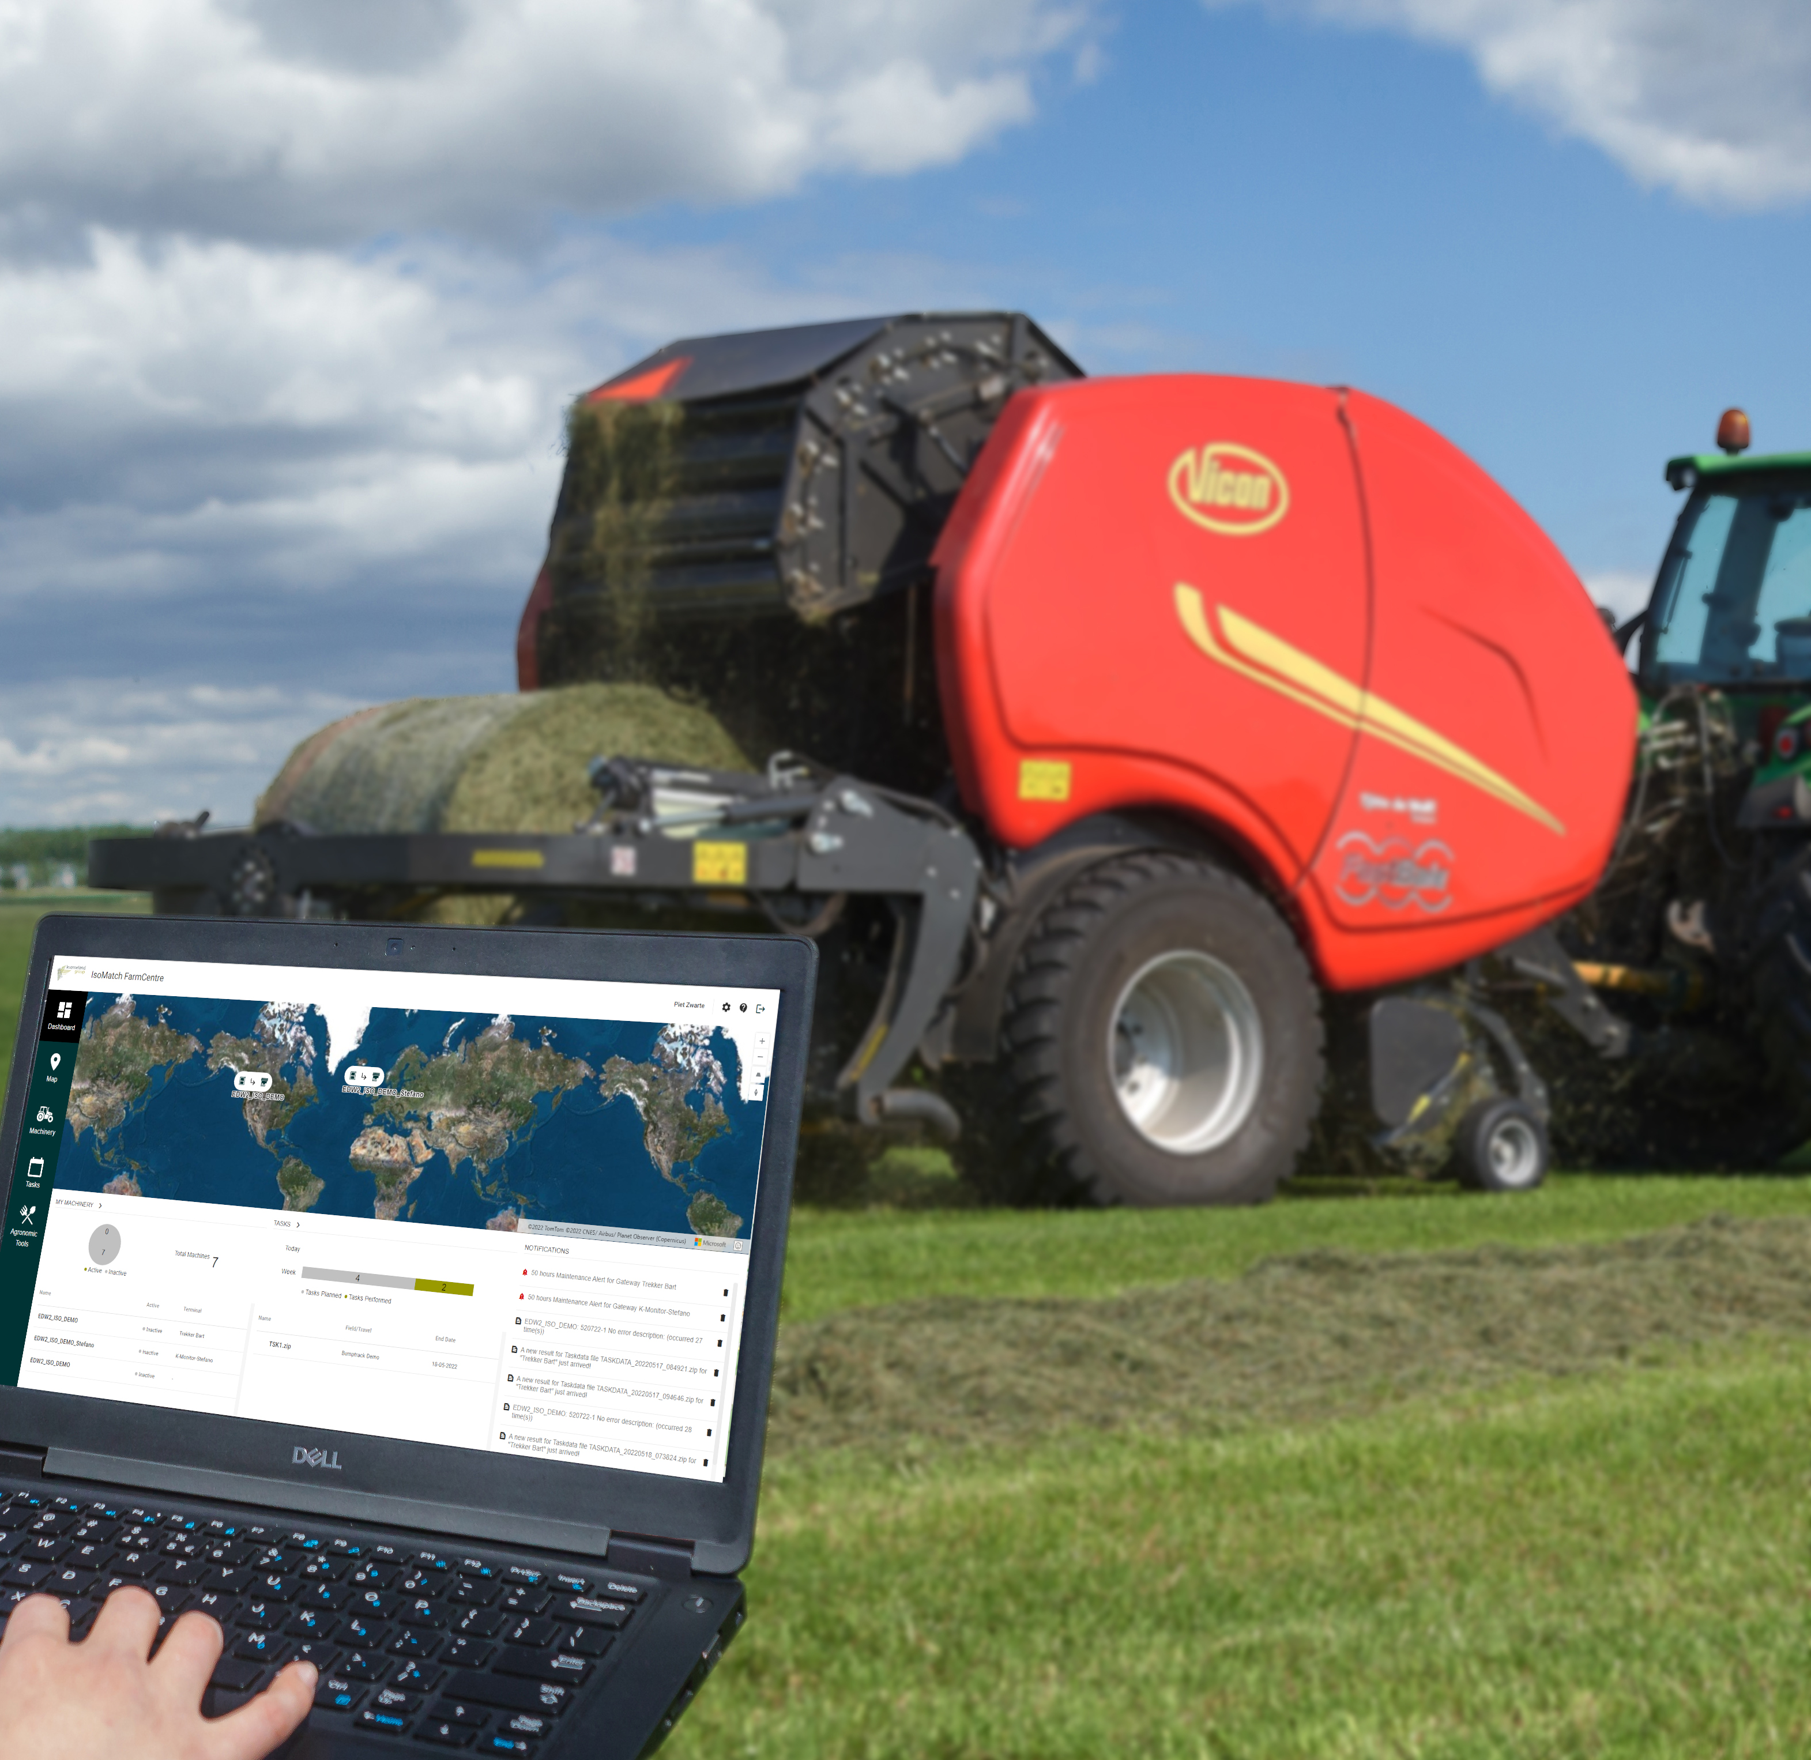
Unique Selling Points
IsoMatch FarmCentre
All-in-one
Full overview
With an easy and clean design.
All details in once place wherever you are.
Track every detail
Collaborative system integration
Ask Maria for an other picture
A Happy Farmer?
In the system, from service alerts to machine performance.
With Agrirouter and FMIS.
SUPPORTS
DECISSION MAKING
Optimize farm operations
With smart reporting.
By being connected.

Slide 8
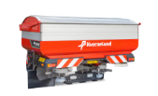
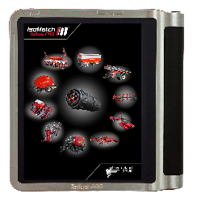
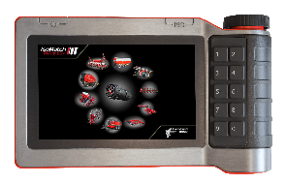
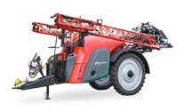
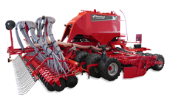
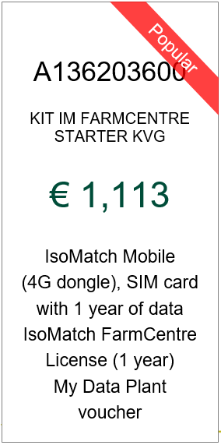
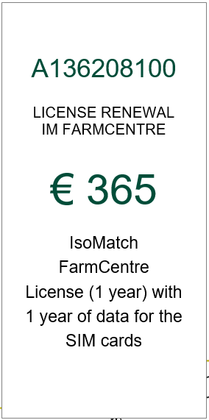
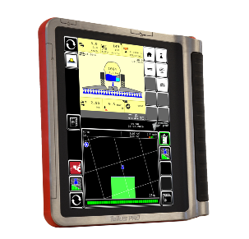
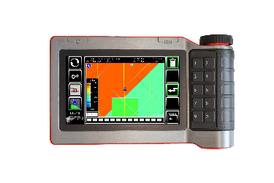
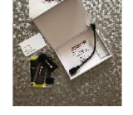
What is needed to sell IsoMatch FarmCentre?
Implements – Spreader, baler, sprayer, seeder
Terminals – IsoMatch GO+ and PRO
Licenses – GEOCONTROL or Variable Rate
IsoMatch FarmCentre

Slide 9
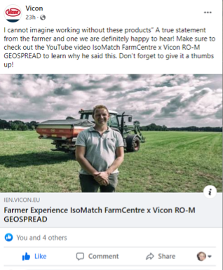
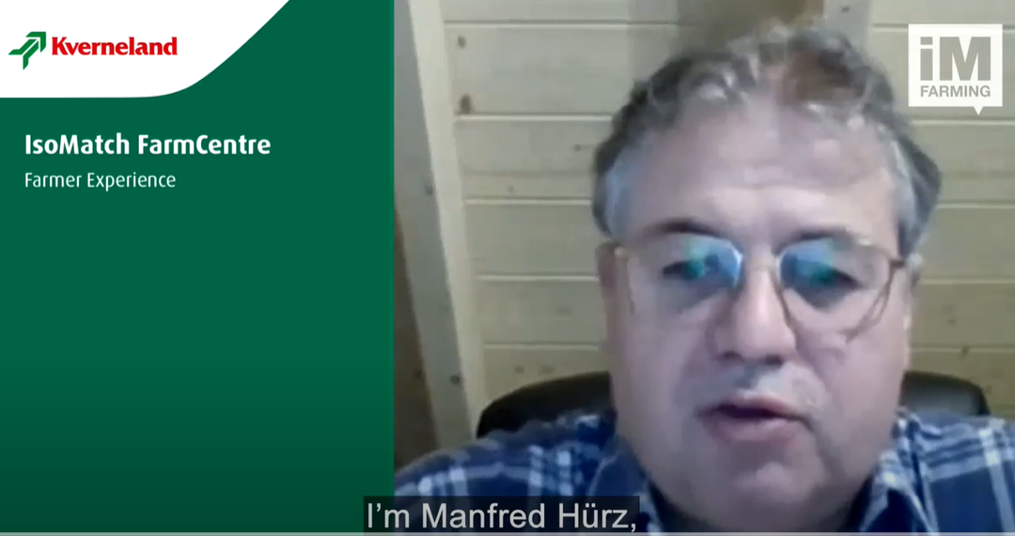
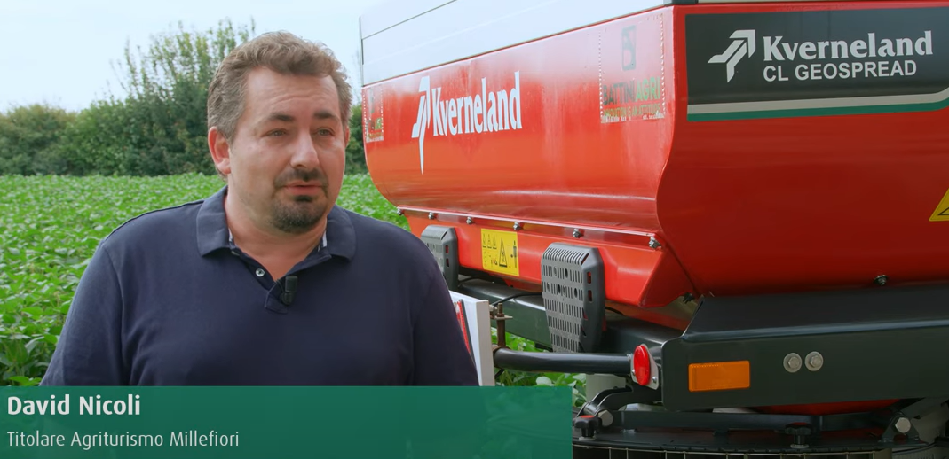
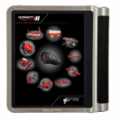
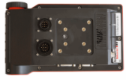
Stories of Success
How FarmCentre has been sold in different countries?
70 kits installed, of which 30 done through Tellus Pro exchange campaign
Promote and sell IM FarmCentre together with a replacement campaign of IM Tellus PRO
170x Tellus Pro + Geocontrol + FarmCentre
100 FC kits working today in Italy
Subsidiary promo
Only 20% of 60 implements would have been sold without the promo. (Spreaders, Balers, Sprayers, Seeders)
Explain how the promo meets 4.0 subsidy
High end implements
Increase sales of connected machines
Increase sales of IM Tellus GO+ and PRO
Promote kit of precision farming
Target campaign 2022
25-30 kits

Slide 10
Contact us
For more information please contact:
Xavier Tros de Ilarduya, Senior Product Manager Ruud Zwirs, Product Manager
xavier.tros@kvernelandgroup.com ruud.zwirs@kvernelandgroup.com
+34 6 0966 7498 +31 6 1023 4961
Gijsbert Heemink, Product Manager Maria Vasbotten, Marketing Coordinator
gijsbert.heemink@kvernelandgroup.com maria.vasbotten@kvernelandgroup.com
+31 6 2563 9336 +31 6 8270 4175
Ariadna Tost, Product Manager
ariadna.tost@kvernelandgroup.com
+31 6 8869 6667

