Slide 1
Tractor Implement Management TIM Baler license key
Sales & Marketing Information, SMI-03-22-M
November 2022

Slide 2
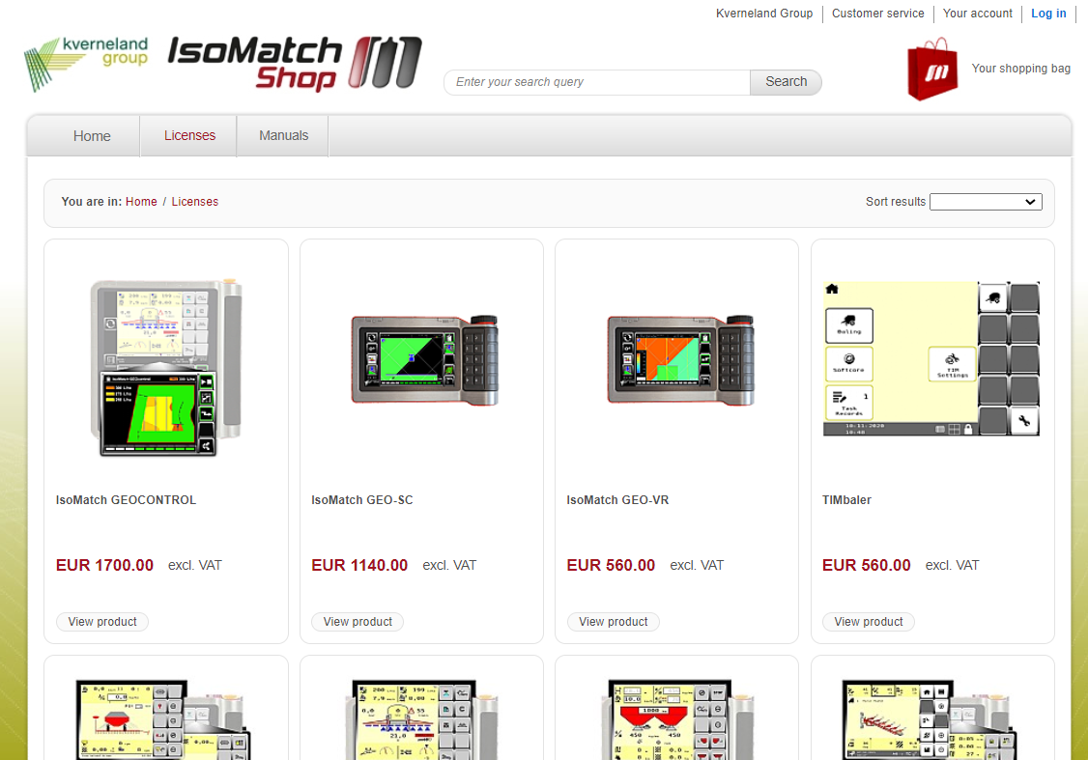
License key TIM Baler
License key TIM Baler is now available for ordering in the IsoMatch Shop.

Slide 3
License key TIM Baler
TIM Baler license key can be used on your Kverneland and Vicon ISOBUS Techno Pack equipped variable chamber and FixBale 500 / 6500F fixed chamber round baler, set to the latest standards and equipped with the latest software version.
This additional license key to activate the software module is another step forward for your intelligent baler to optimize the baling cycle, maximize the efficiency and set a new standard in terms of driver experience and comfort during long days of baling. To enable the system, you need to use the baler in combination with a Tractor Implement Management tractor certified by AEF and have the Techno Pack option installed on your baler.

Slide 4
License key TIM Baler
TIM technology authorizes the control of certain tractor functions such as forward speed, PTO and auxiliary hydraulic valves, allowing the baler to initiate commands to the tractor, which will then execute them instead of the driver. The target is to release the driver from having to make multiple repetitive sequences of actions during the baling cycle in order to increase efficiency and operator comfort.
The level of automation that can be achieved by the system depends on the capabilities of the TIM tractor connected to the baler, so that according the tractor model and brand, the operations may vary slightly.

Slide 5
License key TIM Baler
Examples of functionality and benefits are:
Tractor speed management for slowing tractor motion during binding and bale ejection
Automatic opening and closing of the tailgate for bale ejection
Self adjusting PTO rpm in order to maximize fuel saving and optimization of baler operation
Automatic holding of bale ejection in case of working on slopes is detected for maximum safety
Only one input from the driver needs to be made over a full bale formation cycle (instead of many more per bale with non-TIM mode)
Extra functionality on Techno Pack equipped balers:
Humidity control and measurement allowing direct control of moisture level of the crop being baled and display of average moisture content of the previously formed bale.
Bale ejection control device allowing safer and more comfortable operations in all conditions.

Slide 6
Marketing material
You can find a lot of different marketing material on the Download Centre. By clicking on the icons below, the hyperlink with that specific material will open.
Website
Kverneland TIM
Vicon TIM
Updated website information
Click on this image to download an animation explaining TIM
Click on this image to download an animation explaining TIM
Entire Package Kverneland
Entire Package Vicon
Click on this image to download the entire marketing material package
Click on this image to download the entire marketing material package

Slide 7
Contact us
License key TIMbaler can be ordered in the IsoMatch Shop on https://www.isomatchshop.com
For more information please contact:
Xavier Tros de Ilarduya, Senior Product Manager
xavier.tros@kvernelandgroup.com
+34 6 0966 7498
Ariadna Tost, Product Manager Ruud Zwirs, Product Manager
ariadna.tost@kvernelandgroup.com ruud.zwirs@kvernelandgroup.com
+34 6 8869 6667 +31 6 1023 4961
Luc Souquet, Product Manager bale equipment
luc.souquet@kvernelandgroup.com
+33 2 3852 4342
Kverneland Group Mechatronics BV - Nieuw-Vennep - The Netherlands
Kverneland Group Ravenna Srl - Russi - Italy

