Slide 1
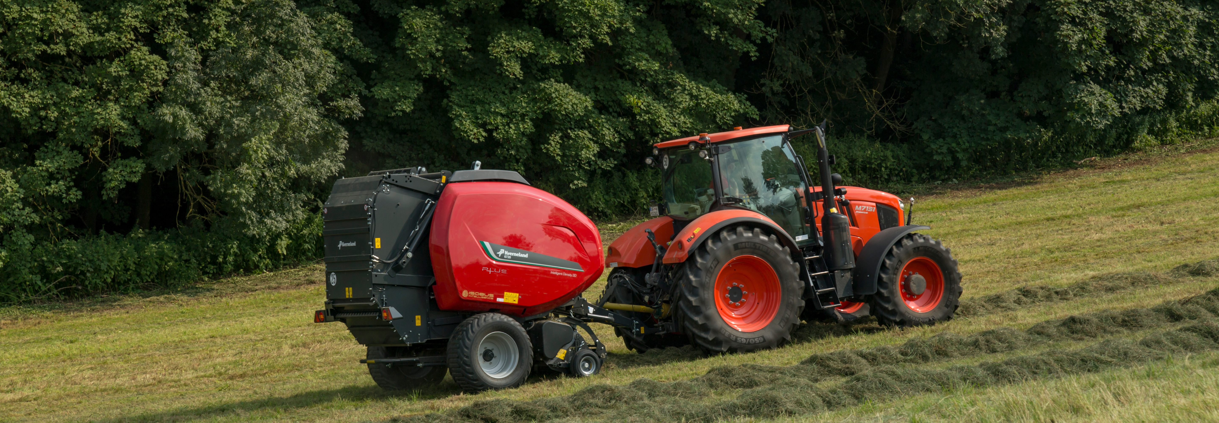
RV 5000 versus TIM ready competitors balers
Tractor Implement Management Competitor comparison

Slide 2

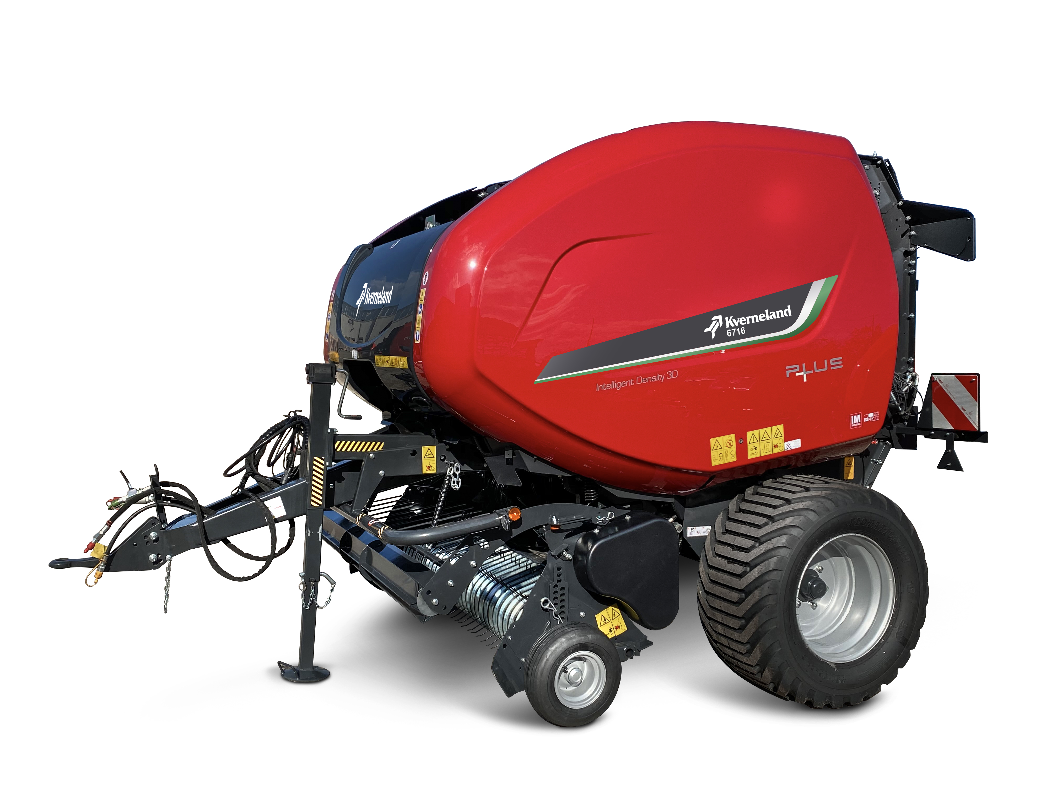
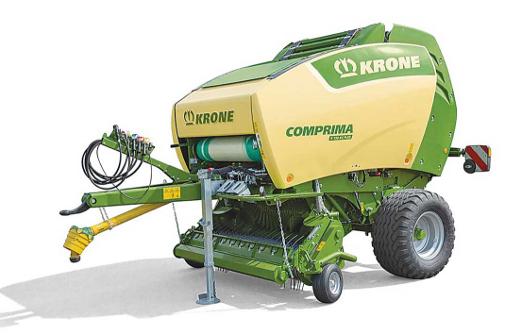

TIM Comparison (desktop research)
6600/6700
Comprima V150/180
 | Only in combination with tractor with CVT transmission and electronic spool valves |  |  | Only in combination with tractor with CVT transmission and electronic spool valves
+ | AEF certified |  | + | AEF certified
+ | PTO speed control at binding stage |  | - | No PTO Speed control capability
+ | Forward speed adaptation from baler control box softkeys |  | - | No forward speed adaptation from baler
+ | Forward speed control from baler without limitation |  | - | Tractor forward speed limited = TIM disengaged above 10 km/h
+ | Slow/pause tractor forward motion ready for binding |  | + | Slow/pause tractor forward motion ready for binding
+ | Control of tractor auxiliary valve to open and close tailgate |  | + | Control of tractor auxiliary valve to open and close tailgate
+ | Check from sensor on bale ramp that bale is clear of tailgate |  | + | Check from sensor on bale ramp that bale is clear of tailgate
+ | Slope sensor to check for safe bale release within pre-set angle |  | - | No slope sensor to check for safe bale release within pre-set angle

Slide 3
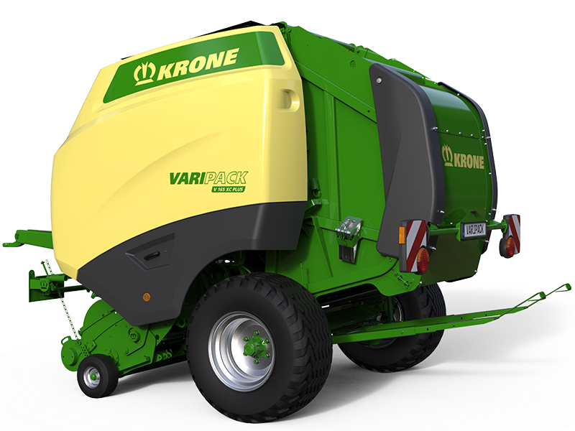
TIM Comparison (desktop research)
6600/6700
Varipack 165/190 (Plus)
 | Only in combination with tractor with CVT transmission and electronic spool valves |  |  | Only in combination with tractor with CVT transmission and electronic spool valves
+ | AEF certified |  | + | AEF certified
+ | PTO speed control at binding stage |  | - | No PTO Speed control capability
+ | Forward speed adaptation from baler control box softkeys |  | - | No forward speed adaptation from baler
+ | Forward speed control from baler without limitation |  | - | Tractor forward speed limited = TIM disengaged above 10 km/h
+ | Slow/pause tractor forward motion ready for binding |  | + | Slow/pause tractor forward motion ready for binding
+ | Control of tractor auxiliary valve to open and close tailgate |  | + | Control of tractor auxiliary valve to open and close tailgate
+ | Check from sensor on bale ramp that bale is clear of tailgate |  | + | Check from sensor on bale ramp that bale is clear of tailgate
+ | Slope sensor to check for safe bale release within pre-set angle |  | - | No slope sensor to check for safe bale release within pre-set angle

Slide 4
TIM Comparison (desktop research)
Relevant text from translated German article:
Clicking on "Confirm/Accept" on the baler terminal gives the baler access permission to the drive and the control unit for the bale chamber.
Now the bale chamber can be filled. Once the set bale diameter has been reached, the net is shot in and the tractor is stopped automatically. When the net is fully tied, the baler accesses the hydraulic control unit and opens the bale chamber. The bale ejector conveys the compressed bale out of the chamber and creates space for easy closing of the bale chamber. An important role is played by a sensor that determines the position of the bale ejector.
If the placement was successful and the bale ejector is back in the starting position, the baler can order the closing of the bale chamber. It is important that the control unit is not in the floating position but in the neutral middle position.
After a successful cycle the accelerator pedal must be pressed and released again and the pressing process is continued.
Reconfirmation of the TIM functions is only necessary if TIM is interrupted, for example, by a change of driving direction.
Copy of text from Krone news web page:
Round baler controls tractor
Krone is the first round baler manufacturer to receive AEF certification (Agricultural Industry Electronics Foundation) for implementing TIM (Tractor Implement Management) on their Fortima, Comprima and VariPack balers. The certification comes as official confirmation that Krone round balers are approved of and able control the tractor. The technology turns the tractor baler combination into one single operating unit, thus making the Krone round balers even more efficient.
And this is how the baler and the tractor communicate: as soon as the bale chamber is filled, the tractor is stopped by TIM. Then the net is fed into the chamber; after wrapping is completed, the rear door opens and the bale is unloaded. As a last step, the door closes again. All these functions are carried out automatically and sequence-controlled by TIM. As a result, the stops to unload the bale are shorter and throughput of the baler is even further enhanced. With all processes being carried out in exactly the same way, the baler produces consistent and uniform bales of maximum densities. In addition, this technology clearly reduces operator strain, as the tractor driver can concentrate on the actual driving.
“This AEF certification shows once again that digitisation is advancing and assuming an ever bigger importance in the industry,” explains Jan Horstmann, division head of electronic system development at Krone. “With the tractor and baler communicating with each other, the baler is operated like a self-propelled machine with the effect of increased efficiency and throughput. Another key feature of our balers is the universal interface that allows them to communicate with all tractor brands that are TIM certified by AEF.”
Relevant text from translated French article (Réussir machinisme website):
The tractor-baler under test is TIM compatible (Tractor Implement Management - management of the tractor by the implement). Its implementation is quite simple: press a dedicated button on the tractor for three seconds and confirm on the baler screen. The TIM can be paused at any time. It is possible to set the level of automation and the number of actions that the implement can control on the tractor. We have chosen to automate as much as possible (stopping the tractor, starting and ending the binding, opening and closing the tailagte). The driver only has to manage the direction and the restart of the tractor after the ejection of the bale. The TIM offers driving serenity, but not the maximum work rate. We had to limit the speed of the tractor to 9.9 km/h, the TIM not being active above 10 km/h. Too bad the automation is not restricted by a higher speed or by a load sensor to optimize the speed.

Slide 5
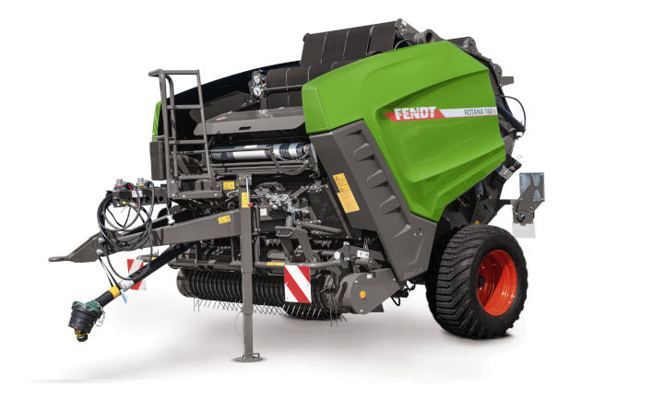


TIM Comparison (desktop research)
6600/6700
4160-4180 V
 | Only in combination with tractor with CVT transmission and electronic spool valves |  |  | Only in combination with tractor with CVT transmission and electronic spool valves
+ | AEF certified |  | + | AEF certified
+ | PTO speed control at binding stage |  | - | No PTO Speed control capability
+ | Forward speed adaptation from baler control box softkeys |  | - | No forward speed adaptation from baler control box keys
+ | Slow/pause tractor forward motion ready for binding |  | + | Slow/pause tractor forward motion ready for binding
+ | Control of tractor auxiliary valve to open and close tailgate |  | + | Control of tractor auxiliary valve to open and close tailgate
+ | Check from sensor on bale ramp that bale is clear of tailgate |  | + | Check from sensor on bale ramp that bale is clear of tailgate
+ | Slope sensor to check for safe bale release within pre-set angle |  | - | No slope sensor to check for safe bale release within pre-set angle
- | No automatic pick-up lifting |  | + | Automatic pick-up lifting while reversing or during binding for weighing
- | No knives automatic actions |  | + | Knives cleaning control + hard bale surface (knives out at bale finishing)

