Slide 1
Demo and Support
Kverneland Group Mechatronics
Season 2024-25

Slide 2
Table of Contents
Demo and Support
Vicon ServiceCentre

Slide 3

Customer first
Service Tools
With the increase of technology in precision farming and electronic solutions, customer needs fast and effective support. Sometimes the response can be delayed due to traveling time and communication between different stakeholders. For Kverneland Group having its own electronic solutions for both its machines and universal terminals, it is a must to provide professional service solutions for the complete ISOBUS range to solve the problems in an efficient way.

Slide 4
Moving forward
Vicon ServiceCentre
Why?
How?
What?
Our customers need continuous and immediate support. Working windows are very short and any downtime means a significant financial loss. To be their preferred supplier, the after sales service offered must be fast and with the highest quality.
By providing the necessary tools to our after sales network to allow them o provide the level of service required by our customers.
A new service tool for ISOBUS implements that is easy to use and allows remote connection to minimise implement downtime in the event of a breakdown.

Slide 5
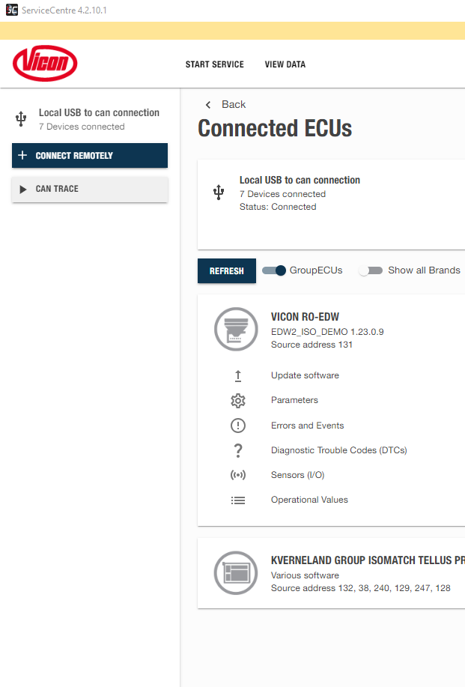
New Service Tool
Vicon ServiceCentre
Vicon ServiceCentre has been developed with a strong focus on usability and stability.
The application is available in two versions:
  Desktop: software to be installed in a Windows PC.
  Web: software to be used in a cloud environment with a web browser in laptops or mobile devices.

Slide 6
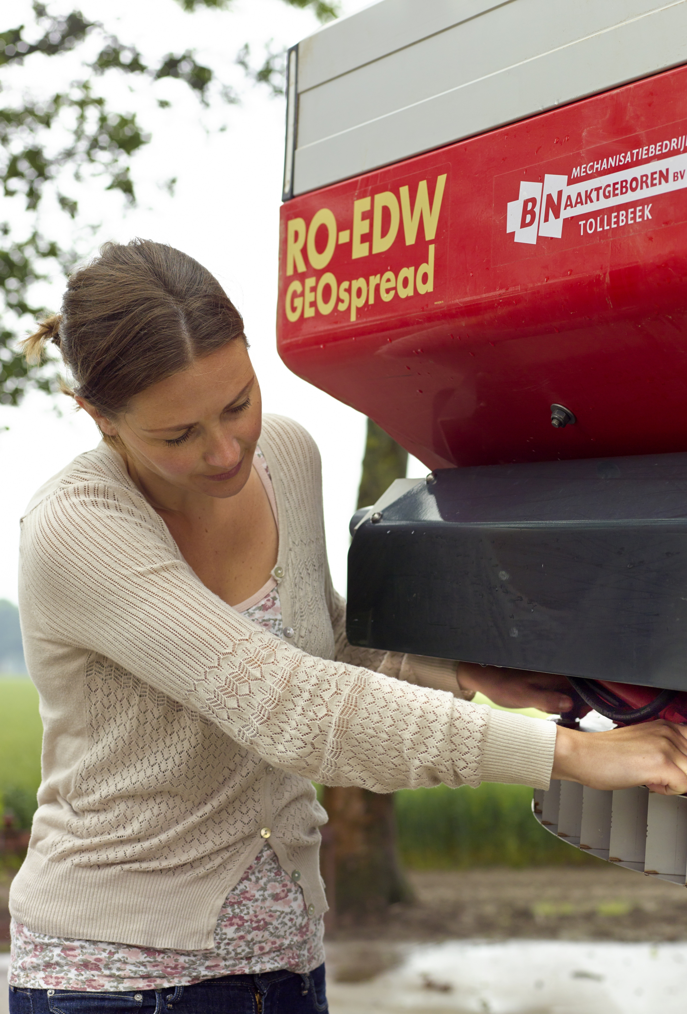
Connection to implements
Vicon ServiceCentre
Remote connection
It can be established with:
  IsoMatch Tellus PRO or Tellus GO+ with 4G dongle or connected to a network using the IsoMatch Wireless.
  Vicon Sync gateway installed in the implement.
Local connection
It can be established using the dongle provided with the IsoMatch TopService Kit or with the Kit ServiceCentre Hardware.
Vicon ServiceCentre
►

Slide 7
Connectivity through the cloud
Vicon ServiceCentre

Slide 8
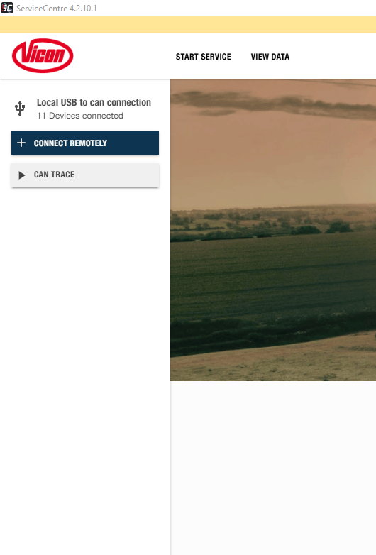
Local connection
ServiceCentre
ServiceCentre is compatible with the dongles used with IsoMatch TopService, hence they can be used to create a local connection to the implements.
For new users it is available the Kit ServiceCentre Connection (A136250700) that includes all necessary harnesses and accessories to perform all service actions requested.
Connection instructions have been simplified to make the tool and the kit more user friendly.

Slide 9

Customer first
Vicon ServiceCentre
Highlights
Vicon ServiceCentre has been developed with a focus on ease of use and with a focus on having only the features that users require, avoiding adding unnecessary functionalities. The result is a service tool that is very easy to operate, stable, and makes it very easy to conduct maintenance work on ISOBUS implements.
Easy to use service tool with a modern and simple interface
Local and remote connection to the implements
Multi-platform: desktop version and web-based
Tracing of implement I/O and sensors performance while working

Slide 10
New approach
Vicon ServiceCentre
Vicon ServiceCentre
  Aimed at all kind of professionals.
  Dedicated to current implements.
  Clear UI and easy to use UX.
  Only relevant features.
  Dedicated tools will not be included.
  Physical and remote connection.
  Recurring license.
IsoMatch TopService
  Aimed at highly qualified professionals.
  Old developments legacy.
  Unstructured UX.
  Non relevant features.
  One-for-all concept.
  Limited to physical connection.
  Lifetime license.

Slide 11
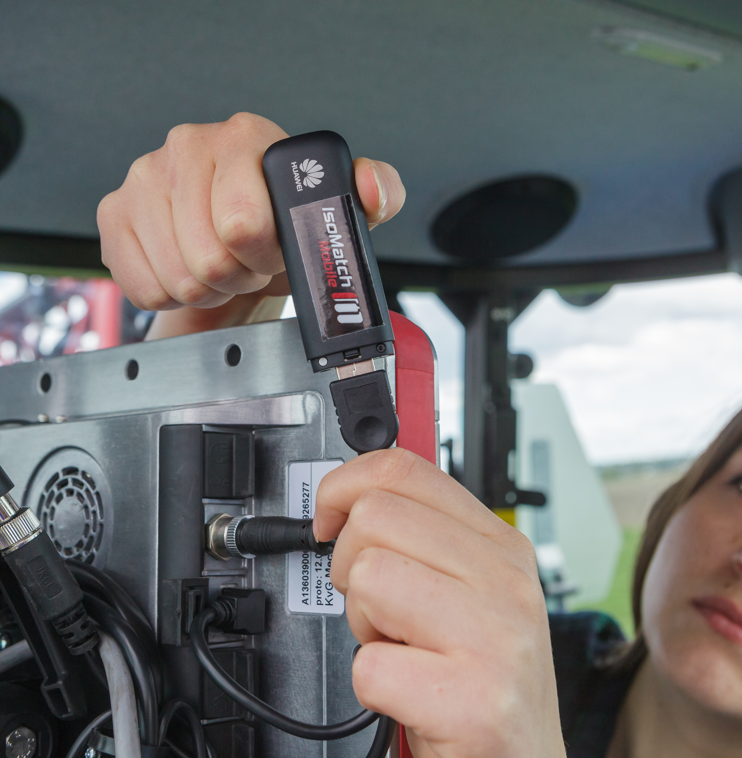
Functionalities
Vicon ServiceCentre
The most important feature we have added to this tool is the possibility to connect remotely to the implement using an IsoMatch Tellus terminal or a Vicon Sync device. But there are other features, like the sensors tracing or the possibility to use tablets or cell phones devices to connect to an implement. All in all, Vicon ServiceCentre represents a huge improvement over IsoMatch TopService.
Comparison of functionalities
i

Slide 12
Summary of functionalities
Vicon ServiceCentre
CONNECTION | Software Update | Can Log | Parameters and SOV | Errors, Events and DTC | Sensor I/O | Remote Terminal
LOCAL | Yes | Yes | Yes | Yes | Yes | No
REMOTE | No | Yes | Yes | Yes | Yes | Yes*
USER LEVELS | Changes Allowed
DEALER | Green Param.
REPRESENTATIVE | Blue Param.
FACTORY | Red Param.
VERSION | Remote Connection | Physical Connection
DESKTOP | Yes | Yes
WEB BASED | Yes | No
* Remote Terminal is not supported when the connection is with a Vicon Sync Gateway

Slide 13

Unique characteristics
Data
Vicon ServiceCentre
Parameters
01
02
03
04
Software Update
Remote Terminal
Which are the features?
Simplicity has played a crucial role in the evolution of Vicon ServiceCentre. However, this doesn't imply that the tool lacks numerous features that significantly enhance its usability and functionality compared to IsoMatch TopService. Vicon ServiceCentre's features are categorized into four distinct sections.

Slide 14
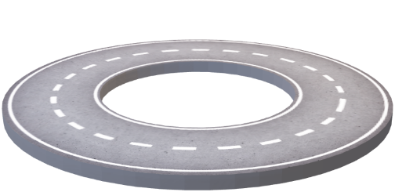
Remote terminal
Vicon ServiceCentre
Remote Terminal
Enable the dealer/service to view the screen of the farmer’s terminal located remotely
The Remote Terminal enables users to mirror their screen onto their computer. However, it restricts interaction due to significant safety risks. This feature is exclusively for remote connections.
01
02
03
04

Slide 15
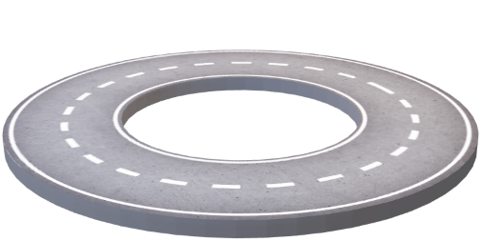
Parameters of Implements
Vicon ServiceCentre
Parameters
Technicians can read, change, save and send back implement’s parameters
This functionality will allow to modify parameters of the implement remotely and with physical connection. Depending on the level of access to the service tool, the technician will be able to modify some parameters while others will be blocked.
01
02
03
04

Slide 16
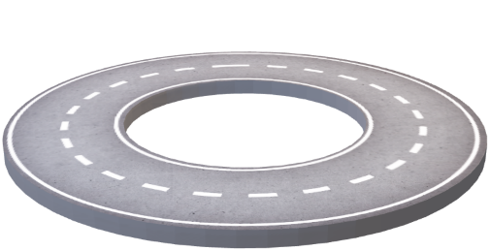
Data of Implements
Vicon ServiceCentre
Some of the data we can collect are DTCs (Device Trouble Codes), Error Codes and SOVs (Standard Operational Values). In all cases the active events or history events can be checked and saved. Also, the implement’s Input and Output status can be tracked on the go and it will be also possible to create remote CAN logs of the system.
Data
Data generated by the implements will be monitored and can be downloaded for further analysis
01
02
03
04

Slide 17
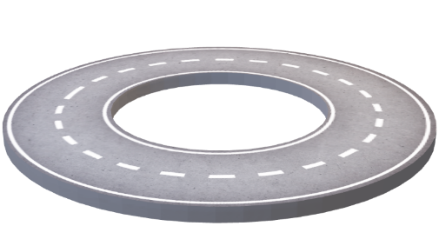
Software Update
Vicon ServiceCentre
Software Update
Vicon ServiceCentre will allow customers to update the software of their implements
Vicon ServiceCentre will download the most updated database of software and will offer to the technician to choose which version has to be installed. The tool will limit the possibilities to the appropriate software for the corresponding implement. This functionality will be limited to local connections.
01
02
03
04

Slide 18
Commercialization and availability
Vicon ServiceCentre
Vicon ServiceCentre will not be distributed by Kverneland Group Mechatronics, it will be part of the Dealer’s Digital packaged introduced by Kverneland Group After Sales.
Kverneland Group Dealers
  Vicon ServiceCentre application installer is available in the Partner Portal. Licenses will be recurring and valid for one year. To get an active license, dealer must purchase the Kverneland Group Dealer’s Digital Package.
Kverneland Group Employees
  Vicon ServiceCentre application installer is available in the software Company Portal. All Kverneland Group employees have by default a license for the application.

Slide 19
Phase in and phase out
Vicon ServiceCentre
Vicon ServiceCentre
Vicon ServiceCentre was released on August 13th, 2024. The application is available in the Company Portal.
From October 2024 it is available for dealers who join the Dealer’s Digital Package program.
A dedicated set of connection hardware was released in December 2024.
IsoMatch TopService
IsoMatch TopService will be supported until August 31st, 2025.
From September 1st, 2025, implement’s software database will not be updated anymore
Hardware delivered with IsoMatch TopService is compatible with Vicon ServiceCentre, so no new hardware has to be purchased for existing users.

Slide 20
Thanks for your attention
Questions and answers

Slide 21
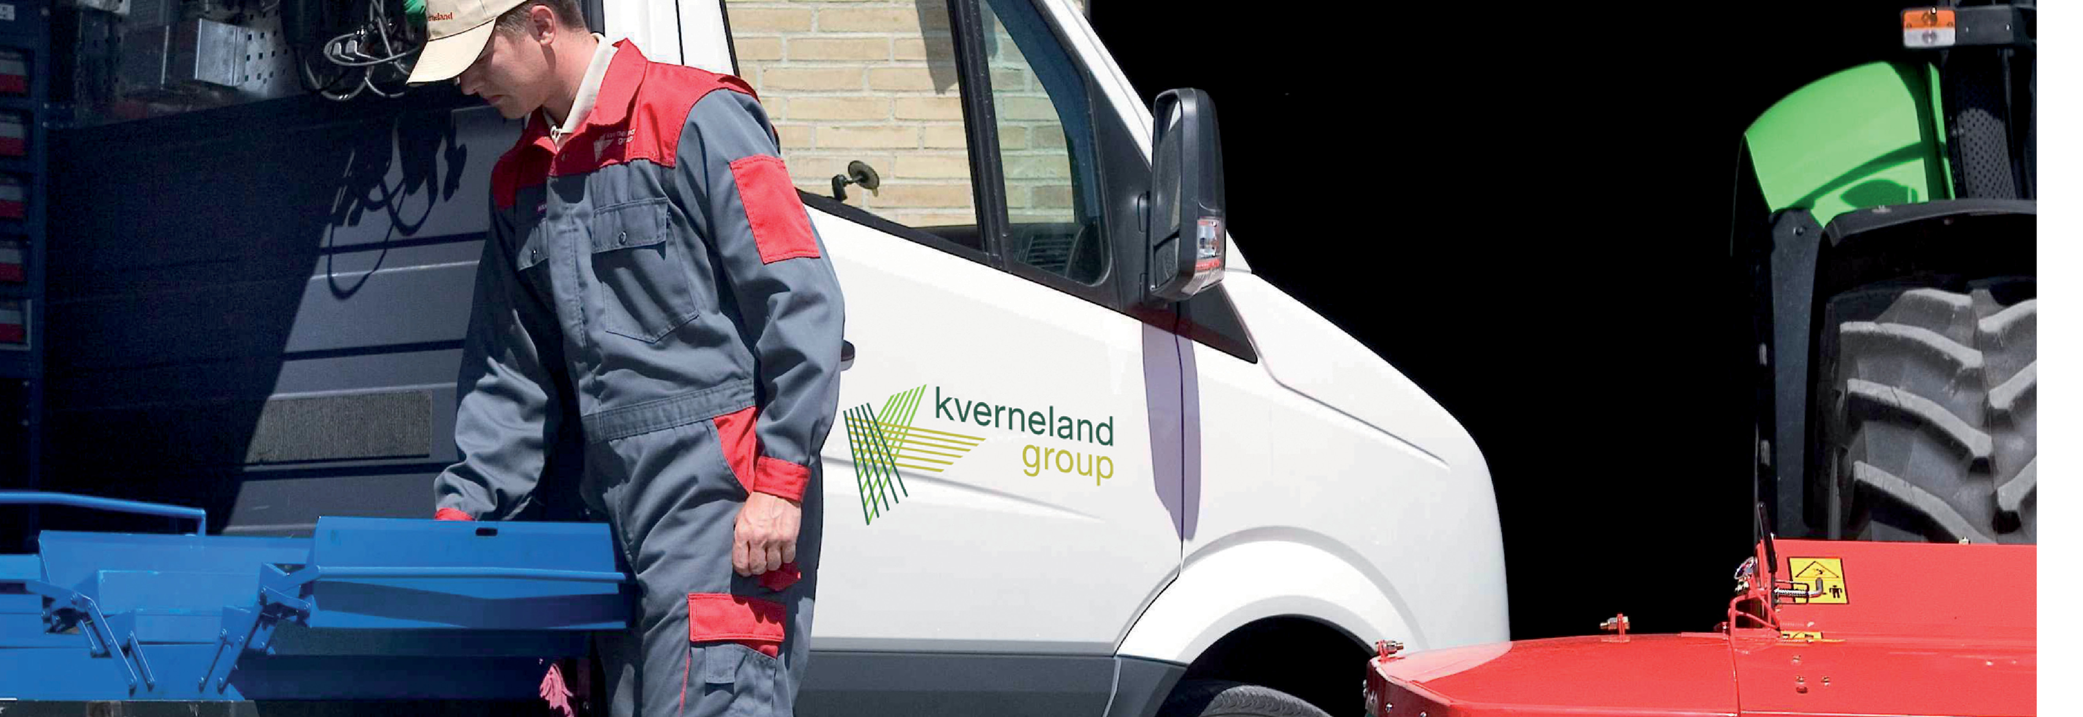
Appendix – Demo and Support
KvG Mechatronics
Season 2024-25

Slide 22
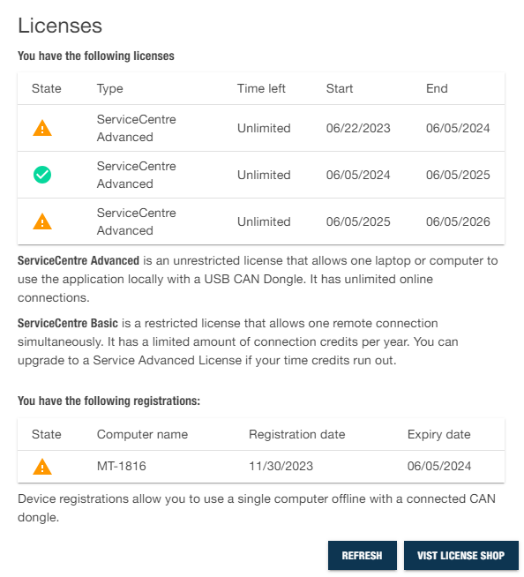
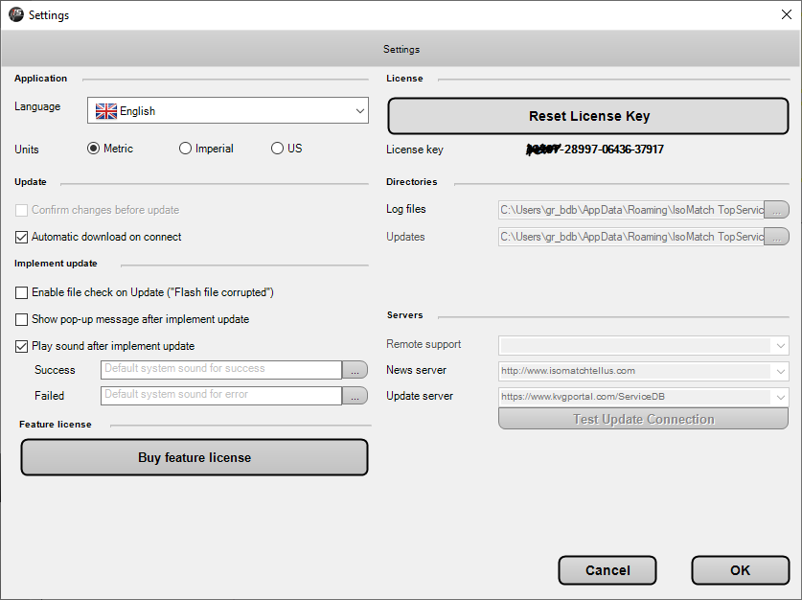
License model
Vicon ServiceCentre
Vicon ServiceCentre
Licenses is recurring and valid for one year.
License is assigned to one user (e-mail).
Application can be installed in one laptop.
IsoMatch TopService
Licenses is lifetime.
License is assigned to one laptop.

Slide 23
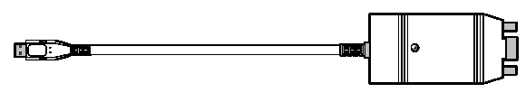

Local connection hardware
Vicon ServiceCentre
Vicon ServiceCentre and IsoMatch TopService
For both tools, the black (Sontheim or CANfox) and white (PCan) USB dongles can be used to connect locally.
CANfox dongle is the one included in the Kit ServiceCentre Hardware.

Slide 24
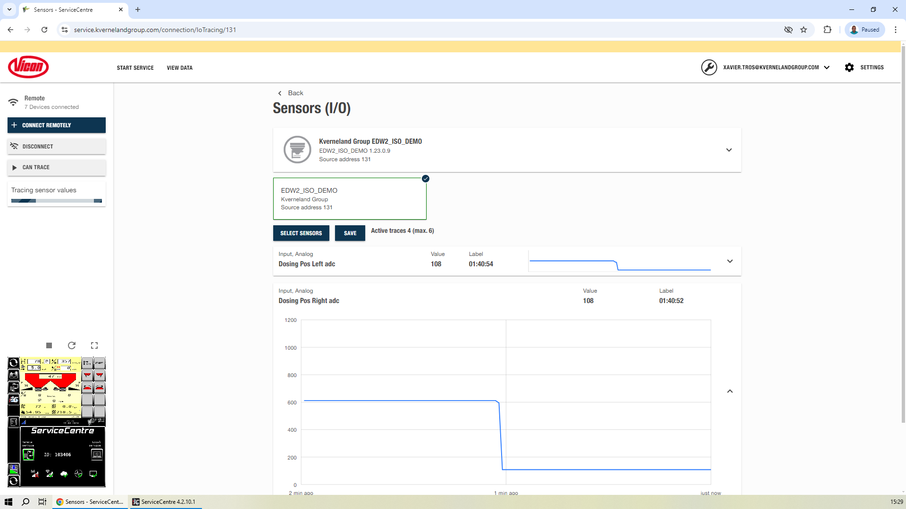
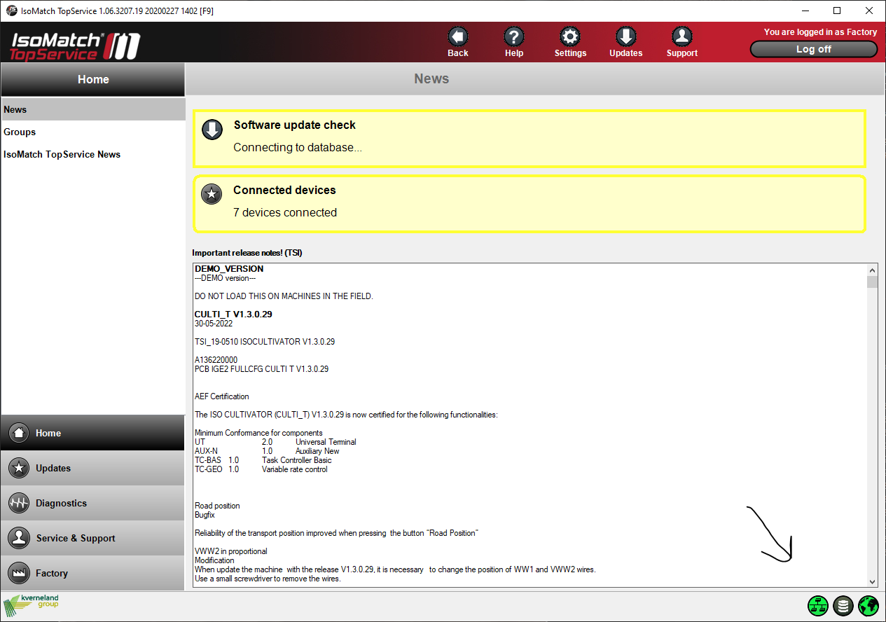
Connection status
Vicon ServiceCentre
Vicon ServiceCentre
The left bar shows whether you are successfully connected with the dongle.
IsoMatch TopService
The bottom indicator shows whether you are successfully connected with the dongle.

Slide 25

Remote connection (terminal)
Vicon ServiceCentre
New Vicon ServiceCentre functionality
With Vicon ServiceCentre it is possible to connect remotely to an implement in the field.
Customer side
  Go to the Vicon ServiceCentre App.
  Click Remote Service to Request an ID.
  Accept and agree the connection conditions.
  A 6-digit code will be facilitated.
  Share the code with the technician.
  Accept the connection.
Technician side side
  Open the Vicon ServiceCentre app in your laptop or open the Vicon ServiceCentre page in a browser.
  Click CONNECT REMOTELY on the left menu.
  Type the code shared by the customer.

Slide 26
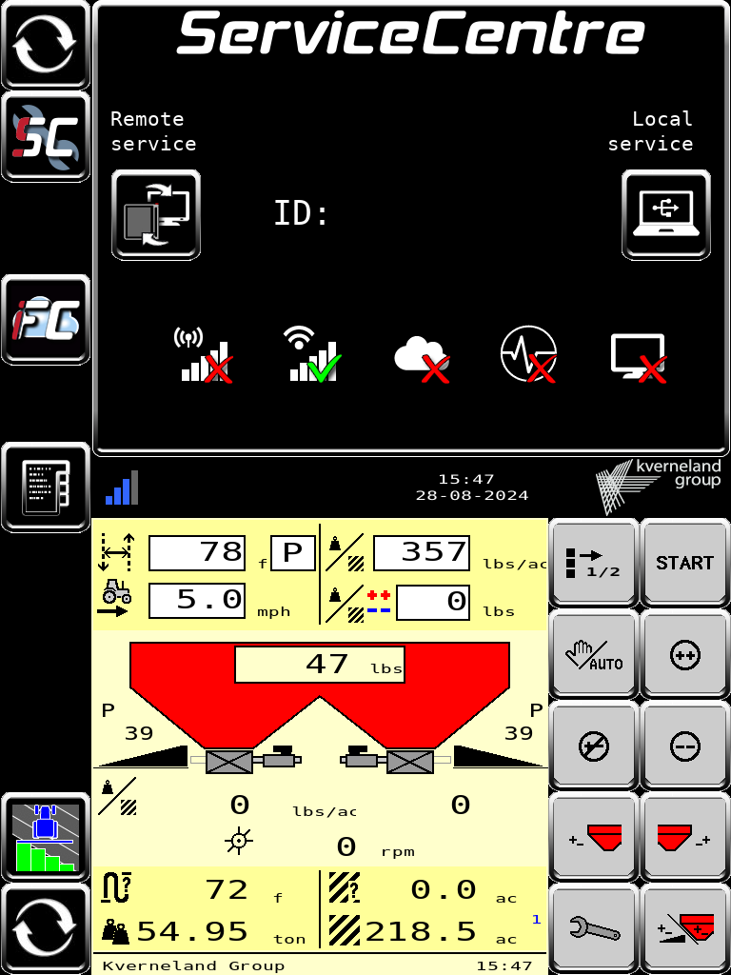
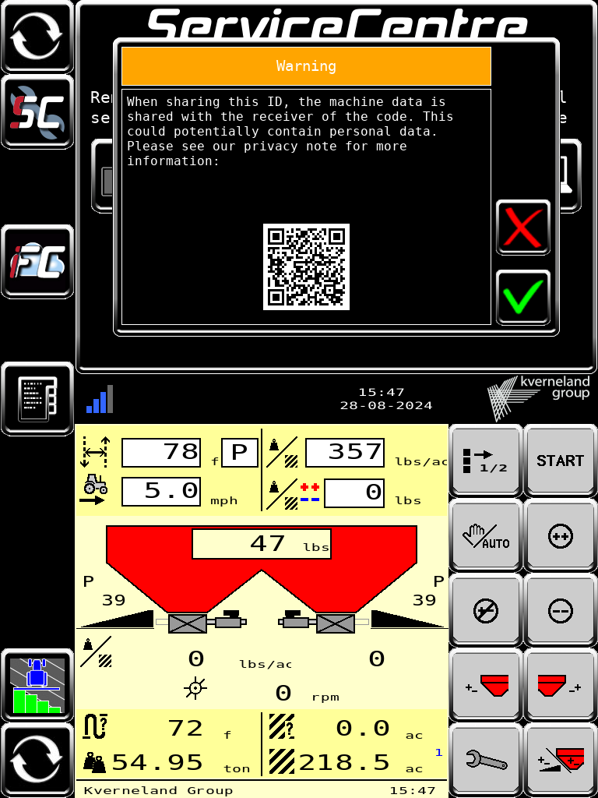
Remote connection (terminal)
Vicon ServiceCentre

Slide 27
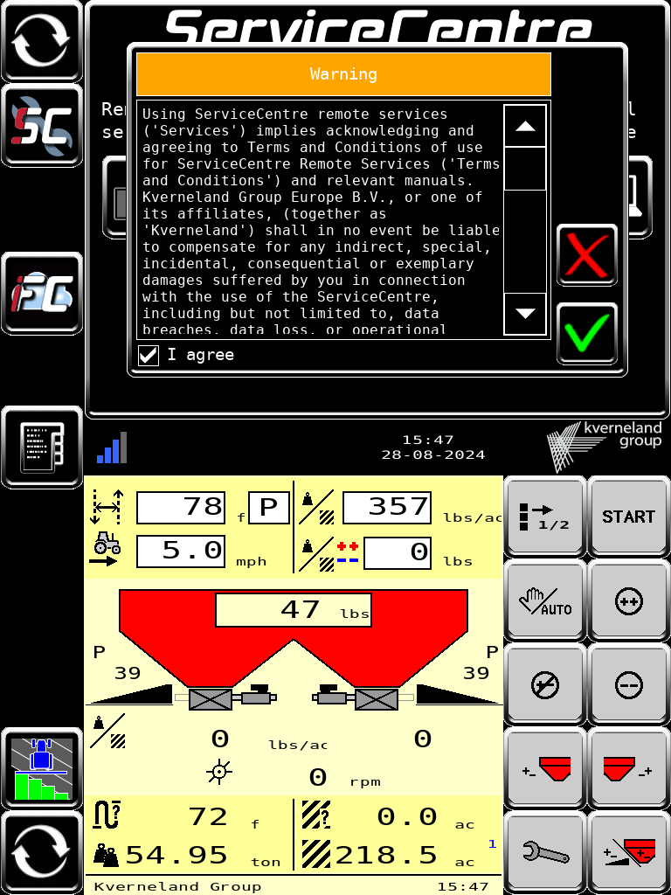
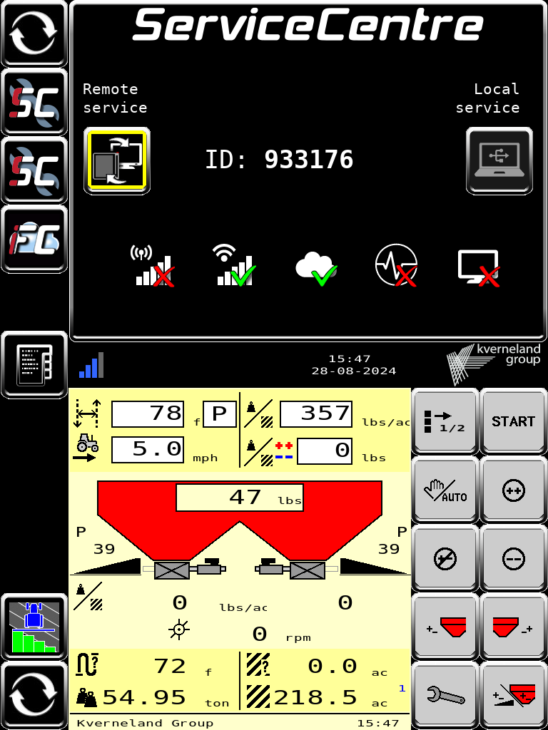
Remote connection (terminal)
Vicon ServiceCentre

Slide 28
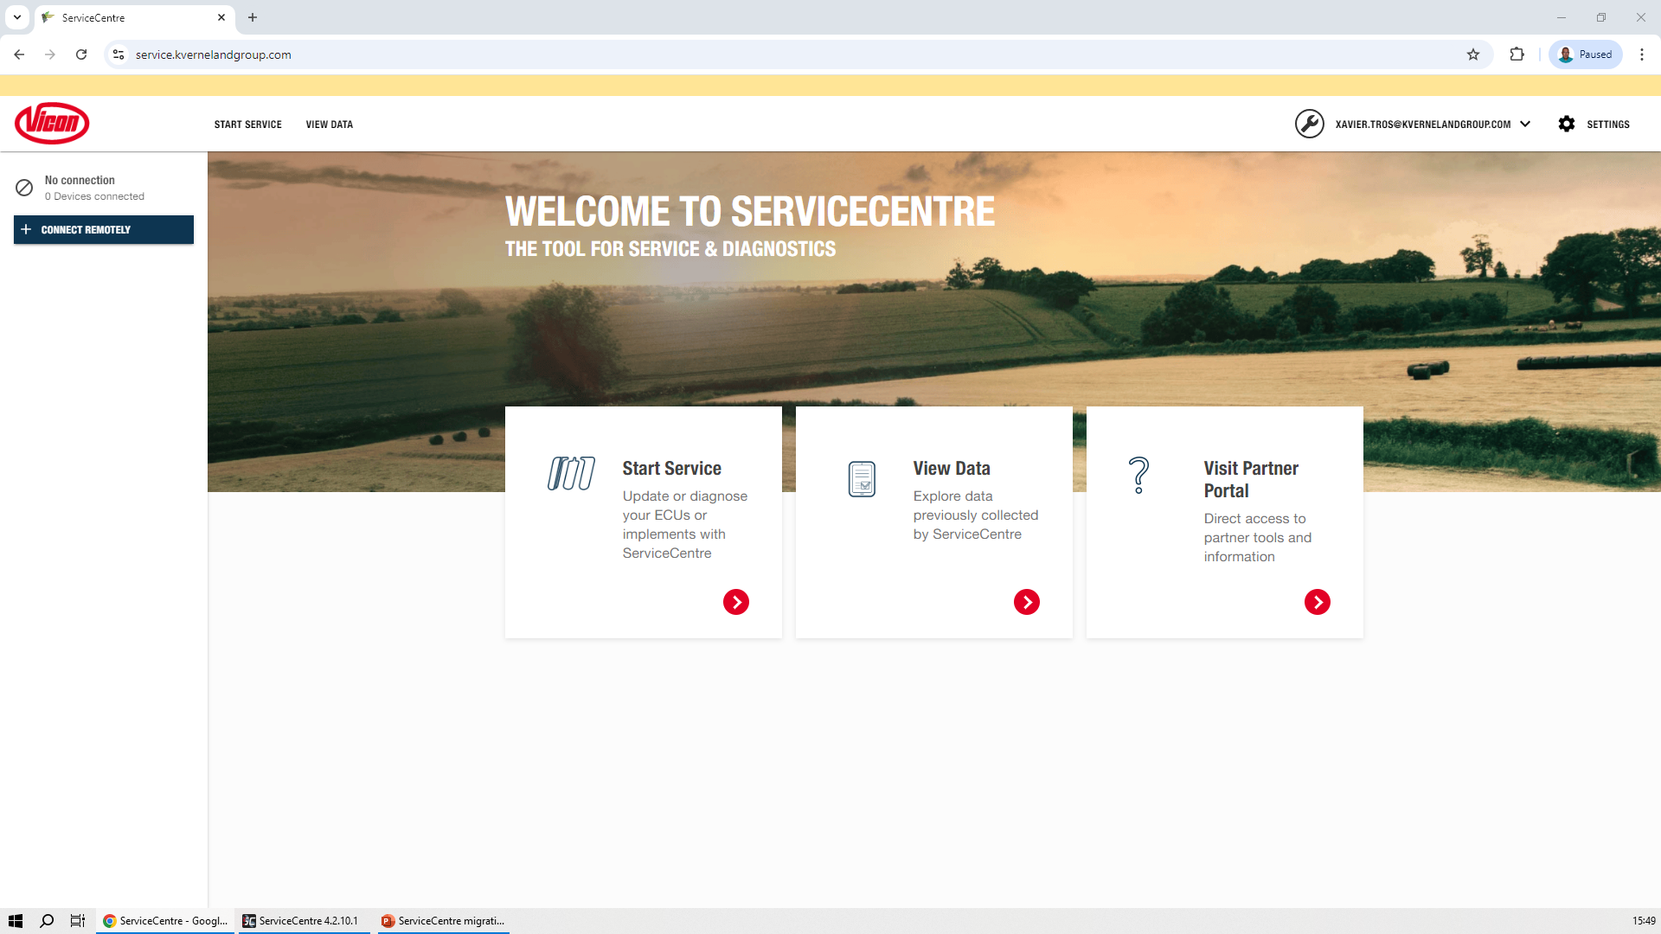
Remote connection (application)
Vicon ServiceCentre

Slide 29
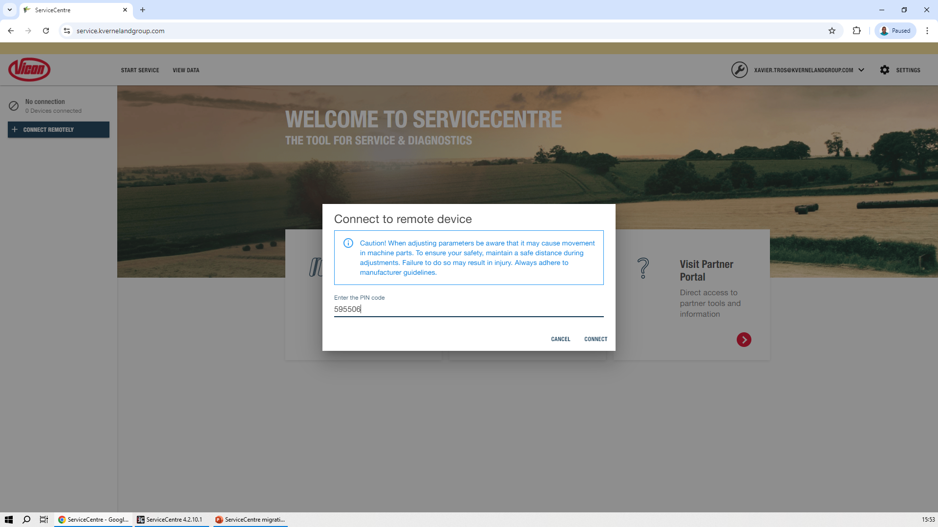
Remote connection (application)
Vicon ServiceCentre

Slide 30
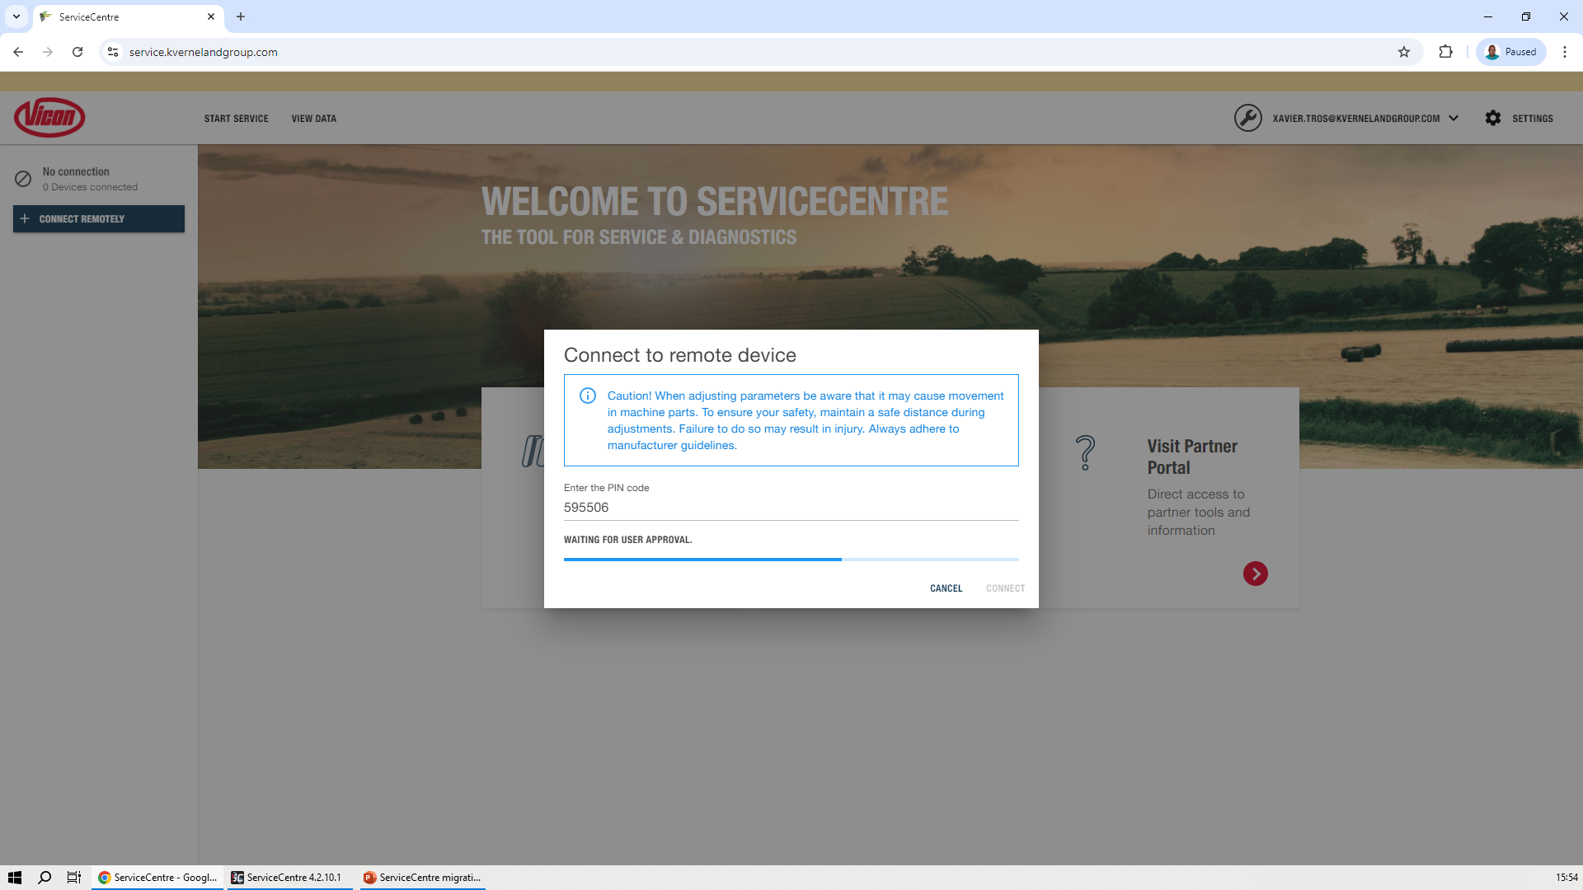
Remote connection (application)
Vicon ServiceCentre

Slide 31
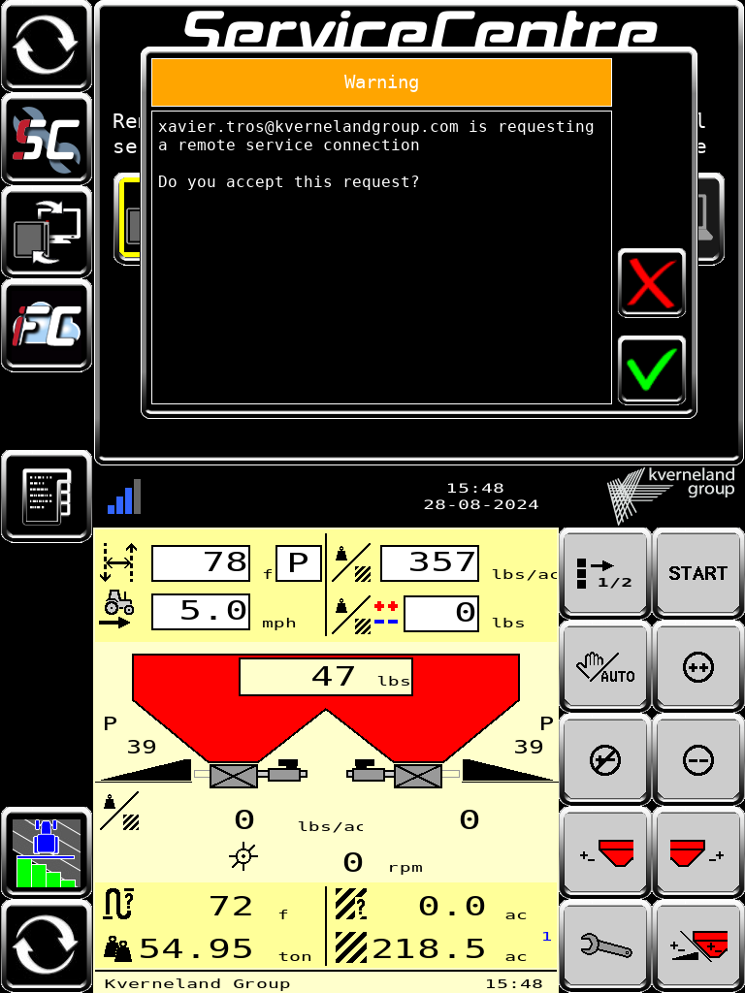
Remote connection (terminal)
Vicon ServiceCentre

Slide 32
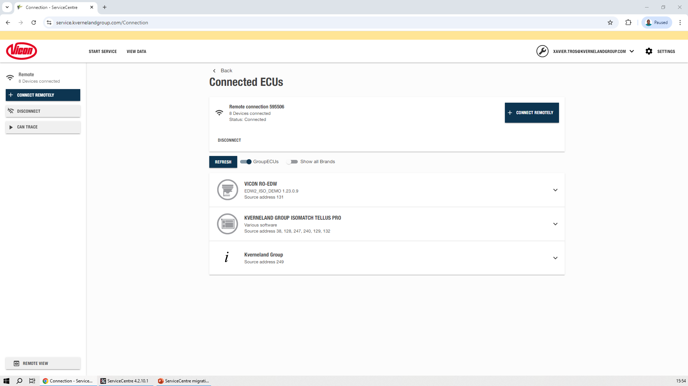
Remote connection (application)
Vicon ServiceCentre

Slide 33
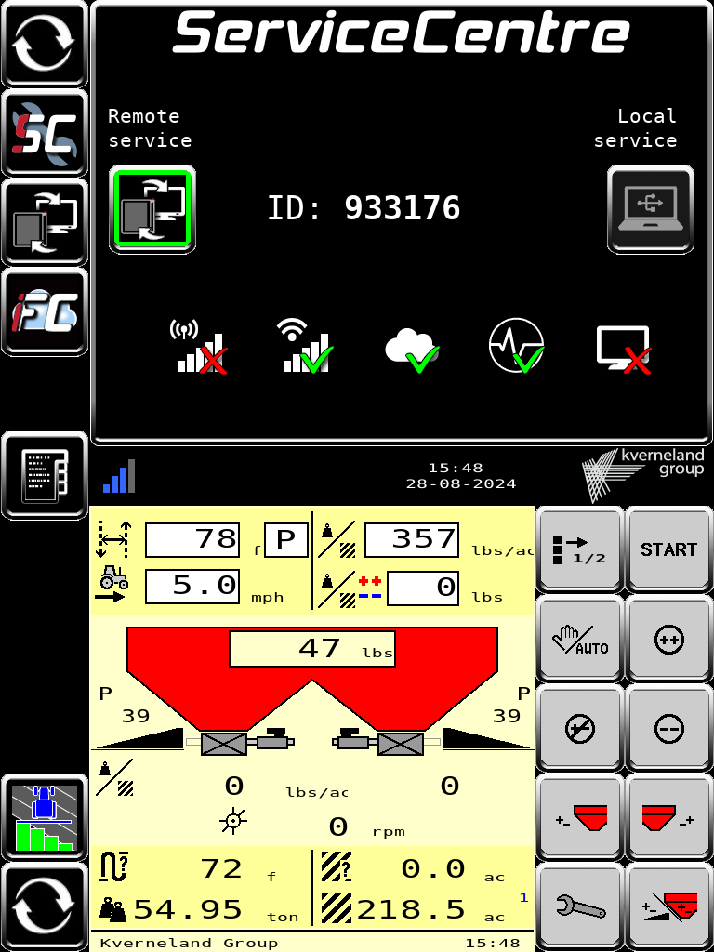
Remote connection (terminal)
Vicon ServiceCentre

Slide 34
Remote connection (Vicon Sync)
Vicon ServiceCentre
New Vicon ServiceCentre functionality
With Vicon ServiceCentre it is possible to connect remotely to an implement.
Customer side
  Go to the Vicon Sync application.
  Click Remote Service to Request an ID.
  Accept and agree the connection conditions.
  A 6-digit code will be facilitated.
  Share the code with the technician.
  Accept the connection.
Technician side
  Open the Vicon ServiceCentre app in your laptop or open the Vicon ServiceCentre page in a browser.
  Click CONNECT REMOTELY on the left menu.
  Type the code shared by the customer.

Slide 35
Remote connection (Vicon Sync)
Vicon ServiceCentre

Slide 36
Remote connection (Vicon Sync)
Vicon ServiceCentre

Slide 37
Remote connection (application)
Vicon ServiceCentre

Slide 38
Remote connection (application)
Vicon ServiceCentre

Slide 39
Remote connection (application)
Vicon ServiceCentre

Slide 40
Remote connection (Vicon Sync)
Vicon ServiceCentre

Slide 41
Remote connection (application)
Vicon ServiceCentre

Slide 42
Remote connection (Vicon Sync)
Vicon ServiceCentre

Slide 43
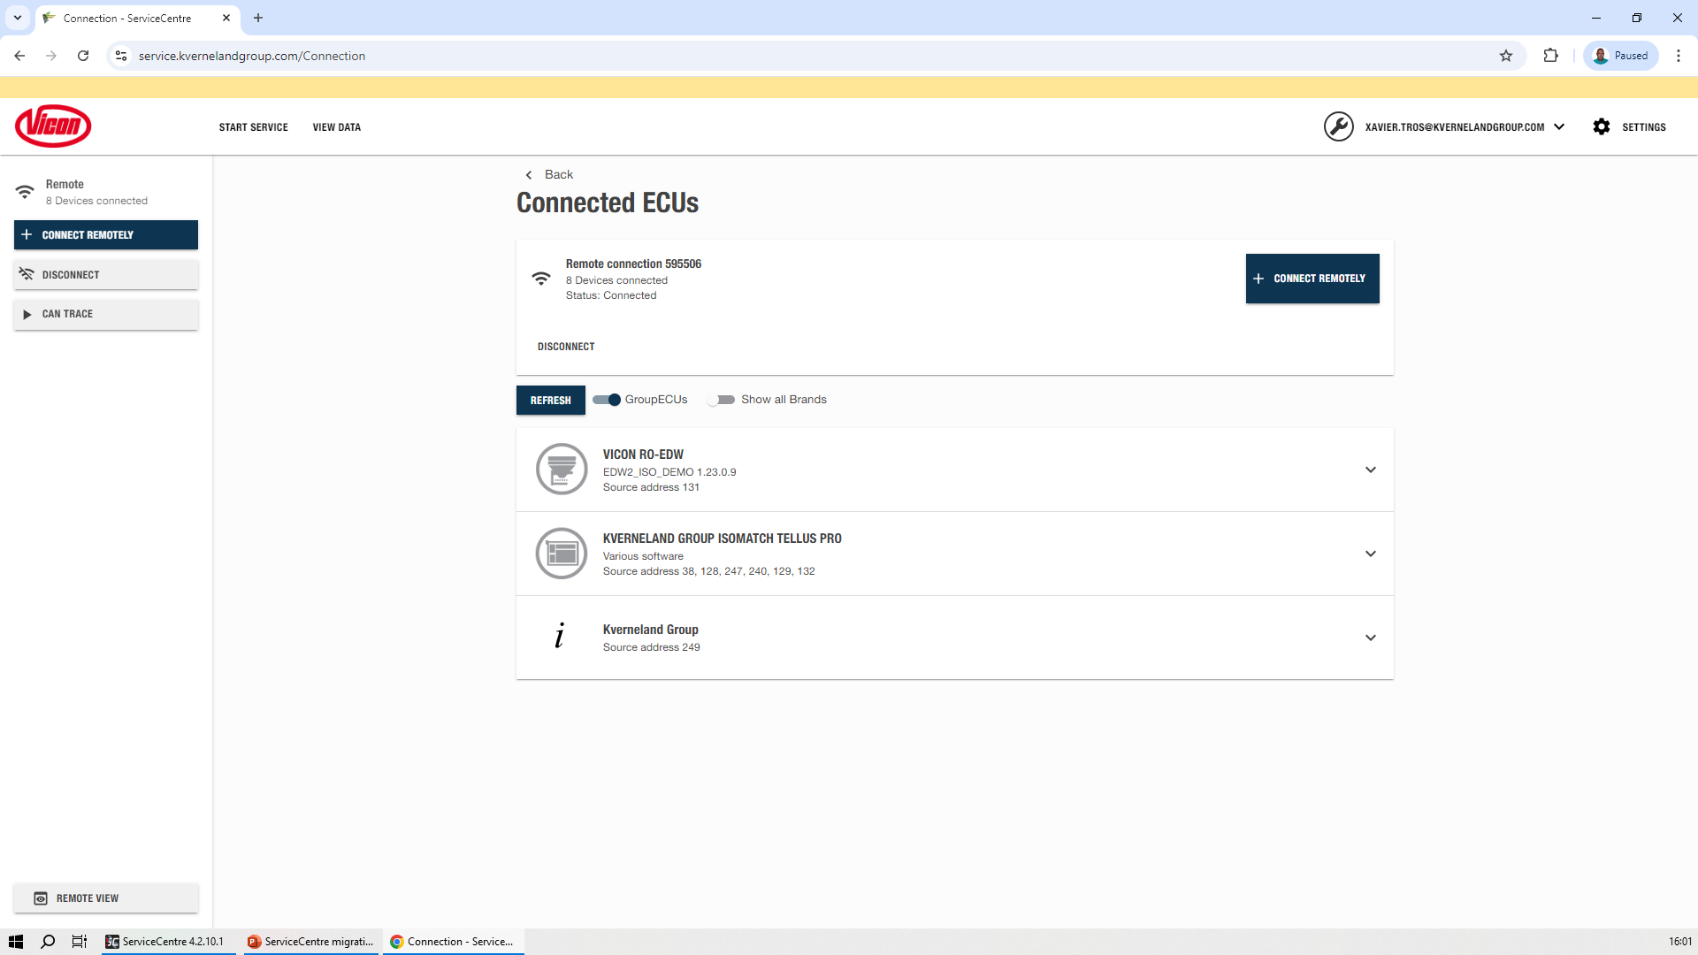
Connected devices
Vicon ServiceCentre
Vicon ServiceCentre
Number of devices (ECU) connected is on the left menu.
On the main menu (Start Service) they are detailed. ECU corresponding to the same device are grouped (Group ECUs). Non Vicon devices are hidden by default.
Click on the device expands the menu to the different functionality's pages.

Slide 44
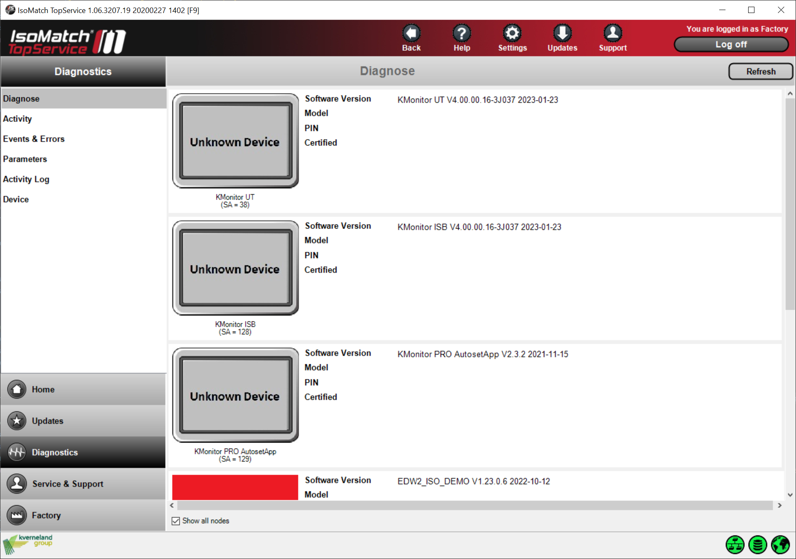
Connected devices
Vicon ServiceCentre
IsoMatch TopService
A list is shown on the “Diagnostics” page showing the connected ISOBUS Nodes. No option to group ECUs from the same device. Non Vicon devices are hidden by default.
Left menu is the access to the application functionalities (not for each device specifically).

Slide 45
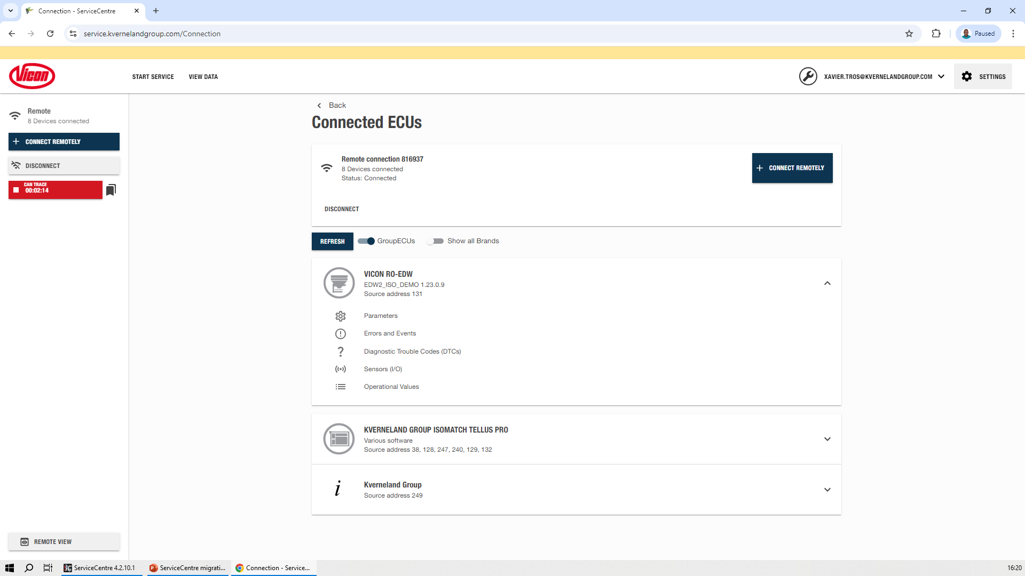
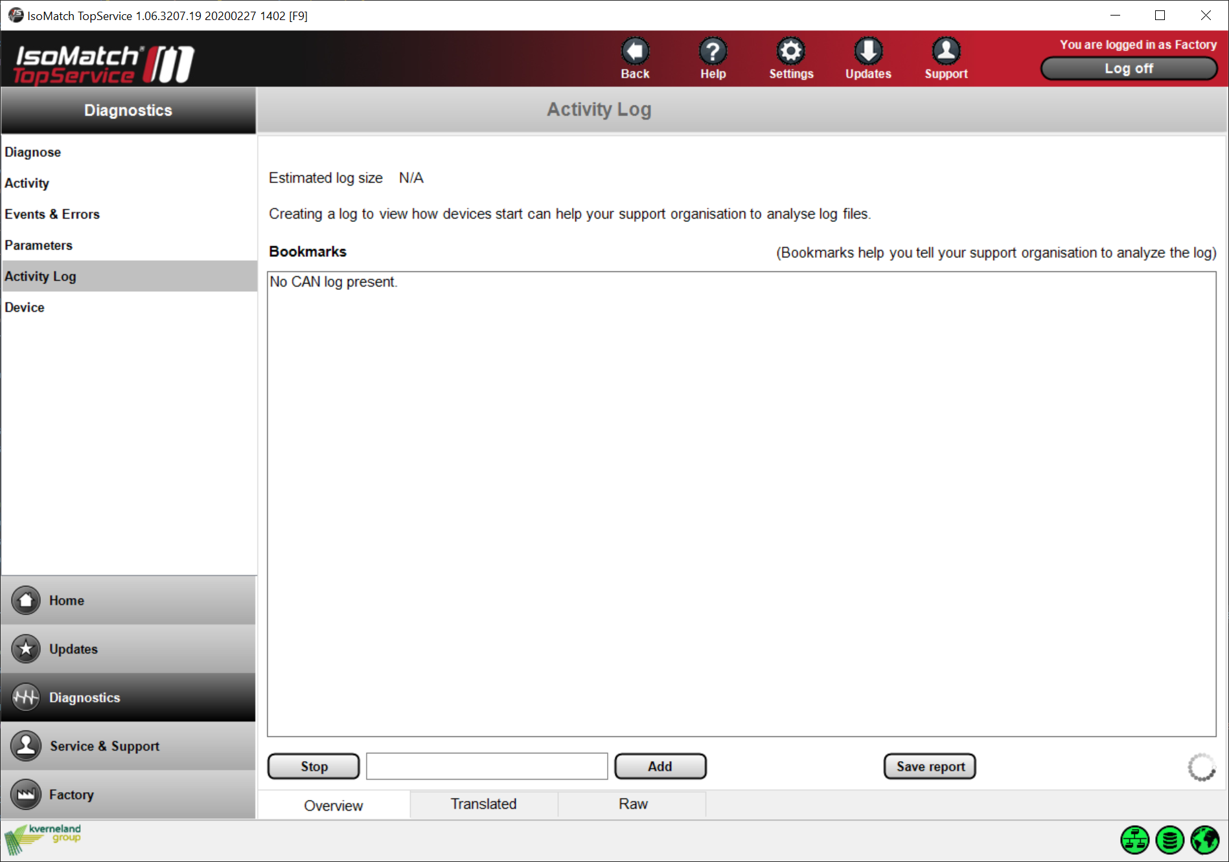
CAN tracing
Vicon ServiceCentre
Vicon ServiceCentre
CAN tracing is on the left menu.
While CAN tracing Vicon ServiceCentre can still be used for other diagnostic purposes.
IsoMatch TopService
CAN tracing can be found under “Activity Log”
CAN tracing can be viewed live (not supported in Vicon ServiceCentre).

Slide 46
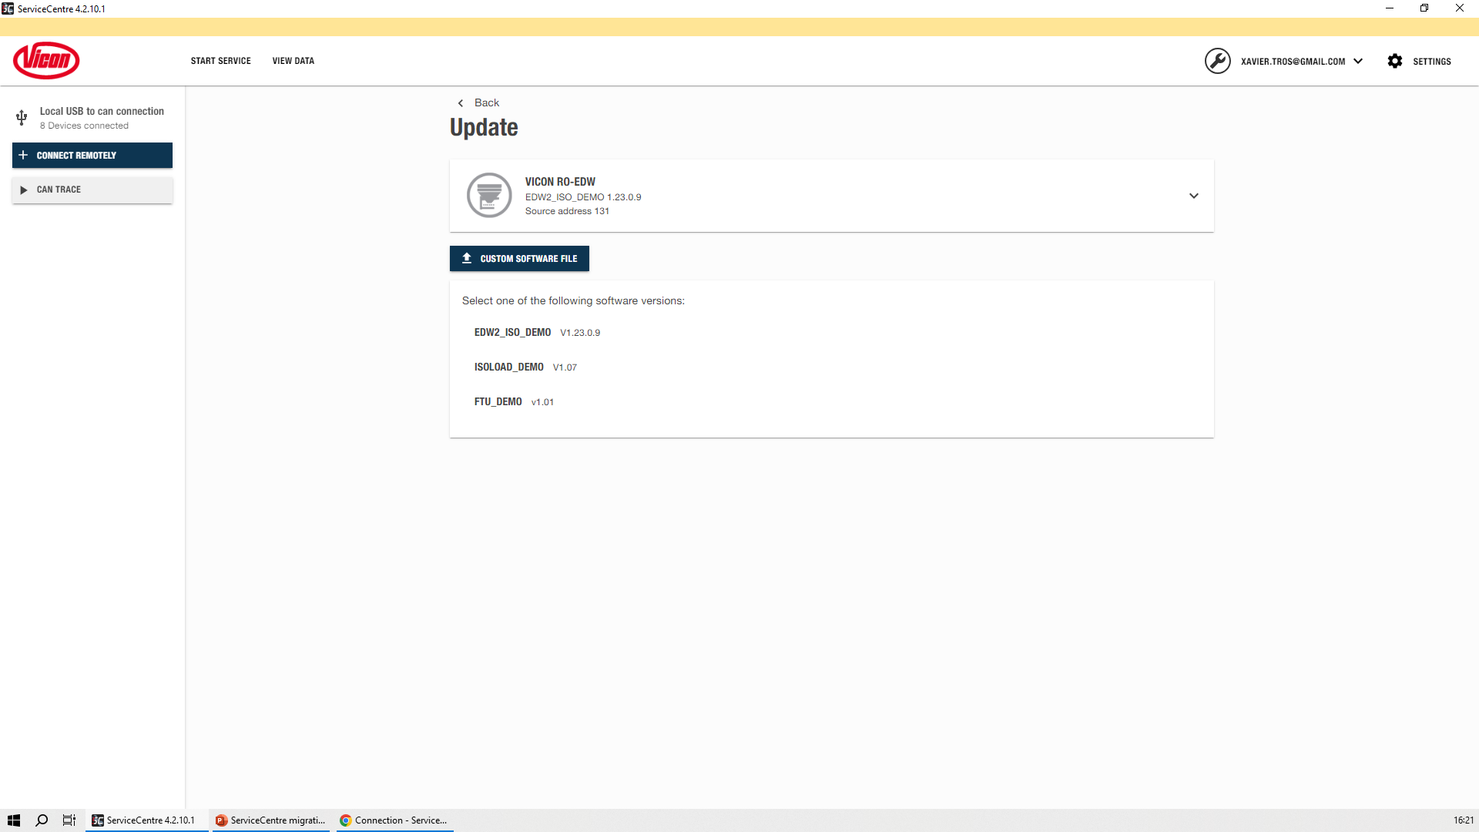
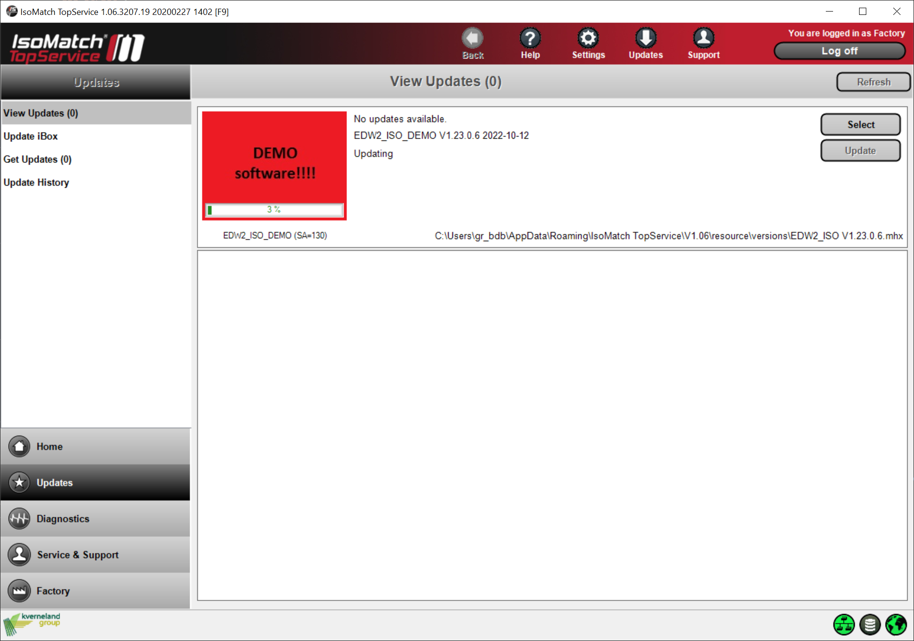
Flashing new software
Vicon ServiceCentre
Vicon ServiceCentre
Flashing is in the device’s dropdown menu.
Only compatible software versions are shown.
Only available with local connection.
IsoMatch TopService
ECUs can be updated on the “Updates” page.
After selecting a software version or updating to the latest a bar shows the updating process

Slide 47
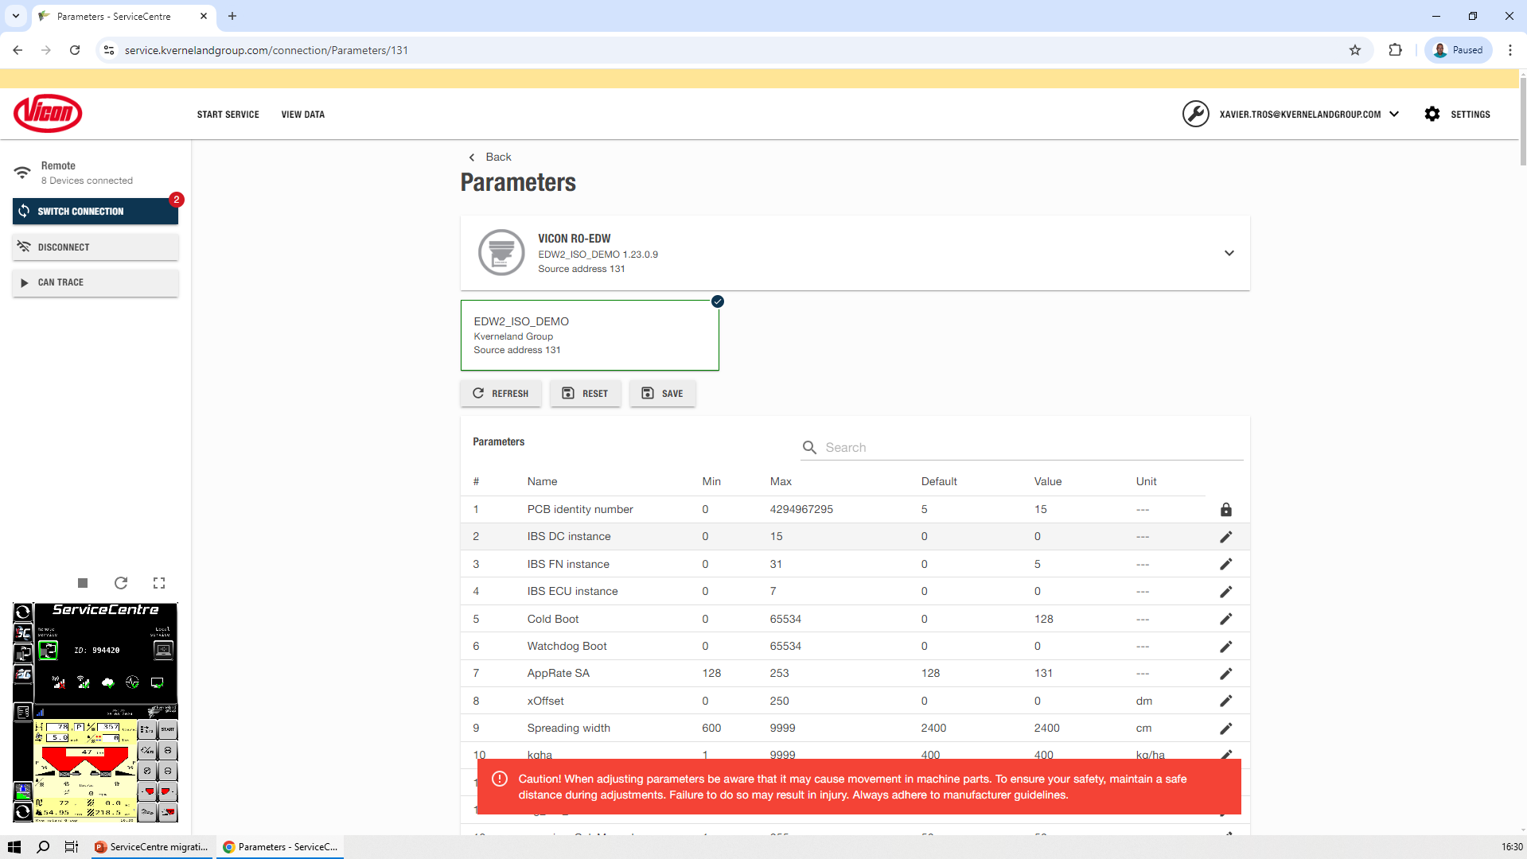
Parameters
Vicon ServiceCentre
Vicon ServiceCentre
Parameters function is in the device’s dropdown menu.
All parameters are loaded in one operation. Locks and pencils indicate what you can edit based on access level.
It is possible to save the complete list of parameters and reset them to the default values.

Slide 48
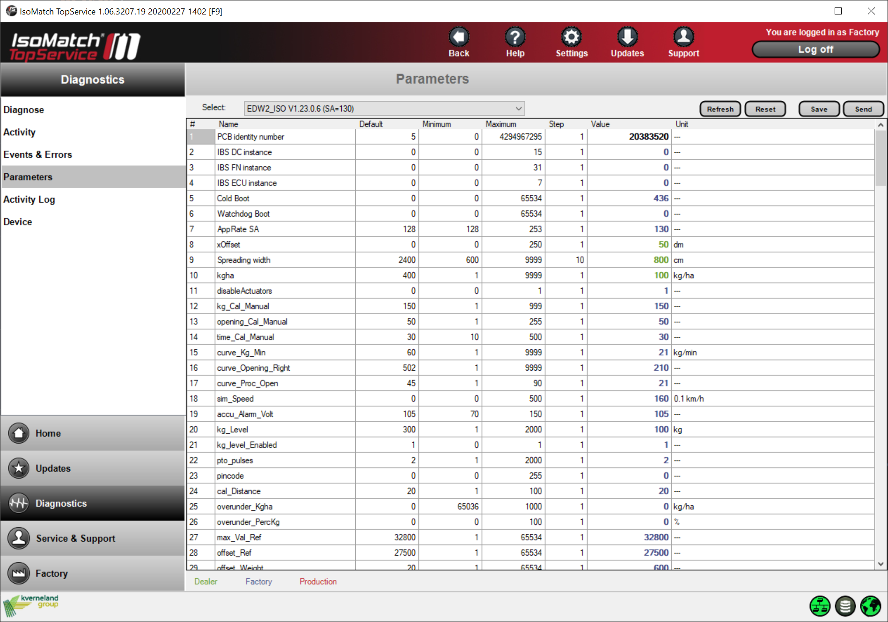
Parameters
Vicon ServiceCentre
IsoMatch TopService
Parameters can be viewed and edited on the “Parameters” diagnostics page.
Device has to be selected on the menu on top. The parameters are loaded one at a time. Colours indicate what you can edit based on access level.
Complete list of parameters can be saved and reset to the default values.

Slide 49
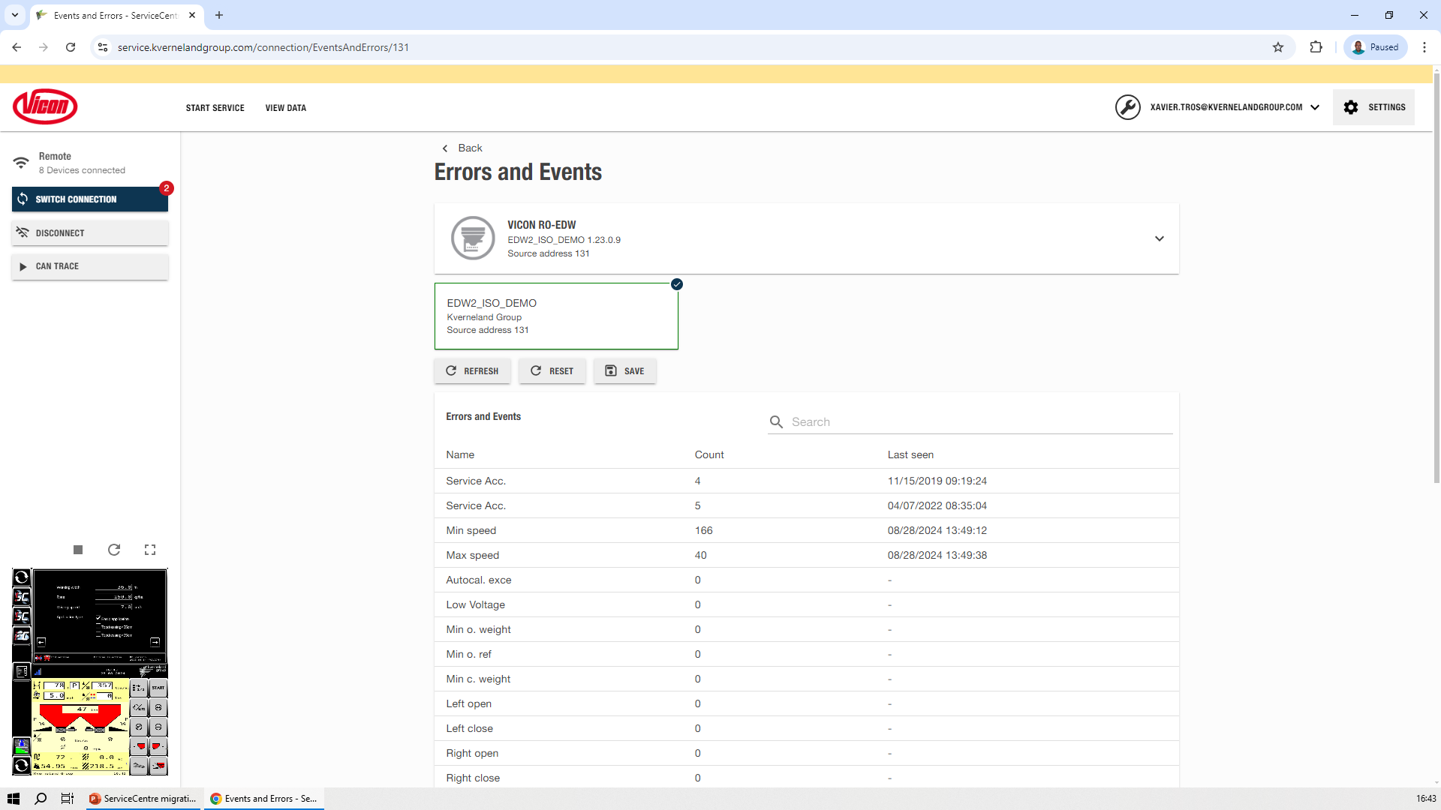
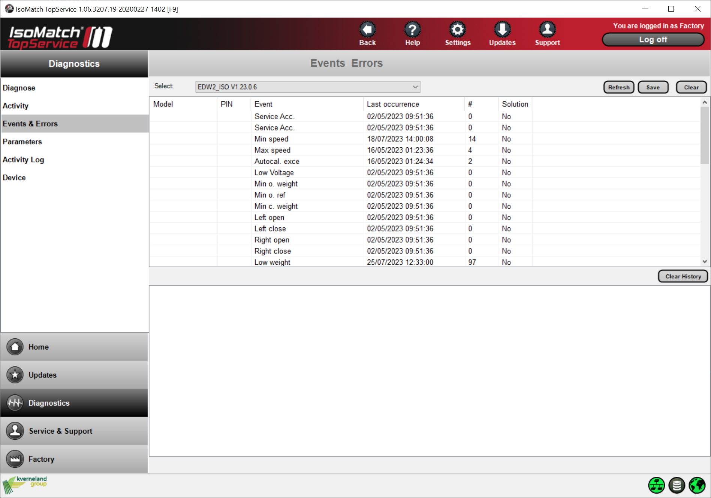
Errors and Events
Vicon ServiceCentre
Vicon ServiceCentre
Errors and Events function is in the dropdown menu of each device.
Occurrences can be reset to 0 and exported.
IsoMatch TopService
Errors and Events diagnostics page.
Device has to be selected on top of the page.
Occurrences can be reset to 0 and exported.

Slide 50

Diagnostic Trouble Codes
Vicon ServiceCentre
New Vicon ServiceCentre functionality
Diagnostic Trouble Codes is in the dropdown menu of each device.
It is possible to export the list to an Excel file.
Historic data can be reset to 0 and exported (not for Active Trouble Codes).

Slide 51
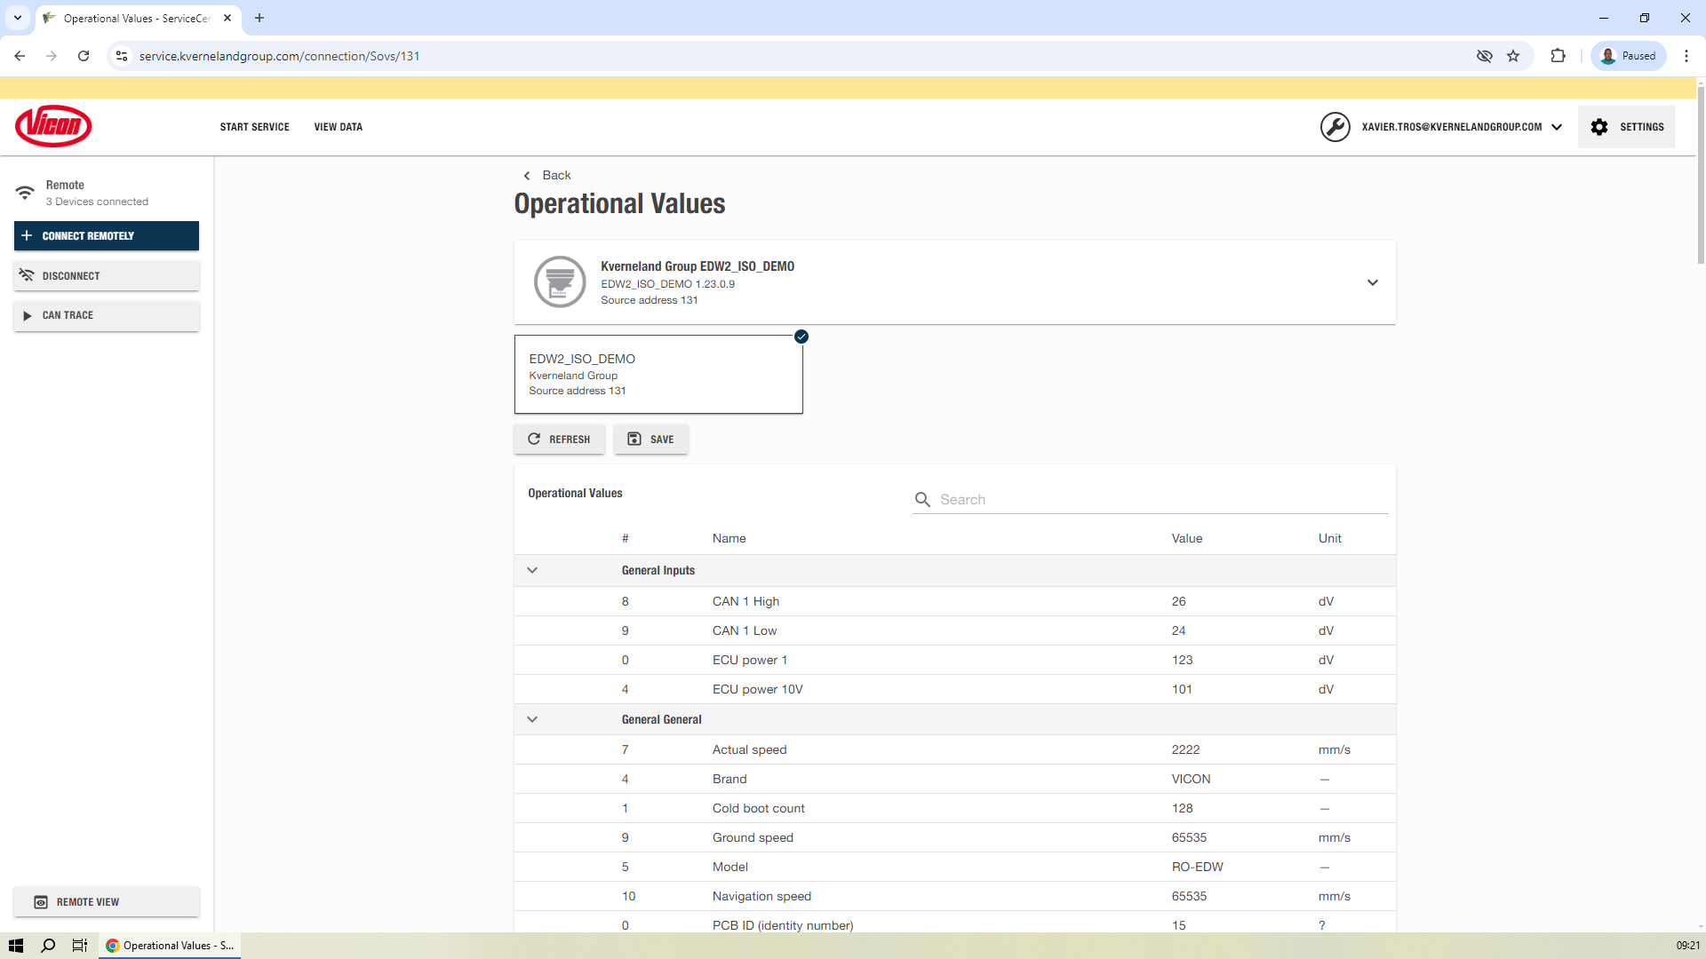
Operational values
Vicon ServiceCentre
New Vicon ServiceCentre functionality
Operational Values function is in the dropdown menu of each device.
These values are the same than the ones displayed in IsoMatch FarmCentre.
It is possible to export the list to an Excel file.

Slide 52
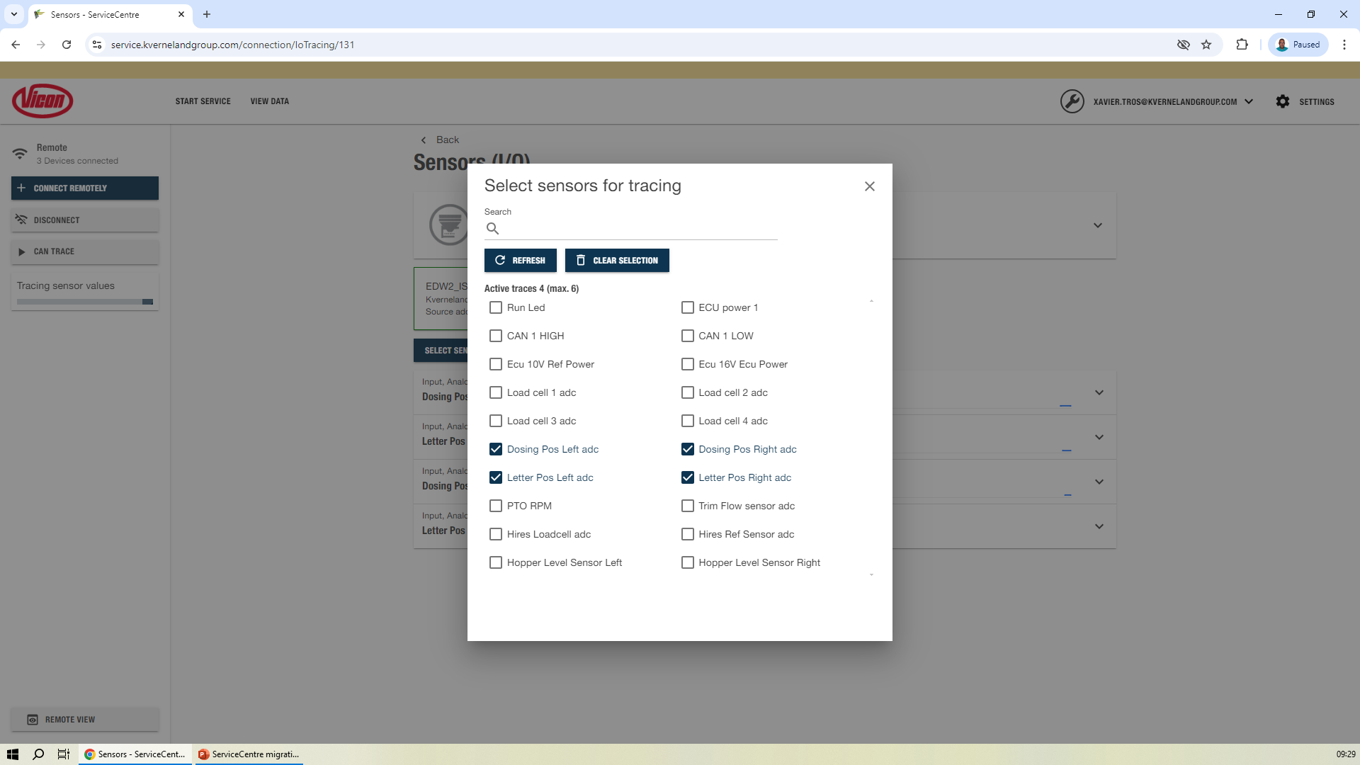
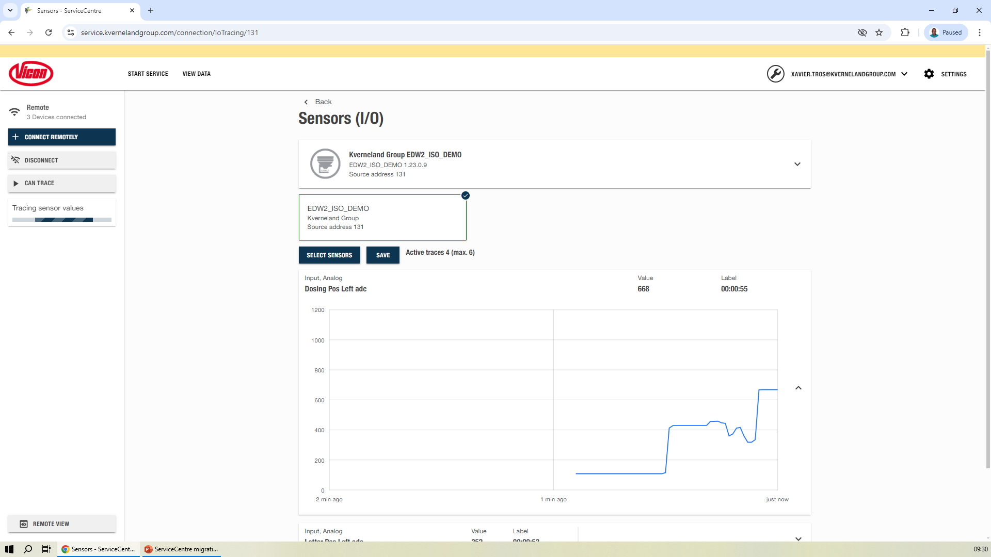
Sensors (I/O)
Vicon ServiceCentre
New Vicon ServiceCentre functionality
Sensors (I/O) function is in the dropdown menu of each device.
Select up to 6 sensors to start tracing their values in an expandable chart.

Slide 53
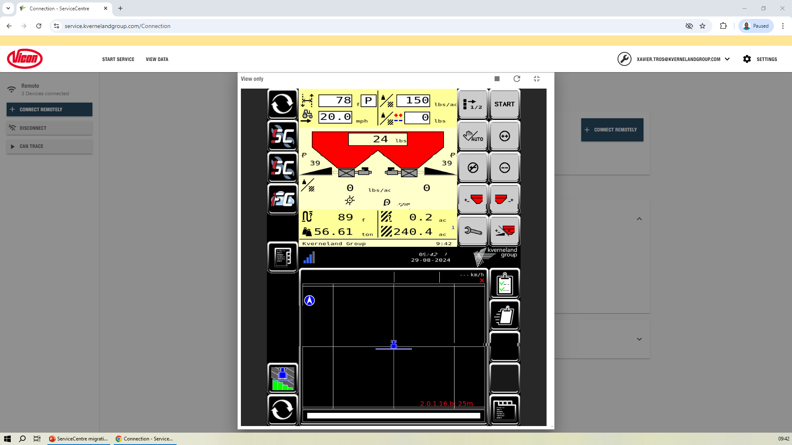
Remote terminal
Vicon ServiceCentre
New Vicon ServiceCentre functionality
Remote terminal function is in the dropdown menu of each device (only with remote connection).
When connected to an IsoMatch Tellus PRO or IsoMatch Tellus GO+ terminal, it is possible to view the terminal screen in the Vicon ServiceCentre application. It is a view function, it is not possible to take the control of the terminal.

Slide 54
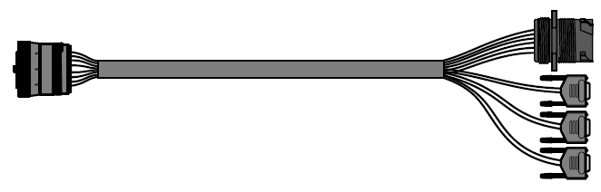
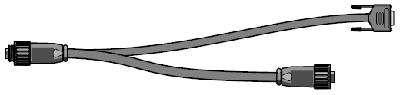
Package Content
ServiceCentre
CABLE ISO DIAGNOSTICS
To be plugged into a Diagnostic Connector, it is a
bridge to connect the CanFox dongle.
CABLE KV DIAGNOSTICS
To be plugged into a 7 pin CAN connector, it is a
bridge to connect the CanFox dongle.

Slide 55


Package Content
ServiceCentre
CABLE DIAGNOSTICS INCAB
To be plugged to a 9 PIN ISOBUS connector in the
ISOBUS can line (tractor or harness). It is a solution
to connect the Cable ISO Diagnostics when no
Diagnostics connector is available.
CABLE USB CAN INTERFACE CANFOX
To be placed when necessary (difficult to access)
between Diagnostics cables and CANFOX dongle.
.

Slide 56
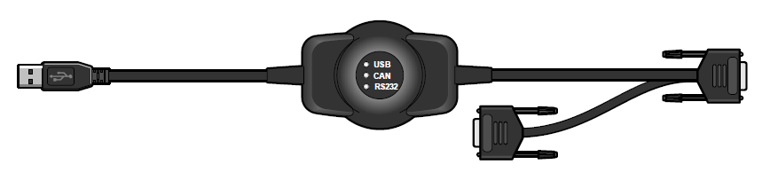
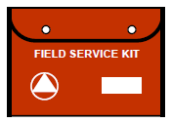
Package Content
ServiceCentre
CABLE USB CAN INTERFACE CANFOX
To be plugged to the service laptop and to the Cable
ISO Diagnostics.
KIT ESD FIELD SERVICE
Electrostatic protection mat to prevent damage to
electronic components when conecting them for repair
or replacement.

Slide 57
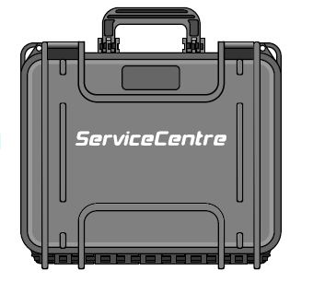
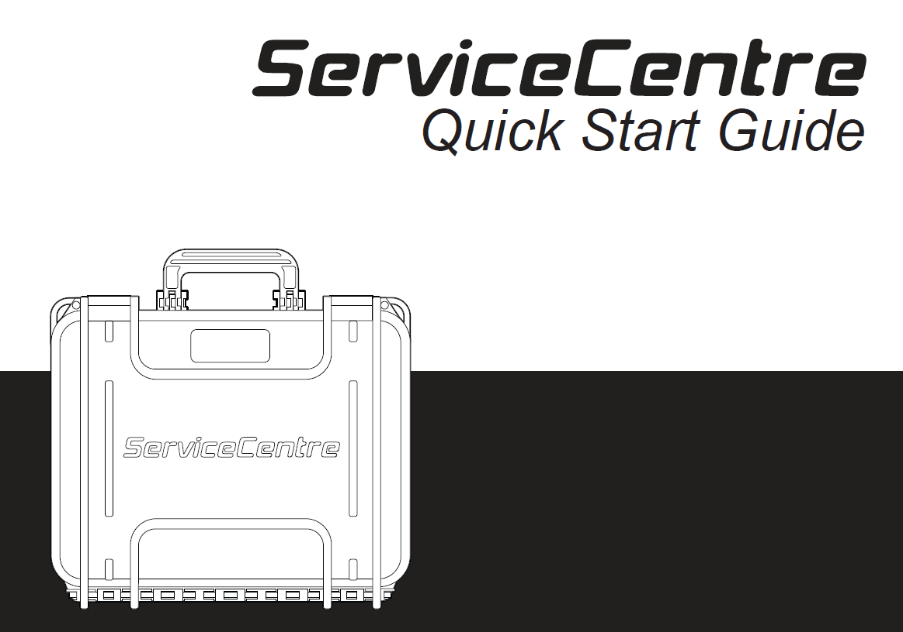
Package Content
ServiceCentre
The kit components are delivered in a heavy duty case with a Quick Start Guide.

Slide 58
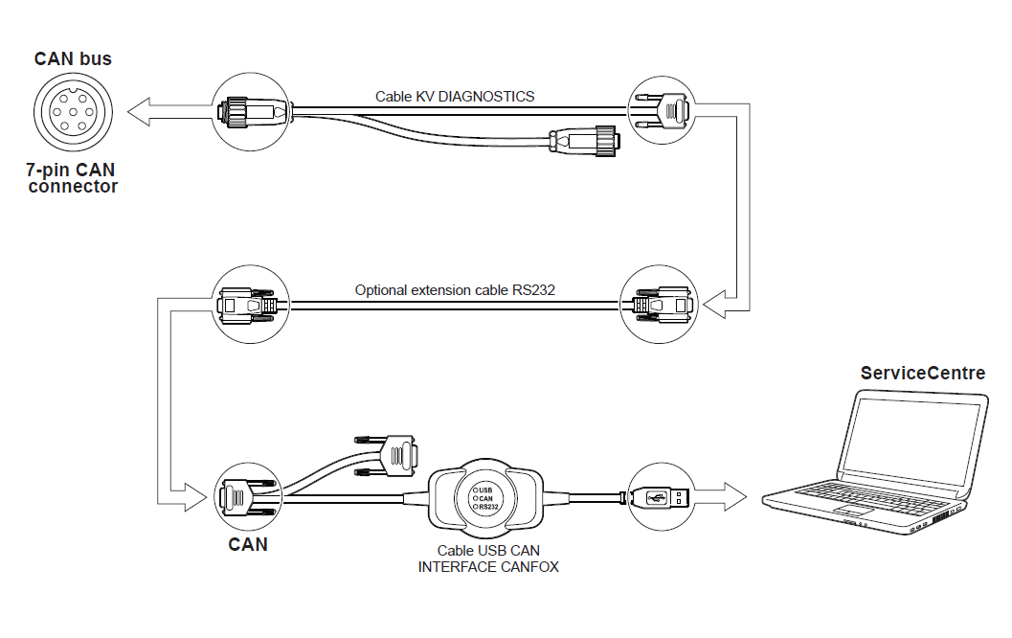
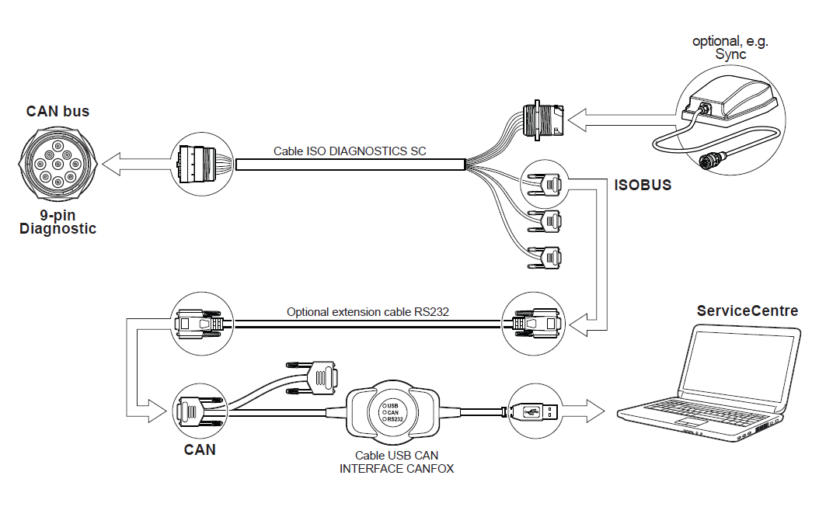
Summary of Connections
ServiceCentre
KvG standard pilotbox connection
Diagnostic connector on tractor

Slide 59
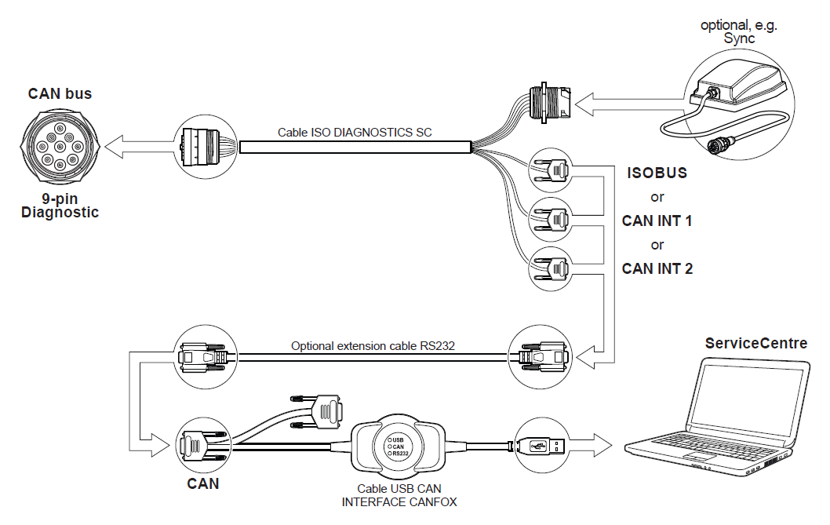
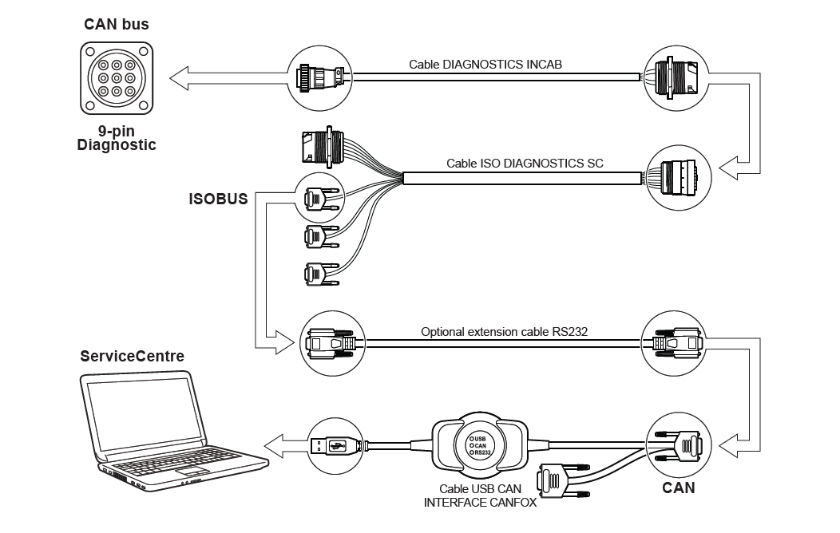
Summary of Connections
ServiceCentre
Diagnostic connector on implement
No diagnostic connector available

