Slide 1
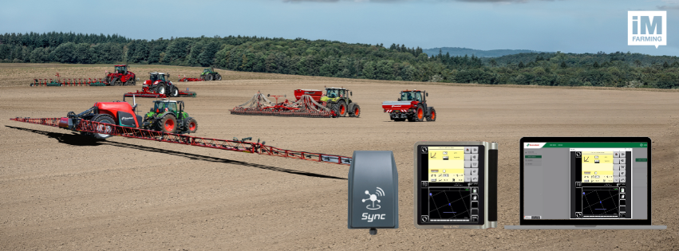

Kverneland Sync
Product Starter Kit
2025

Slide 2
Content
Product Information
Customer Onboarding
IsoMatch FarmCentre
Remote Service - Kverneland ServiceCentre
Market Introduction

Slide 3
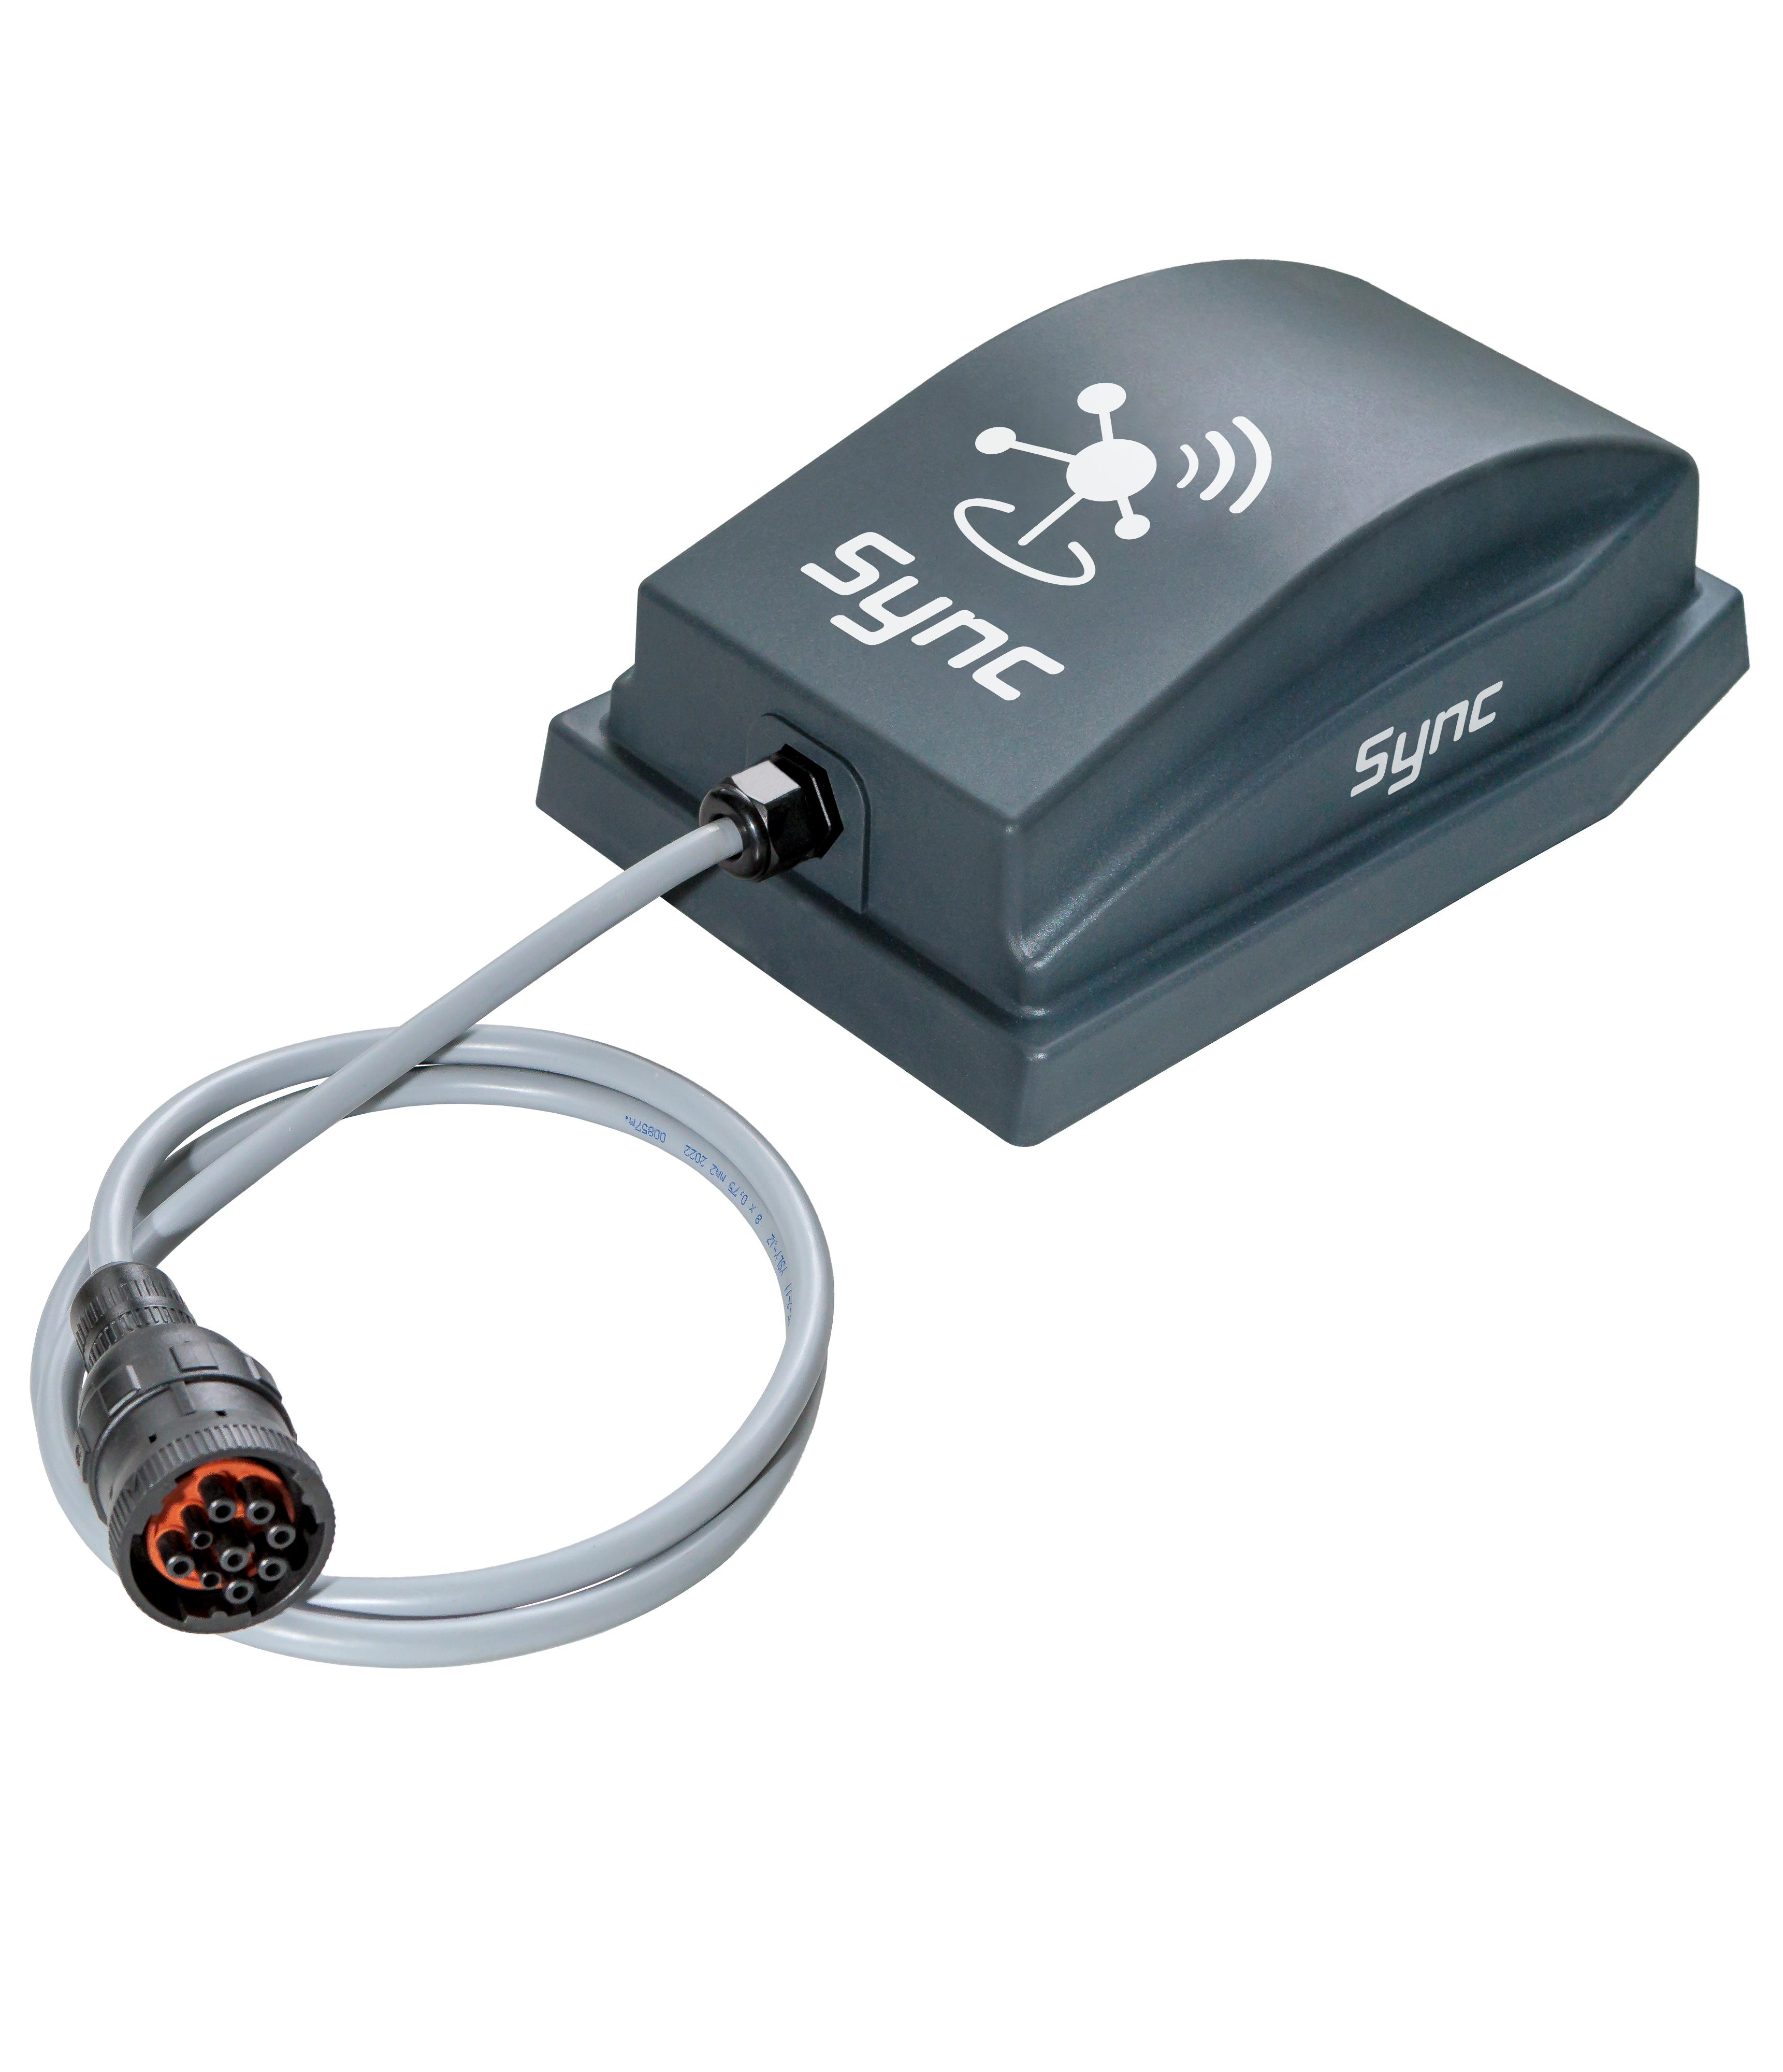
Hardware Release
Kverneland Sync
Last year, Kverneland Group Mechatronics released a new tool to the market: Kverneland Sync. This is the advanced gateway for ISOBUS Vicon machines.
Since September 2024, we have been connecting implements to corporate digital tools, enabling remote service, IsoMatch FarmCentre, and synchronizing spreaders with the Kverneland Spreading Charts App.
*Check market introduction and market availability slides.

Slide 4
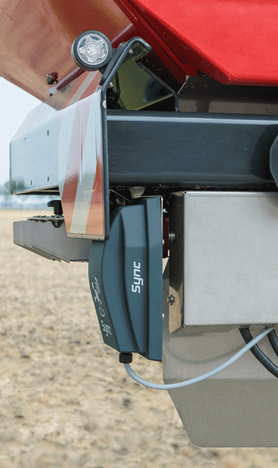
Implements Connected
Kverneland Sync
Sync is a connectivity device installed in Kverneland ISOBUS implements. This gateway allows the connection of the implements to the cloud. In this way, it will be possible to use remote tools like Kverneland ServiceCentre or IsoMatch FarmCentre.
It allows also to connect to the implement via Bluetooth and interact with them with dedicated applications like the Kverneland Spreading Charts App.

Slide 5
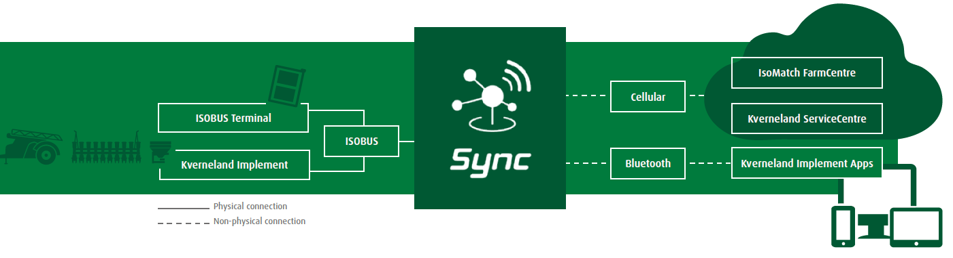
Cloud Connection
Kverneland Sync
Physical Connection:
ISOBUS terminals
Kverneland ISOBUS implements
Remote Connection:
ServiceCentre via cloud
IsoMatch FarmCentre via cloud
Implement Apps via Bluetooth

Slide 6
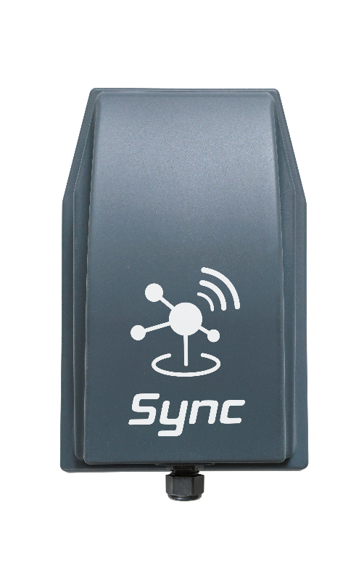
Benefits
Kverneland Sync
Sync ensures smooth connectivity and farming data flow between Kverneland ISOBUS implements and digital tools.
Always Connected
Sync ensures seamless
connectivity to online services, with smooth data transfer to the cloud.
Remote Service
Technicians can resolve issues promptly using service tools with remote connection, like Kverneland ServiceCentre.
Maximize Profitability and Growth
Data analysis of the KPI form the implements.
Tracking & Reporting
It allows real-time tracking of operations and diagnostic
codes, offering detailed reporting and secure task data storage.
New Features and Enhanced Safety
Enjoy synchronization with implement apps, precise tracking, and geofencing. Benefit from automated documentation, enhanced safety, and precise task planning.
Terminal Connectivity
Connect your Tellus Terminal via Kverneland Sync for access to digital tools directly on your terminal.

Slide 7
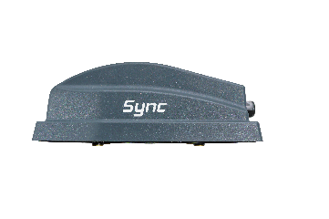




Features
Kverneland Sync
ENABLING THE TOOLS
Tracking & Reporting
Data insights
Complete ecosystem
Machine insights with IsoMatch FarmCentre.
Geofence when implement is OFF.
Always connected to the implement.
Independent of tractor brand.
Remote service through implement dealer.
Seamless data collection.
Dedicated platforms for farmers and dealers.
Kverneland Spreading Charts App.
IsoMatch FarmCentre
Remote connection from any location at any time Real-time visibility into tasks, alert history and operational values.
Kverneland ServiceCentre
Kverneland Sync on the implement enables remote diagnostics, monitoring machine health, timely replacement of parts and efficient troubleshooting.

Slide 8
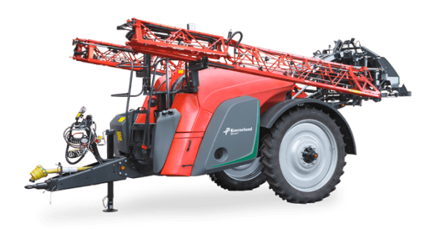
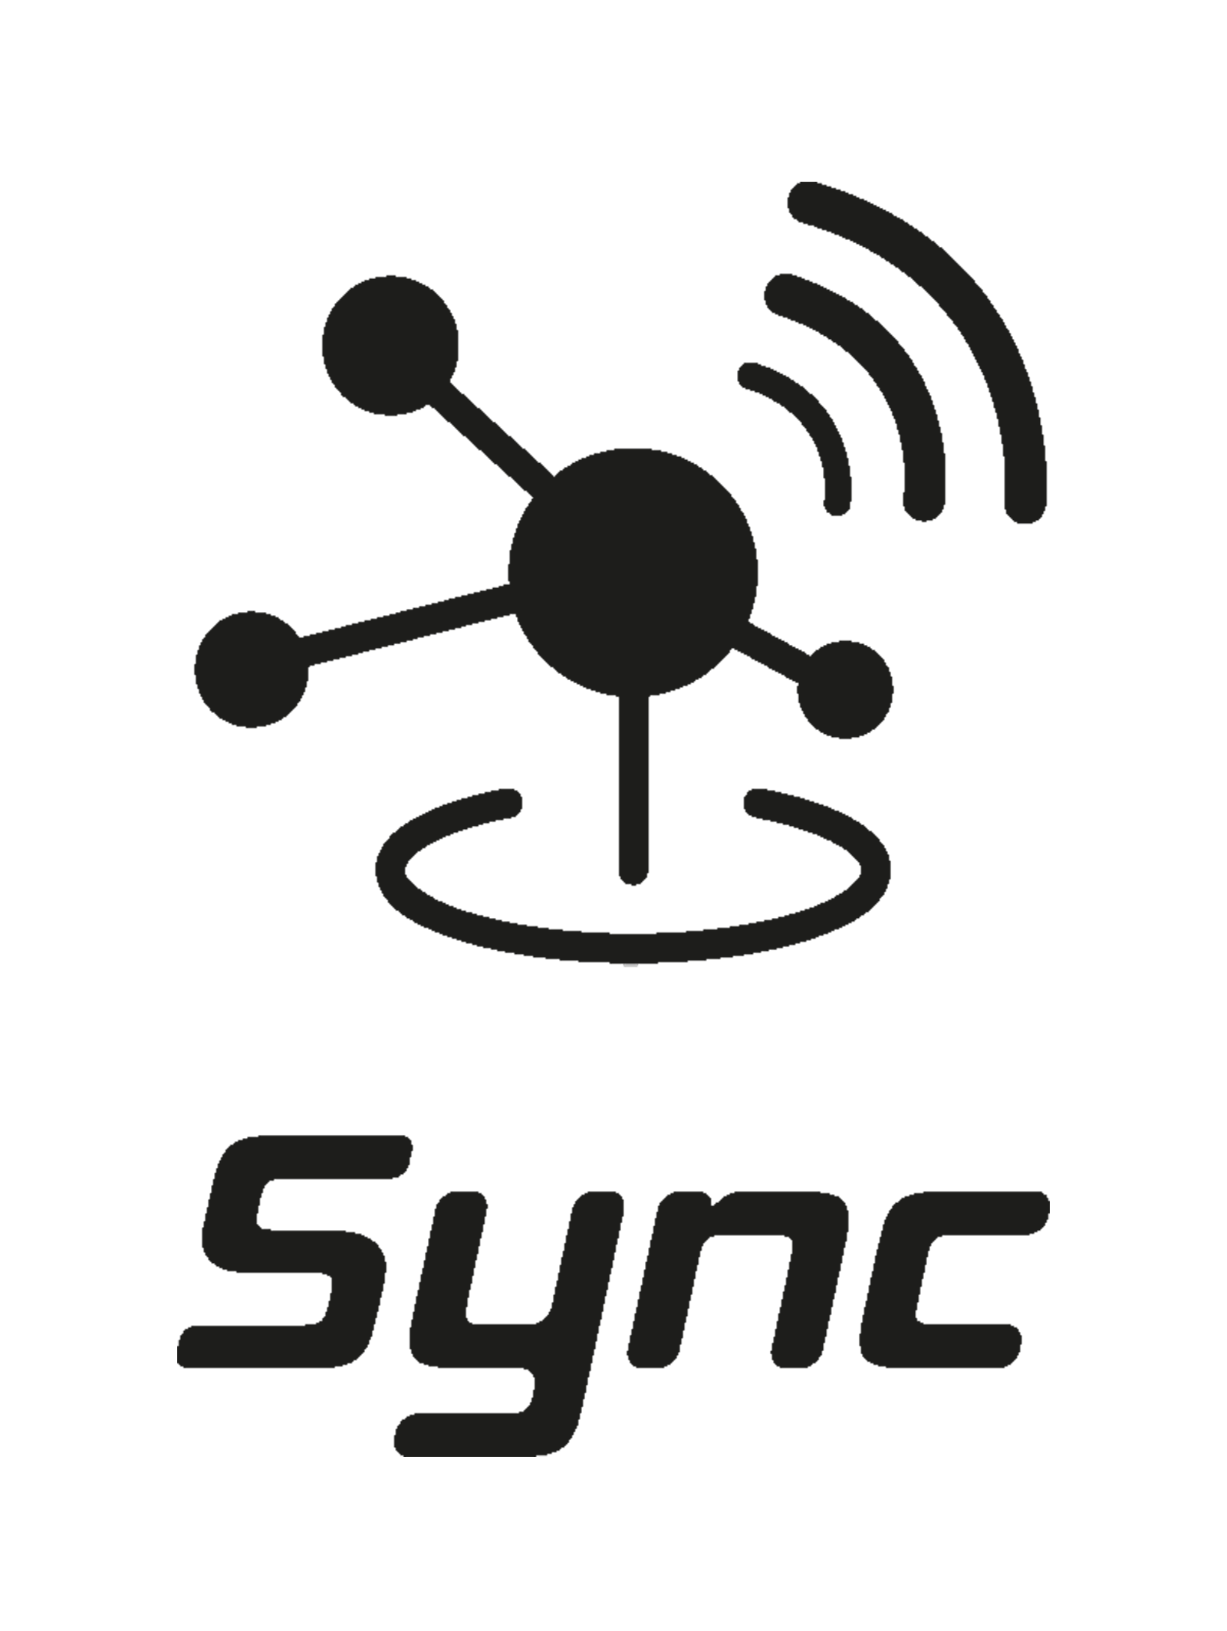

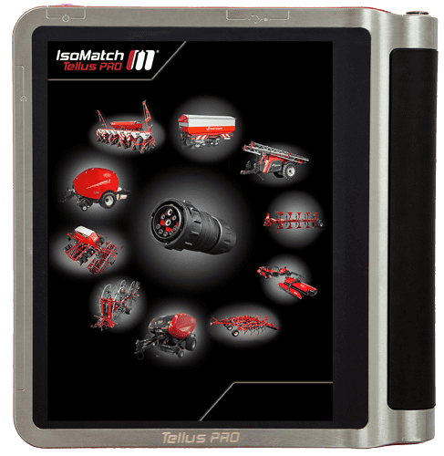

Not connected vs Connected implements
Kverneland Sync-connected implements
Functionality | Not connected | Connected with Sync | Connected with Terminal | Connected with Sync and Terminal
IsoMatch FarmCentre – fleet management | ✗ | ✓ | ✓ | ✓
IsoMatch FarmCentre – taskdata exchange | ✗ | ✗ | ✓ | ✓
Remote service – without screen replication | ✗ | ✓ | ✓ | ✓
Remote service – with screen replication | ✗ | ✗ | ✓ | ✓
Geofence – implement working | ✗ | ✓ | ✓ | ✓
Geofence – when implement is OFF | ✗ | ✓ | ✗ | ✓ (specific configuration)
Share internet – with IsoMatch Tellus GO+ and Tellus PRO. | ✗ | ✓ | ✗ | ✓
Kverneland Spreading Charts App | ✗ | ✓ | ✗ | ✓

Slide 9
Before vs. Now
Kverneland Sync-connected implements
To have a connected Kverneland ISOBUS implement:
Before | Now
Only via KvG Terminals – needed | Connected regardless of the terminal
Kverneland Sync – not included | Kverneland Sync – included, installed, activated
2 years connectivity – not included | 2 years connectivity - included
Remote service – manual terminal connection with wifi and 4G dongles | Remote service – enabled without any extra connectivity device on terminal
IsoMatch FarmCentre – to be purchased separately | IsoMatch FarmCentre – included license for 2 years

Slide 10
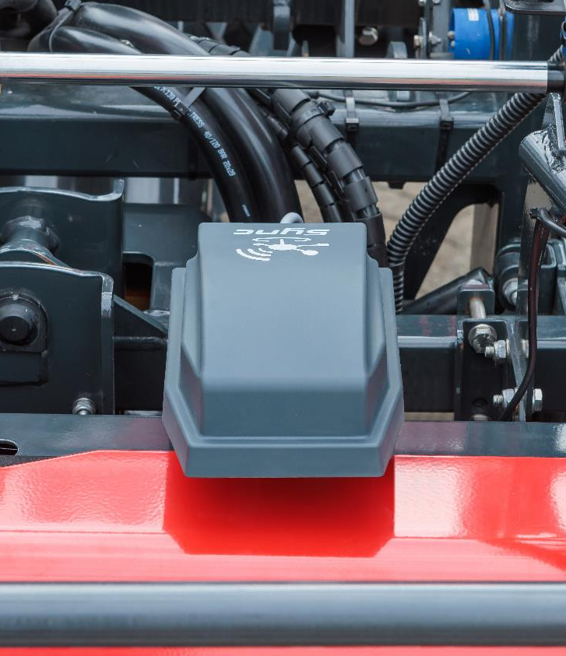
Activation
Kverneland Sync
Kverneland Sync is delivered together with the corresponding implement where it is fitted. The gateway includes a SIM card with 2 years of data and a license for IsoMatch FarmCentre valid also for 2 years. When the implement is delivered, some steps have to take place to activate the gateway and to consent the use of customer data and register Kverneland Sync into the IsoMatch FarmCentre account.

Slide 11


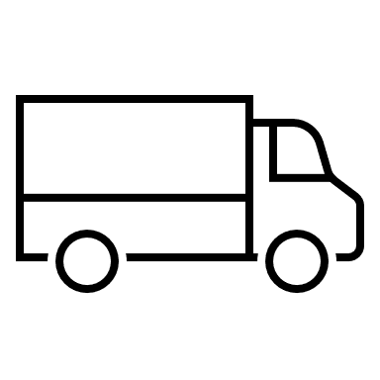

Customer onboarding
Kverneland Sync
Machine delivery
Machine is delivered to the dealer. Kverneland Sync is fitted and installed in the machine.
Document preparation
Dealer downloads and prints the warranty conditions and data contract from Quest.

Slide 12
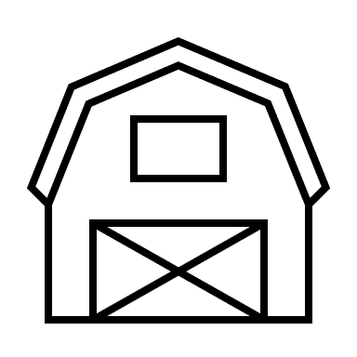
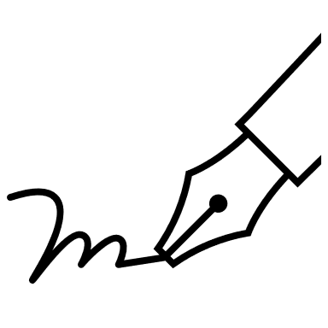


Machine delivery
Machine is delivered to the farmer and final setup is done by the dealer.
Customer’s signature
Customer is asked to sign the delivery documents with the warranty conditions and the data contract to fulfil the GDPR requirements.
Accept
Customer signs and accepts the data contract and the dealer sends it to the Sync Support mailbox syncsupport@kvernelandgroup.com Kverneland Sync is active, ready for remote support and starts sending data to the cloud.
Decline
Customer does not accept to share data. Contract with the decline request has to be sent to the Kverneland Sync Support mailbox syncsupport@kvernelandgroup.com.

Slide 13

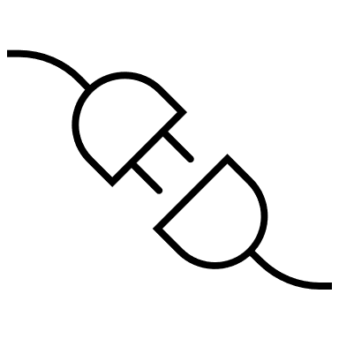
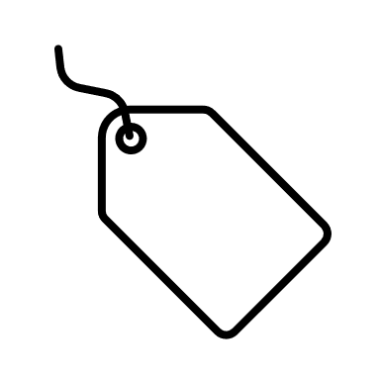


Log in
De-activation
Customer is asked to create an account in MyKverneland landing sites.
Within 5 working days from receiving the decline from customer, IsoMatch FarmCentre data collection through Kverneland Sync is de-activated.
Registration
Once logged in the landing site, customer can access to IsoMatch FarmCentre and register the Kverneland Sync device. Implement will appear automatically.
Usage
Customer gets machine information in its IsoMatch FarmCentre account and can request remote service when necessary.
Renewal
After two years customer can access to the Terrako Marketplace to purchase an IsoMatch FarmCentre license renewal. As long as the customer account is active, Kverneland Sync will continue to send data to the cloud.

Slide 14
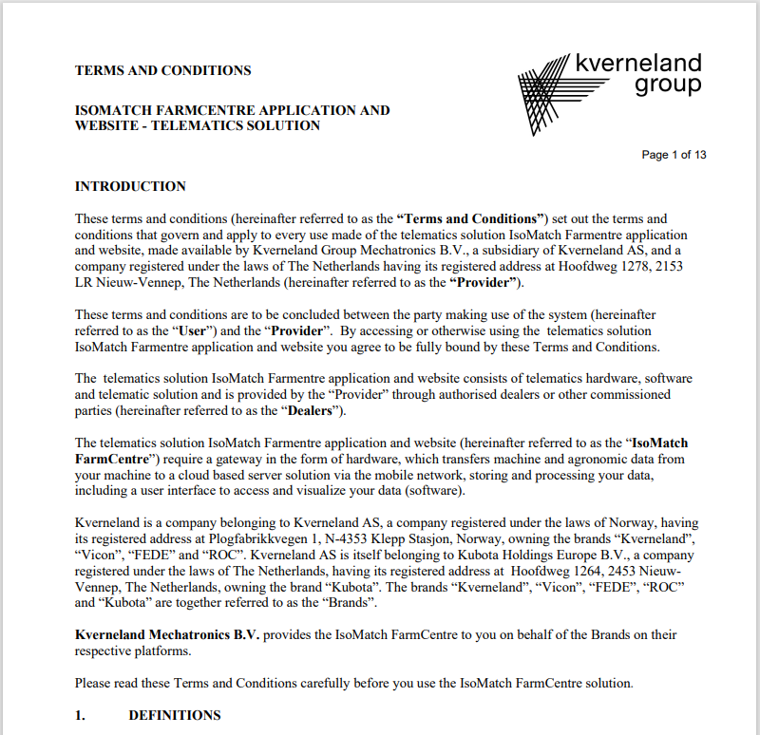
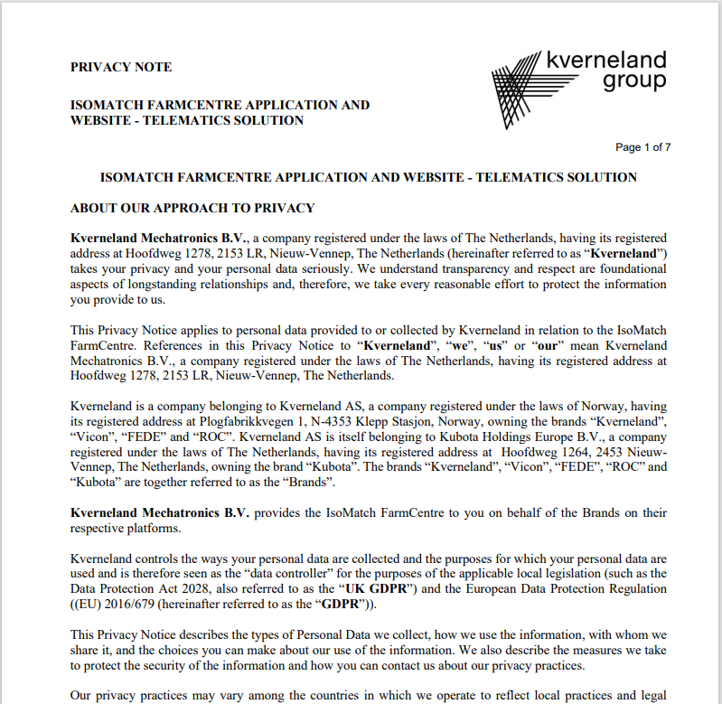
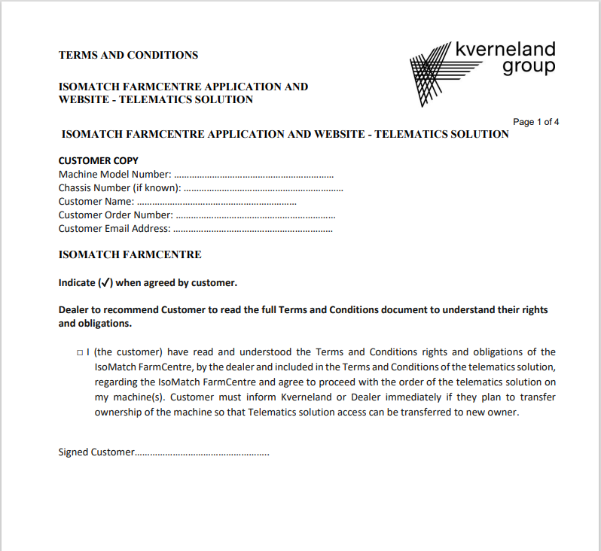
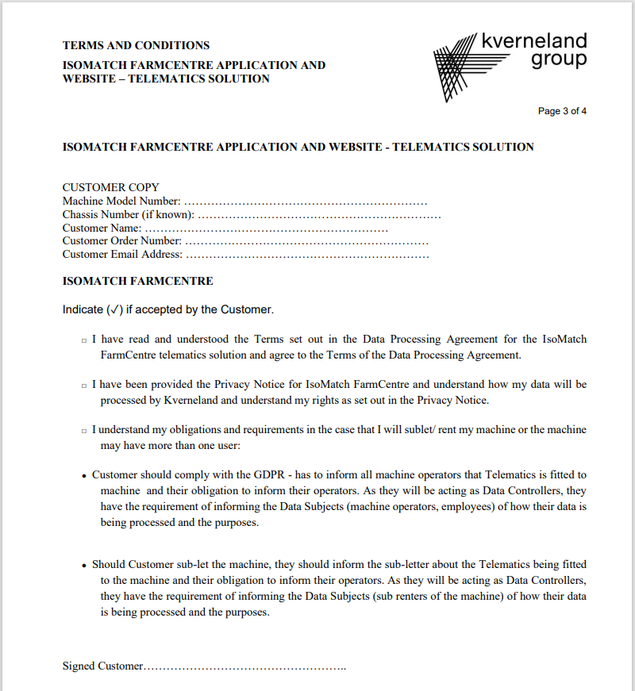
Customer’s Signature
Kverneland Sync
1. Dealer has to print the next documents available in Quest
2. Customer needs to read
T&C and DPA – Quest Nº 848977
Privacy Notice – Quest Nº 848979
3. Customer needs to sign
Signatures – Quest Nº 848978
4. Dealer needs to scan the CUSTOMER COPY of Signatures documents and forward to syncsupport@kvernelandgroup.com

Slide 15
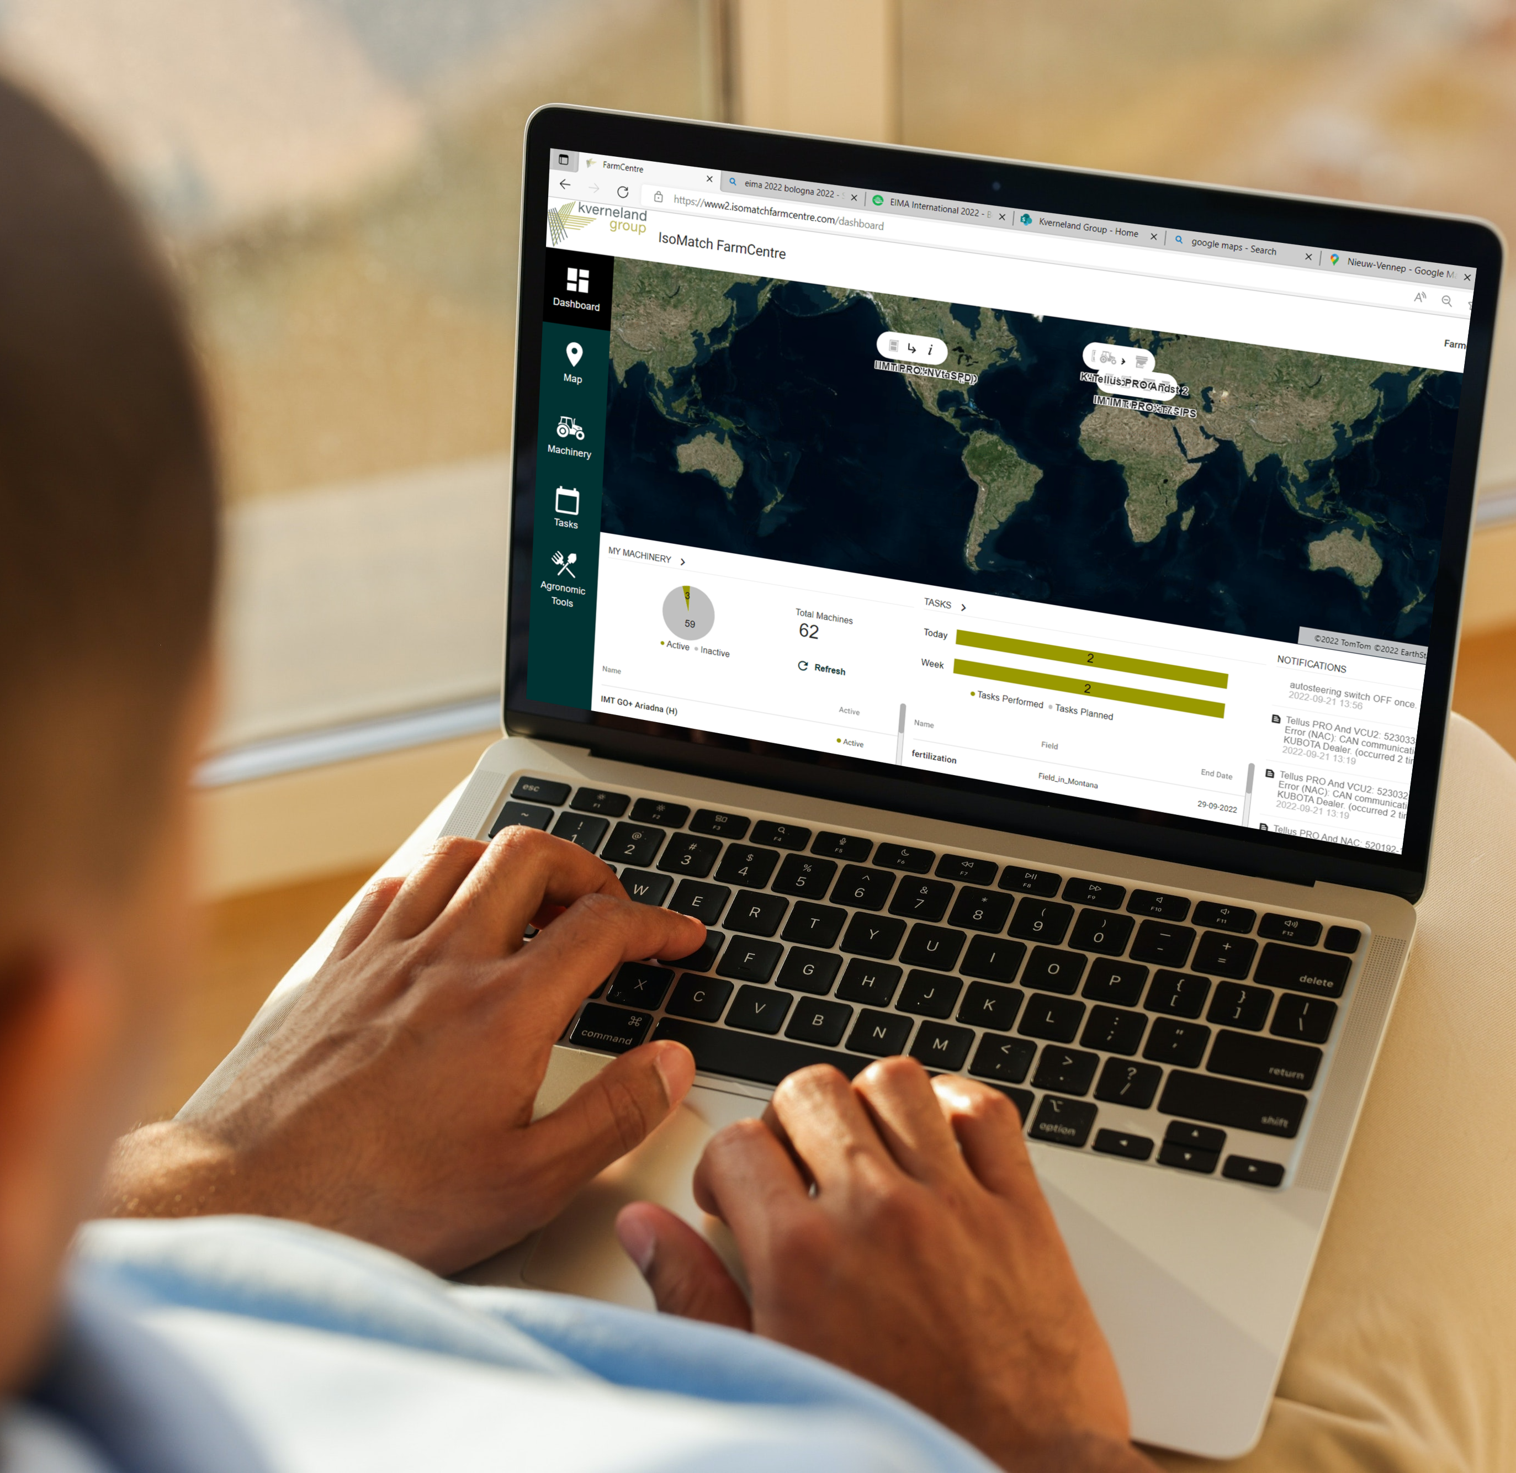
IsoMatch FarmCentre
Kverneland Sync
New user
Register in MyKverneland
  https://my.kverneland.com
With the credentials log in IsoMatch FarmCentre
Add Kverneland Sync (see next slides)
Existing user
Log in IsoMatch FarmCentre
  https://www.isomatchfarmcentre.com/
Add Sync (see next slides)

Slide 16
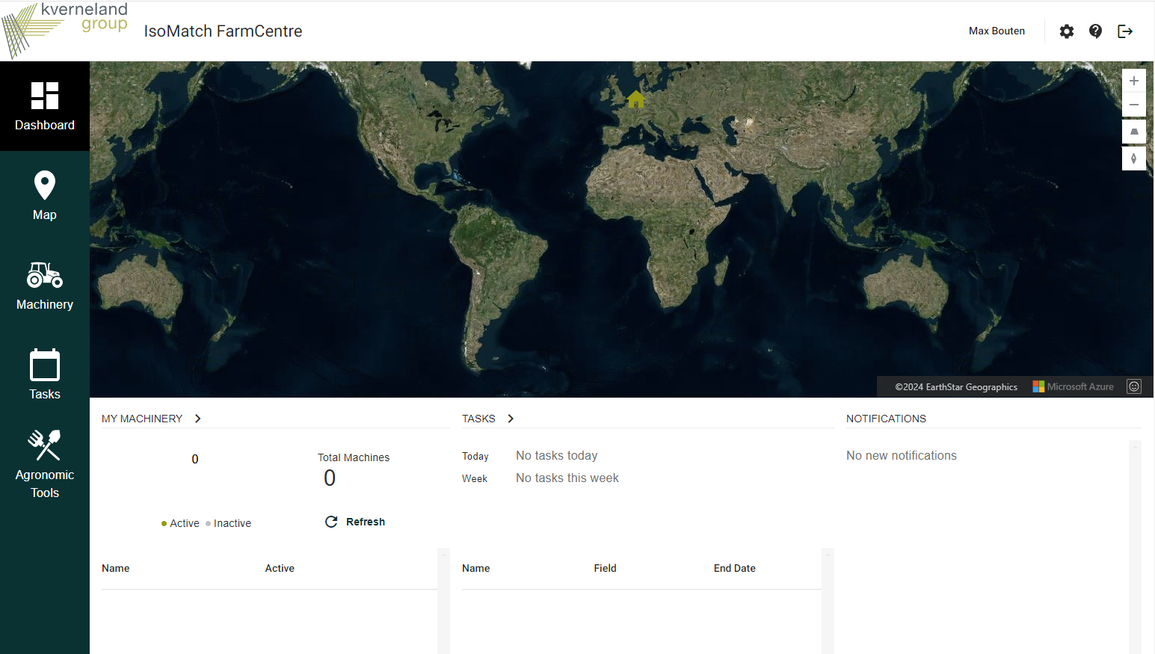
Add Implement to IsoMatch FarmCentre
Kverneland Sync
1. Go settings on the top right of the page
2. Select “Gateways & Terminals” section
3. Select “+ Add Gateway”
Note: There is no license key needed to add a Gateway
4. Add a Gateway name and the MAC Address of Sync
Note: It is possible to change the gateway name in settings
5. Confirm your input by “Add Gateway”
6. Go back to Dashboard
7. Find your Sync in the “Machinery” section
Note: Implements connected to Sync will automatically be added and can be renamed in “Settings”
1

Slide 17
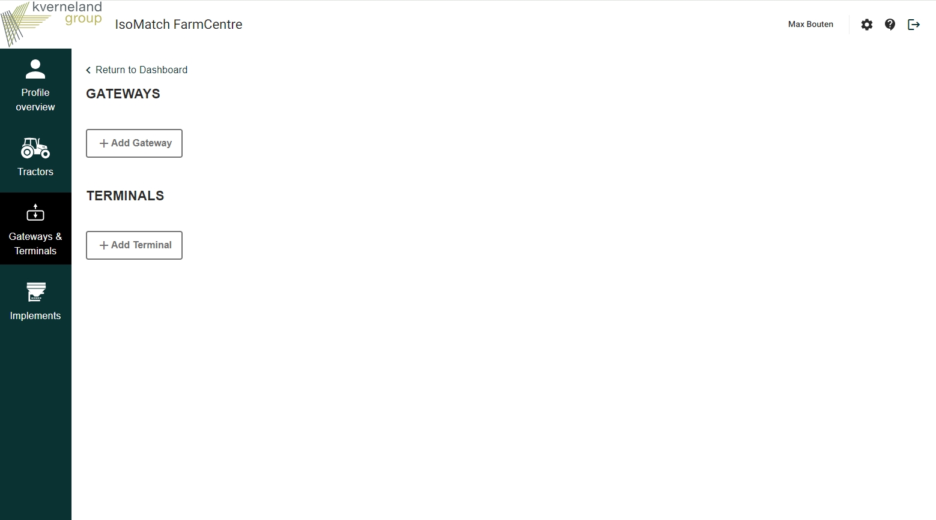
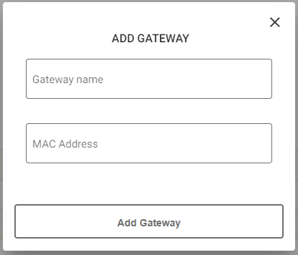
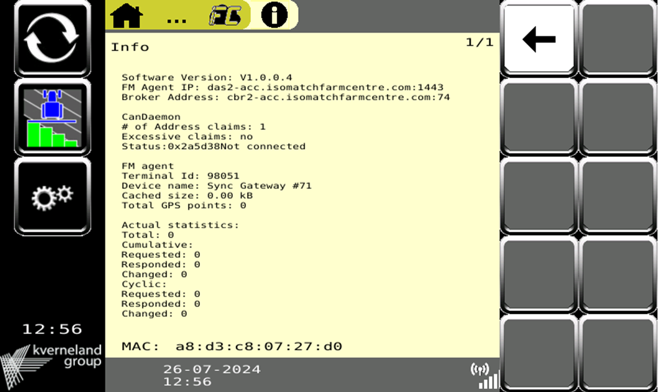
Add Implement to IsoMatch FarmCentre
Kverneland Sync
6
1. Go settings on the top right of the page
2. Select “Gateways & Terminals” section
3. Select “+ Add Gateway”
Note: There is no license key needed to add a Gateway
4. Add a Gateway name and the MAC Address of Sync
Note: It is possible to change the gateway name in settings
5. Confirm your input by “Add Gateway”
6. Go back to Dashboard
7. Find your Sync in the “Machinery” section
Note: Implements connected to Sync will automatically be added and can be renamed in “Settings”
3
User manual
IsoMatch FarmCentre
2
4
5

Slide 18
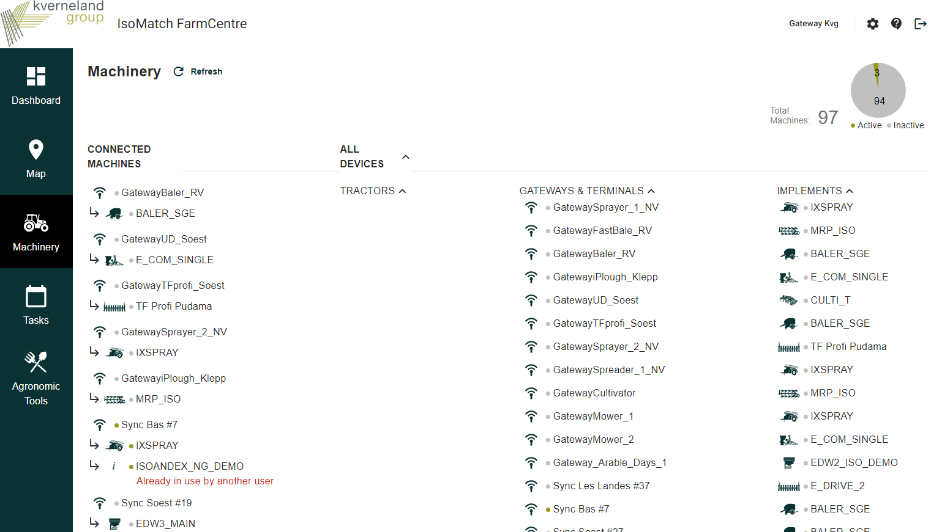
Add Implement to IsoMatch FarmCentre
Kverneland Sync
1. Go settings on the top right of the page
2. Select “Gateways & Terminals” section
3. Select “+ Add Gateway”
Note: There is no license key needed to add a Gateway
4. Add a Gateway name and the MAC Address of Sync
Note: It is possible to change the gateway name in settings
5. Confirm your input by “Add Gateway”
6. Go back to Dashboard
7. Find your Sync in the “Machinery” section
Note: Implements connected to Sync will automatically be added and can be renamed in “Settings”
7

Slide 19
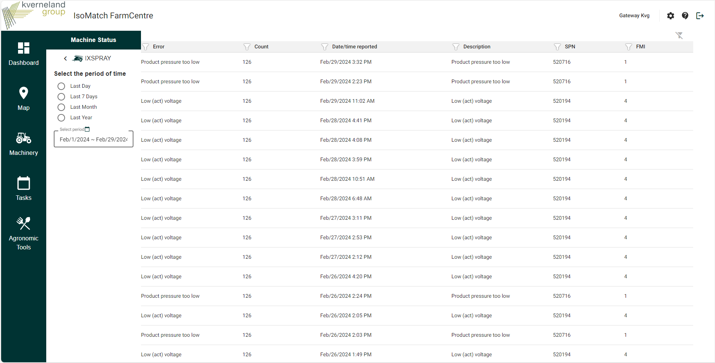
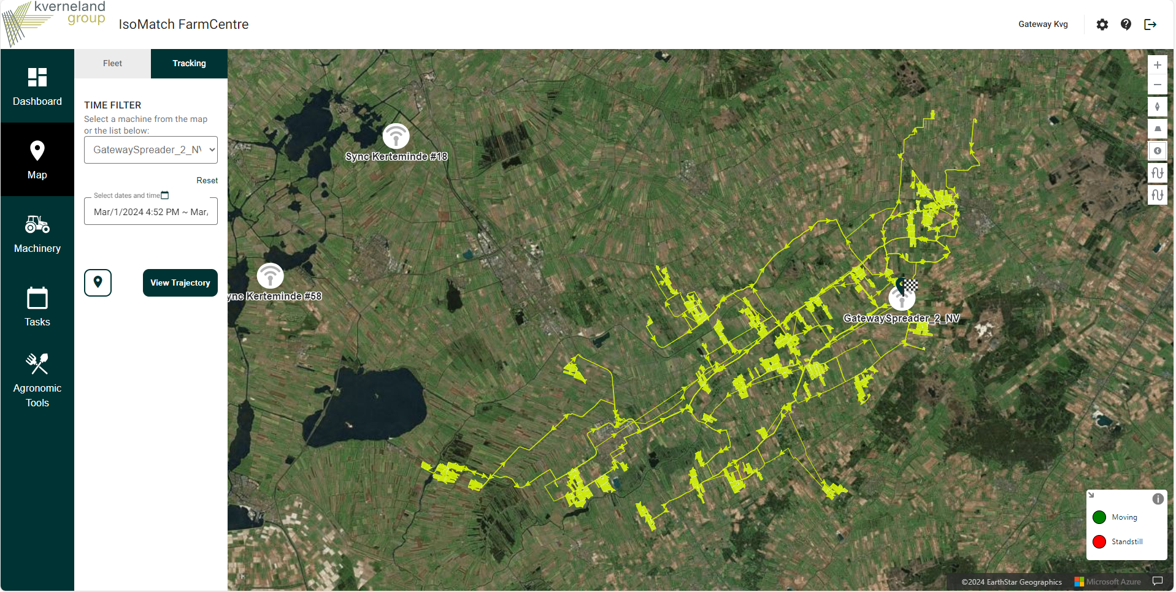
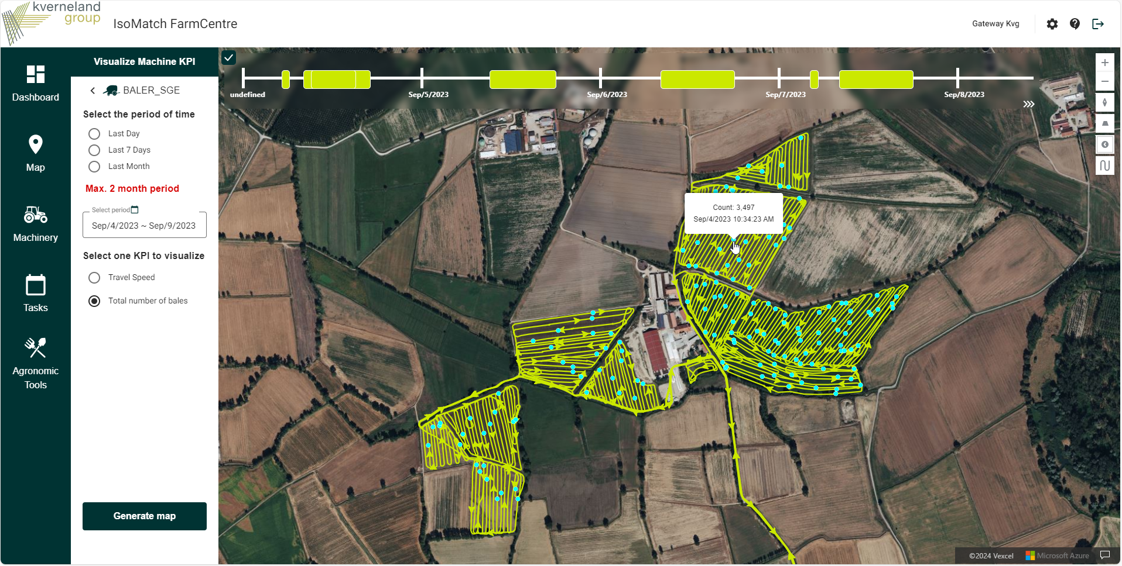
IsoMatch FarmCentre
Kverneland Sync + Implement
When a customer has Implement + Sync, the information below is automatically created in IsoMatch FarmCentre:
  Map tracking
  Documentation
  Machinery DTCs (Diagnostic Trouble Codes)

Slide 20
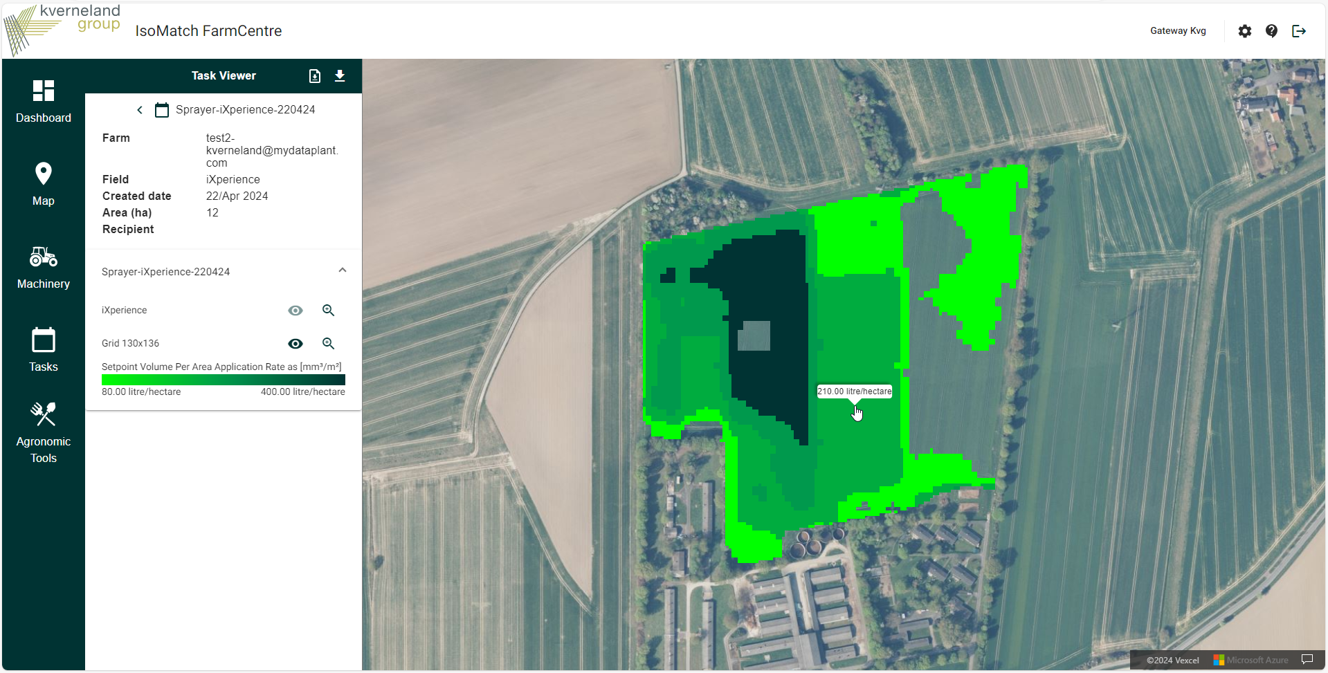
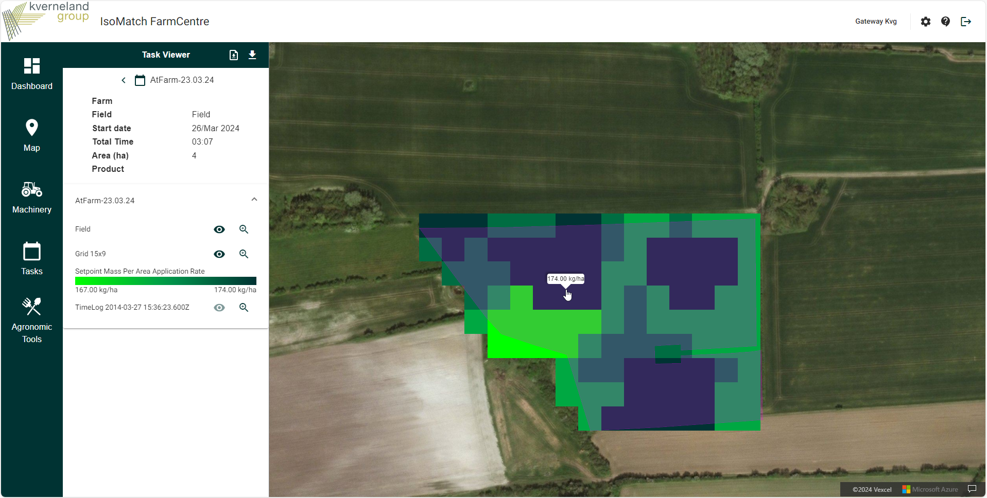
IsoMatch FarmCentre
Kverneland Sync + Implement + KvG Terminal
When a customer has an Implement with Kverneland Sync and a KvG connected terminal, it is possible to also do:
  Planned task data visualization and remote exchange to the connected terminal
  As-applied task data visualization in map

Slide 21
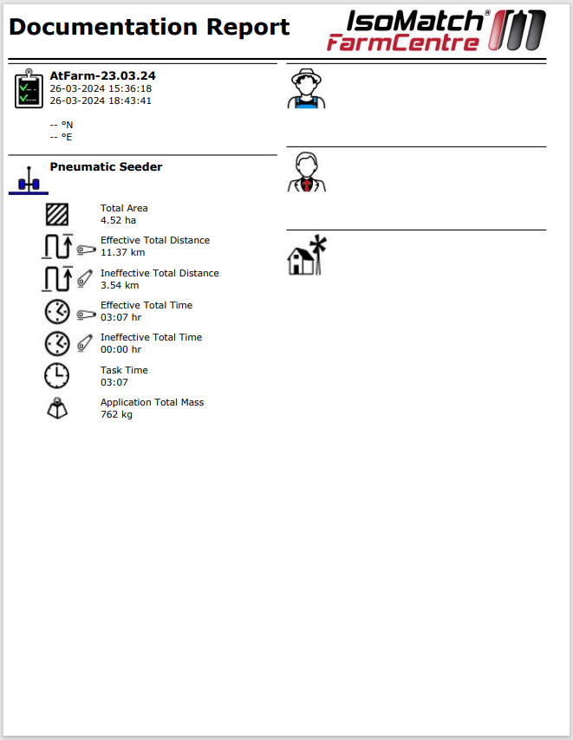
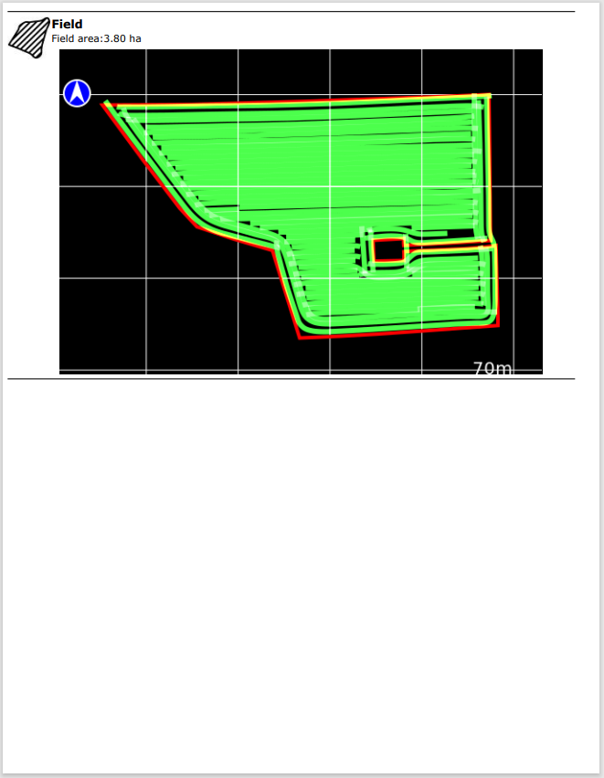
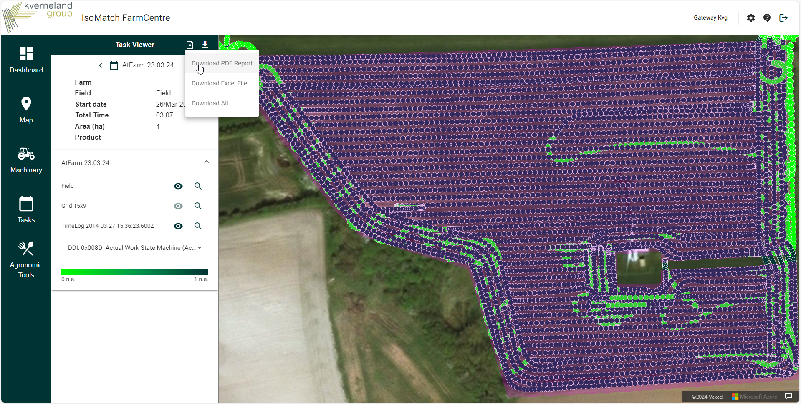
IsoMatch FarmCentre
Kverneland Sync + Implement + KvG Terminal
Also PDF reports are available:
For performed task
Click on View task
Click on download PDF

Slide 22
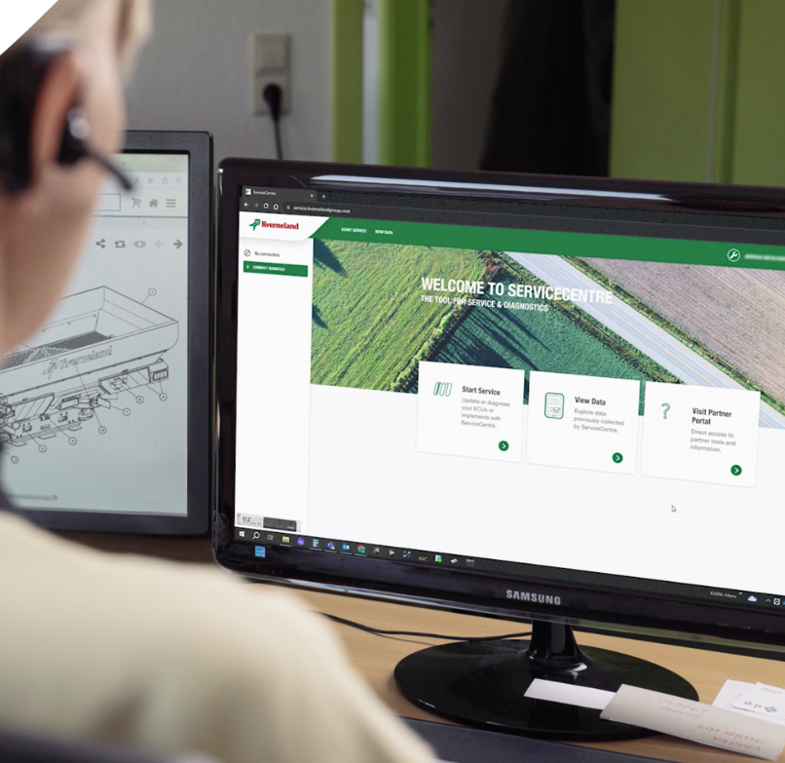
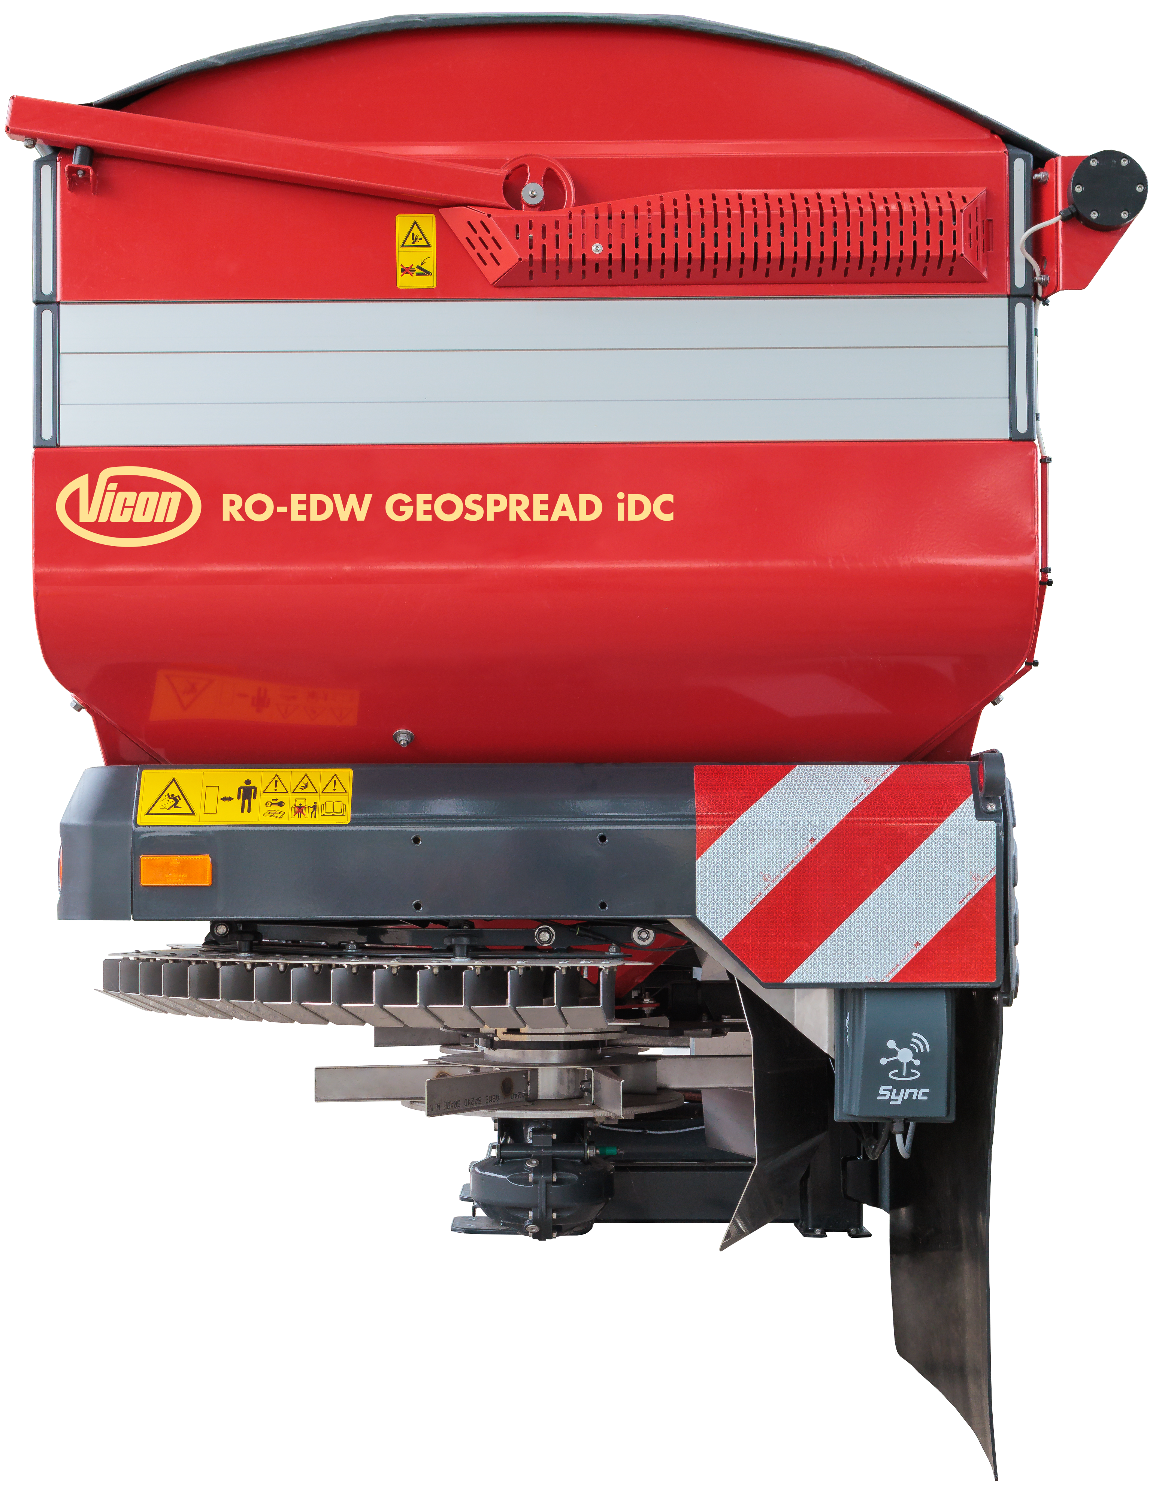

Remote Service
Kverneland Sync
Any user with a Kverneland Sync equipped implement plus any ISOBUS terminal will be able to request remote support.
Customer side
  Go to the Sync application, click Remote Service.
  Share the code with the technician.
  Accept the connection.
Technician side
  Open Kverneland ServiceCentre app or page.
  Click CONNECT REMOTELY on the left menu.
  Type the code shared by the customer.
* Remote Terminal is not supported when the remote connection is established with a Sync Gateway

Slide 23
Remote Service – User Interface
Kverneland Sync

Slide 24
Remote Service – User Interface
Kverneland Sync

Slide 25
Remote Service – User
Kverneland Sync

Slide 26
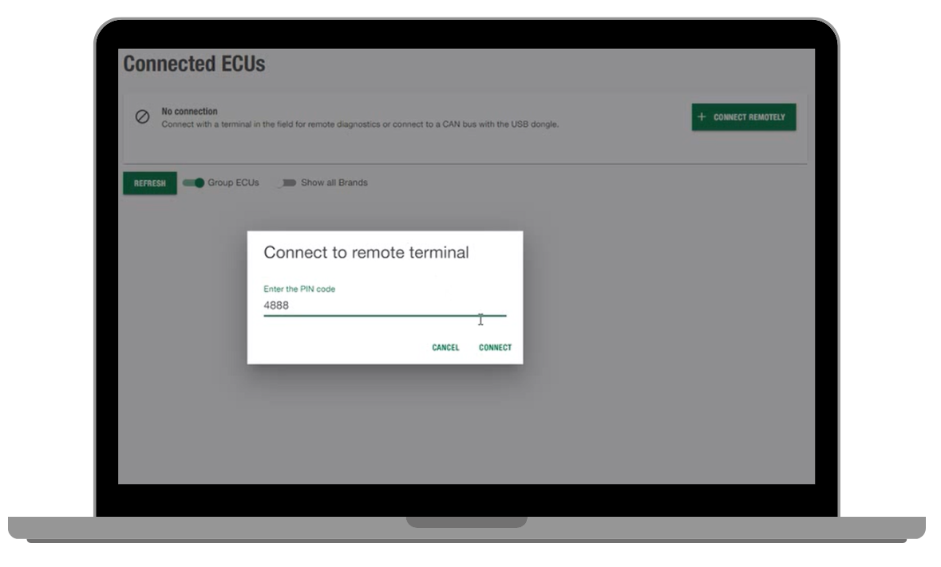
Remote Service – Dealer Interface
Kverneland Sync

Slide 27
Remote Service – User
Kverneland Sync

Slide 28
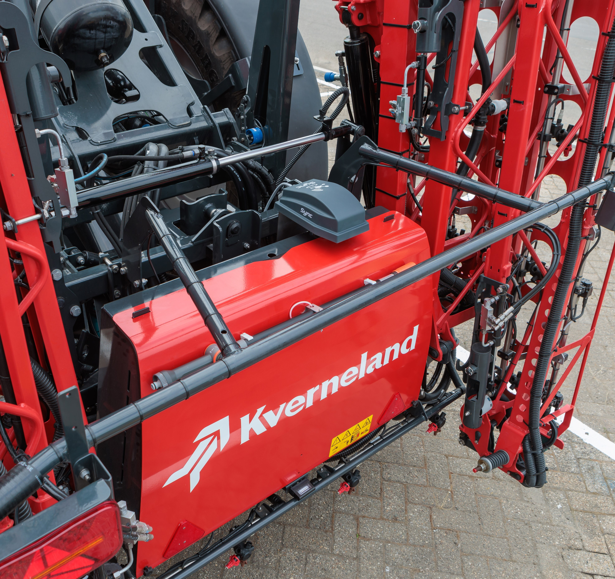
Market Introduction
Kverneland Sync
The target is to equip all Kverneland ISOBUS implements with Kverneland Sync as factory standard by September 2025. It will be implemented in a ramp-up phase which started in September 2024.

Slide 29
Introduction Plan – Phase 1
Kverneland Sync
IMPLEMENT | MODEL | FACTORY | INTRODUCTION
SPREADERS | All EDW3 models | KvG Nieuw-Vennep | September 2024
SPRAYERS | T6 | KvG Nieuw-Vennep | September 2024
PRECISION SEEDER | Optima F | KvG Soest | September 2024
POWER HARROW | Rotago* | KvG Soest | September 2024
PLOUGH | i-Plogh | KvG Klepp | September 2024
DISC MOWER | EXTRA 7100 | KvG Kerteminde | October 2024*
BALE-WRAPER | FastBale Premium | KvG Ravenna | January 2025
BALER | VariBale / FixBale | KvG Ravenna | January 2025
*Availability in IsoMatch FarmCentre to be later.
Subject to Factory confirmation

Slide 30
Introduction Plan – Phase 2
Kverneland Sync
IMPLEMENT | MODEL | FACTORY | INTRODUCTION
SPRAYERS | iXdrive S6 iXter T3 / iXter T4 / iXter B | KvG Nieuw-Vennep | January 2025
PRECISION SEEDER | Optima V / Optima R / Optima TF Profi / Monopill / Unicorn | KvG Soest | January 2025
SEED DRILL | u-drill / e-drill* / Satio F* / f-drill* | KvG Soest | January 2025
CULTIVATOR | i-Tiller | KvG Les Landes | January 2025
PLOUGH | PW / RW | KvG Klepp | September 2025
*Availability in IsoMatch FarmCentre to be later.
Subject to Factory confirmation

Slide 31
Introduction Plan – Phase 3
Kverneland Sync
IMPLEMENT | MODEL | FACTORY | INTRODUCTION
SPRAYERS | iXtra Life iXtra A | KvG Nieuw-Vennep | September 2025
PRECISION SEEDER | Optima RS | KvG Soest | September 2025
SEED DRILL | TS-drill | KvG Soest | September 2025
MECHANICAL WEEDER | Onyx | KvG Les Landes | (TBC)
Subject to Factory confirmation

Slide 32
Market availability
Kverneland Sync
Kverneland Sync is available in all markets where Kverneland group distributes ISOBUS implements except the following ones:
  America
  Canada
  United States
  Mexico
  Brazil
  Paraguay
  Chile
  Uruguay
  Argentina
  CIS
  Uzbekistan
  Azerbaijan
  Belarus
  Russian Federation
  Far East
  Korea
  Taiwan
  Vietnam
  India
  Malaysia
  Singapore
  Thailand
  China
  Near East
  Israel
  United Arab Emirates
  Saudi Arabia

