Slide 1
Vicon Sync
Product Starter Kit
2025

Slide 2
Content
Vicon Sync
Product Information
Customer Onboarding
IsoMatch FarmCentre
Remote Service - Vicon ServiceCentre
Market Introduction

Slide 3
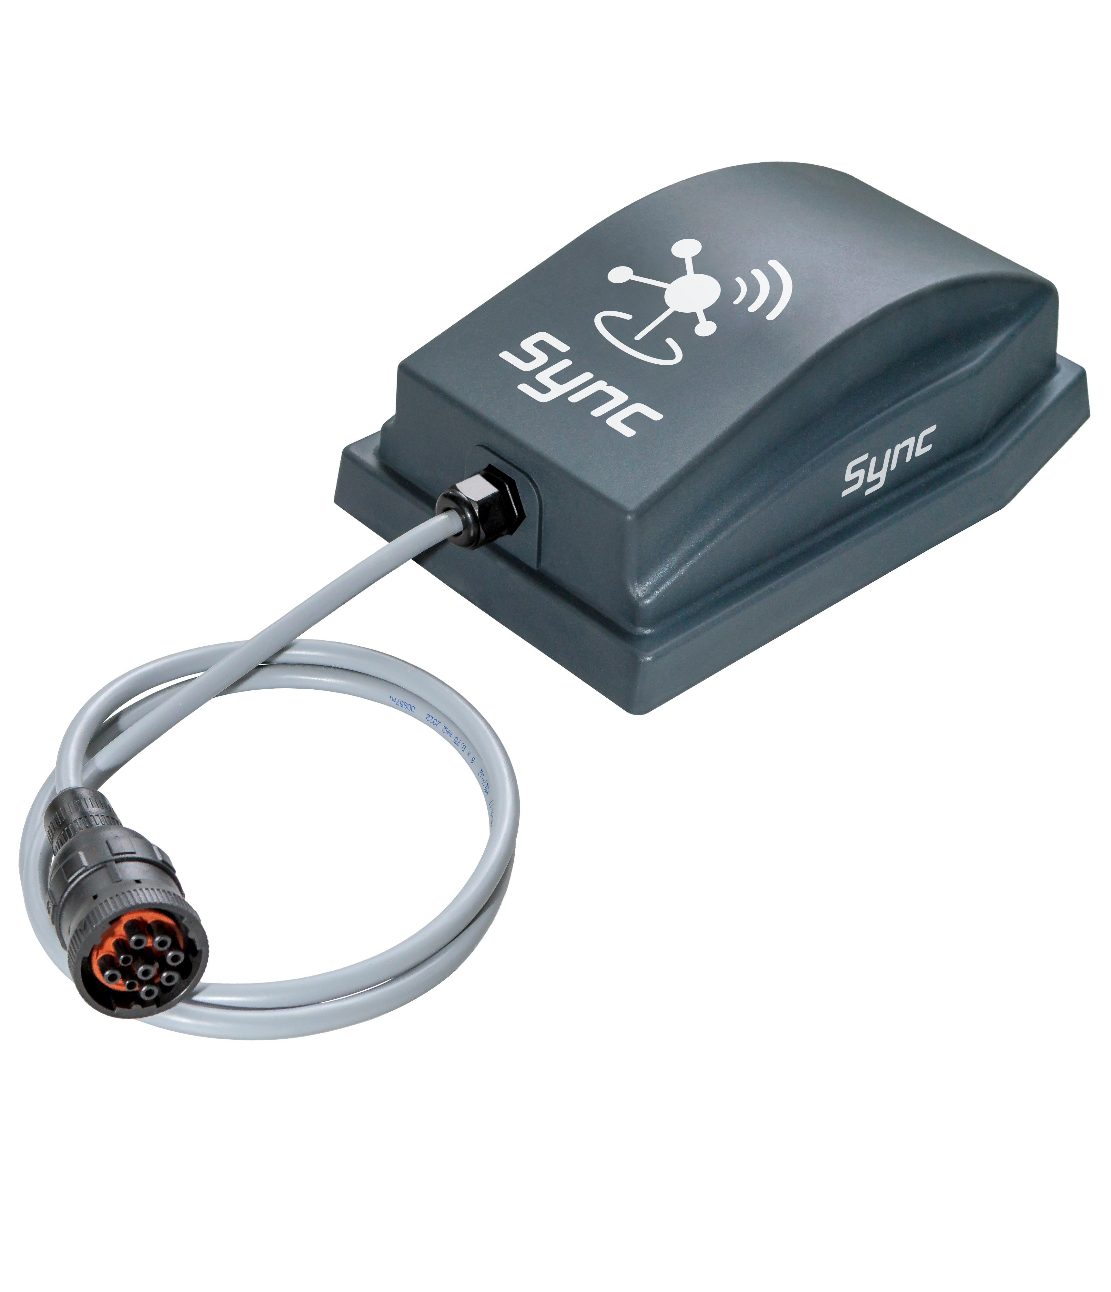
Hardware Release
Vicon Sync
Last year, Kverneland Group Mechatronics released a new tool to the market: Vicon Sync. This is the advanced gateway for ISOBUS Vicon machines.
Since September 2024, we have been connecting implements to corporate digital tools, enabling remote service, IsoMatch FarmCentre, and synchronizing spreaders with the Vicon Spreading Charts App.

Slide 4
Implements Connected
Vicon Sync
Vicon Sync is a connectivity device installed in Vicon ISOBUS implements. This gateway allows the connection of the implements to the cloud. In this way, it will be possible to use remote tools like Vicon ServiceCentre or IsoMatch FarmCentre.
It allows also to connect to the implement via Bluetooth and interact with them with dedicated applications like the Vicon Spreading Charts App.

Slide 5
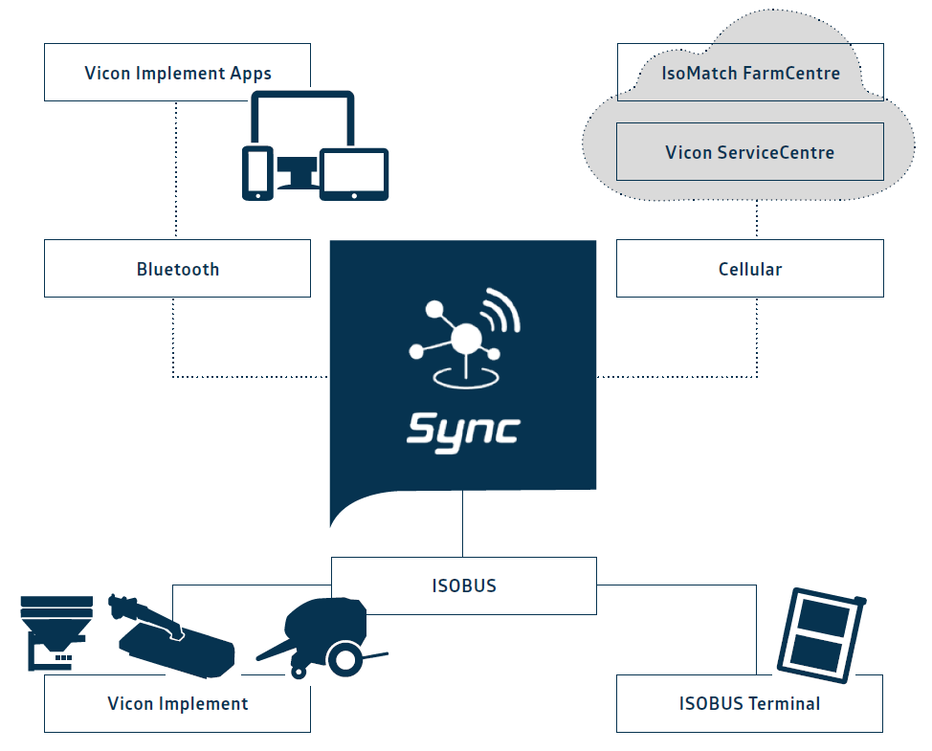
Cloud Connection
Vicon Sync
Remote connection
ServiceCentre via cloud
IsoMatch FarmCentre via cloud
Implement Apps via Bluetooth
Physical connection
ISOBUS terminals.
Vicon ISOBUS implements.

Slide 6
Benefits
Vicon Sync
Vicon Sync ensures smooth connectivity and farming data flow between Vicon ISOBUS implements and digital tools.
Always Connected
Vicon Sync ensures seamless
connectivity to online services, with smooth data transfer to the cloud.
Remote Service
Technicians can resolve issues promptly using service tools with remote connection, like Vicon ServiceCentre.
Maximize Profitability and Growth
Data analysis of the KPI form the implements.
Tracking & Reporting
It allows real-time tracking of operations and diagnostic
codes, offering detailed reporting and secure task data storage.
New Features and Enhanced Safety
Enjoy synchronization with implement apps, precise tracking, and geofencing. Benefit from automated documentation, enhanced safety, and precise task planning.
Terminal Connectivity
Connect your Tellus Terminal via Vicon Sync for access to digital tools directly on your terminal.

Slide 7
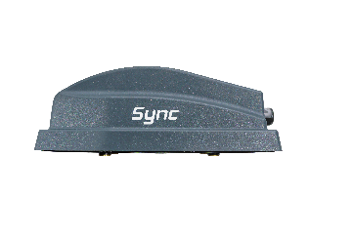
Features
Vicon Sync
ENABLING THE TOOLS
Tracking & Reporting
Data insights
Complete ecosystem
Machine insights with IsoMatch FarmCentre.
Geofence when implement is OFF.
Always connected to the implement.
Independent of tractor brand.
Remote service through implement dealer.
Seamless data collection.
Dedicated platforms for farmers and dealers.
Vicon Spreading Charts App.
IsoMatch FarmCentre
Remote connection from any location at any time Real-time visibility into tasks, alert history and operational values.
Vicon ServiceCentre
Vicon Sync on the implement enables remote diagnostics, monitoring machine health, timely replacement of parts and efficient troubleshooting.

Slide 8
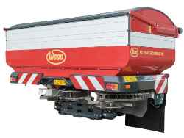
Not connected vs Connected implements
Vicon Sync-connected implements
Functionality | Not connected | Connected with Vicon Sync | Connected with Terminal | Connected with Vicon Sync and Terminal
IsoMatch FarmCentre – fleet management | ✗ | ✓ | ✓ | ✓
IsoMatch FarmCentre – taskdata exchange | ✗ | ✗ | ✓ | ✓
Remote service – without screen replication | ✗ | ✓ | ✓ | ✓
Remote service – with screen replication | ✗ | ✗ | ✓ | ✓
Geofence – implement working | ✗ | ✓ | ✓ | ✓
Geofence – when implement is OFF | ✗ | ✓ | ✗ | ✓ (specific configuration)
Share internet – with IsoMatch Tellus GO+ and Tellus PRO. | ✗ | ✓ | ✗ | ✓
Vicon Spreading Charts App | ✗ | ✓ | ✗ | ✓

Slide 9
Before vs. Now
Vicon Sync-connected implements
To have a connected Vicon ISOBUS implement:
Before | Now
Only via KvG Terminals – needed | Connected regardless of the terminal
Vicon Sync – not included | Vicon Sync – included, installed, activated
2 years connectivity – not included | 2 years connectivity - included
Remote service – manual terminal connection with wifi and 4G dongles | Remote service – enabled without any extra connectivity device on terminal
IsoMatch FarmCentre – to be purchased separately | IsoMatch FarmCentre – included license for 2 years

Slide 10
Activation
Vicon Sync
Vicon Sync is delivered together with the corresponding implement where it is fitted. The gateway includes a SIM card with 2 years of data and a license for IsoMatch FarmCentre valid also for 2 years. When the implement is delivered, some steps have to take place to activate the gateway and to consent the use of customer data and register the Vicon Sync into the IsoMatch FarmCentre account.

Slide 11
Customer onboarding
Vicon Sync
Machine delivery
Machine is delivered to the dealer. Vicon Sync is fitted and installed in the machine.
Document preparation
Dealer downloads and prints the warranty conditions and data contract from Quest.

Slide 12
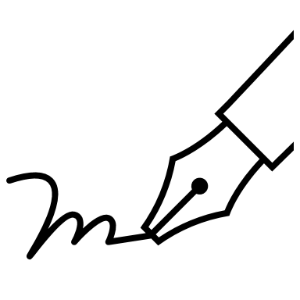
Machine delivery
Machine is delivered to the farmer and final setup is done by the dealer.
Customer’s signature
Customer is asked to sign the delivery documents with the warranty conditions and the data contract to fulfil the GDPR requirements.
Accept
Customer signs and accepts the data contract, and the dealer sends it to the Vicon Sync Support mailbox syncsupport@kvernelandgroup.com Vicon Sync is active, ready for remote support and starts sending data to the cloud.
Decline
Customer does not accept to share data. Contract with the decline request has to be sent to the Vicon Sync Support mailbox syncsupport@kvernelandgroup.com.

Slide 13
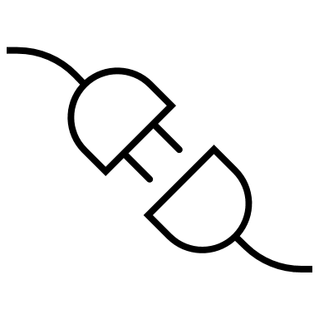
Log in
De-activation
Customer is asked to create an account in MyVicon landing sites.
Within 5 working days from receiving the decline from customer, IsoMatch FarmCentre data collection through Vicon Sync is de-activated.
Registration
Once logged in the landing site, customer can access to IsoMatch FarmCentre and register the Vicon Sync device. Implement will appear automatically.
Usage
Customer gets machine information in its IsoMatch FarmCentre account and can request remote service when necessary.
Renewal
After two years customer can access to the Terrako Marketplace to purchase an IsoMatch FarmCentre license renewal. As long as the customer account is active, Vicon Sync will continue to send data to the cloud.

Slide 14
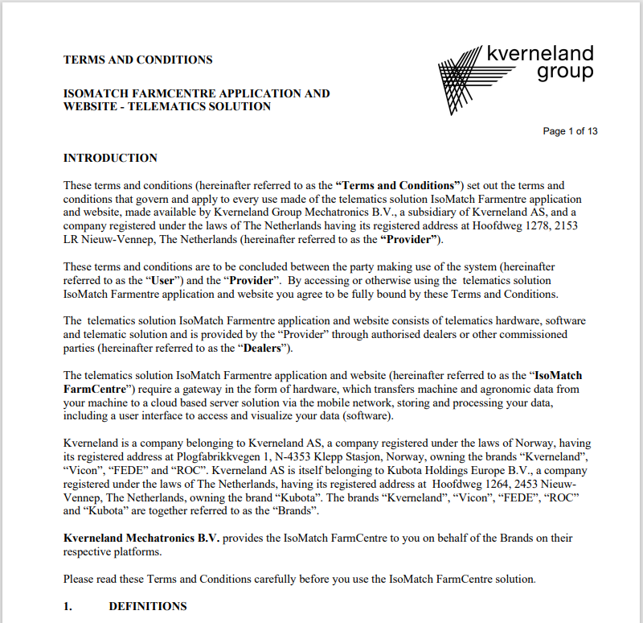
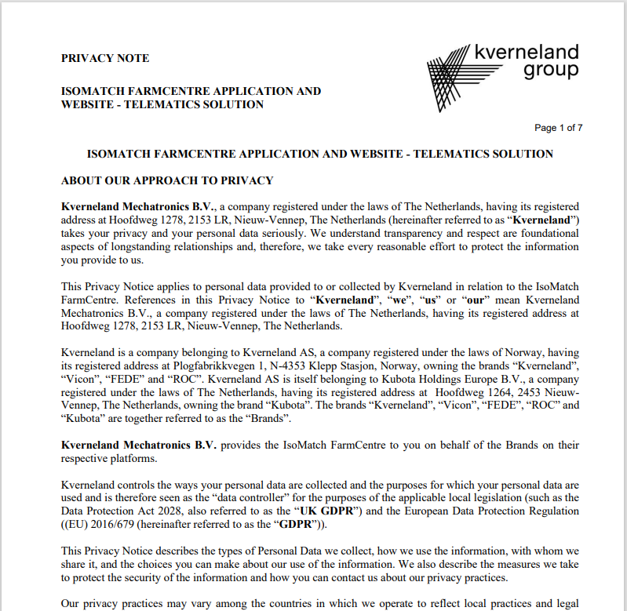
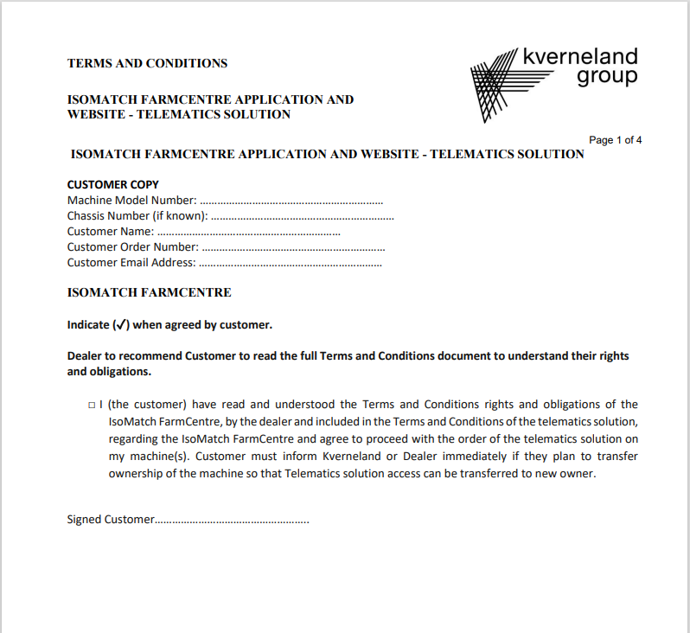
Customer’s signature
Vicon Sync
1. Dealer has to print the next documents available in Quest
2. Customer needs to read
T&C and DPA – Quest Nº 848977
Privacy Notice – Quest Nº 848979
3. Customer needs to sign
Signatures – Quest Nº 848978
4. Dealer needs to scan the CUSTOMER COPY of Signatures documents and forward to syncsupport@kvernelandgroup.com

Slide 15
IsoMatch FarmCentre
Vicon Sync
New user
Register in MyVicon
https://my.vicon.eu/
With the credentials log in IsoMatch FarmCentre
Add Vicon Sync (see next slides)
Existing user
Log in IsoMatch FarmCentre
https://www.isomatchfarmcentre.com/
Add Vicon Sync (see next slides)

Slide 16
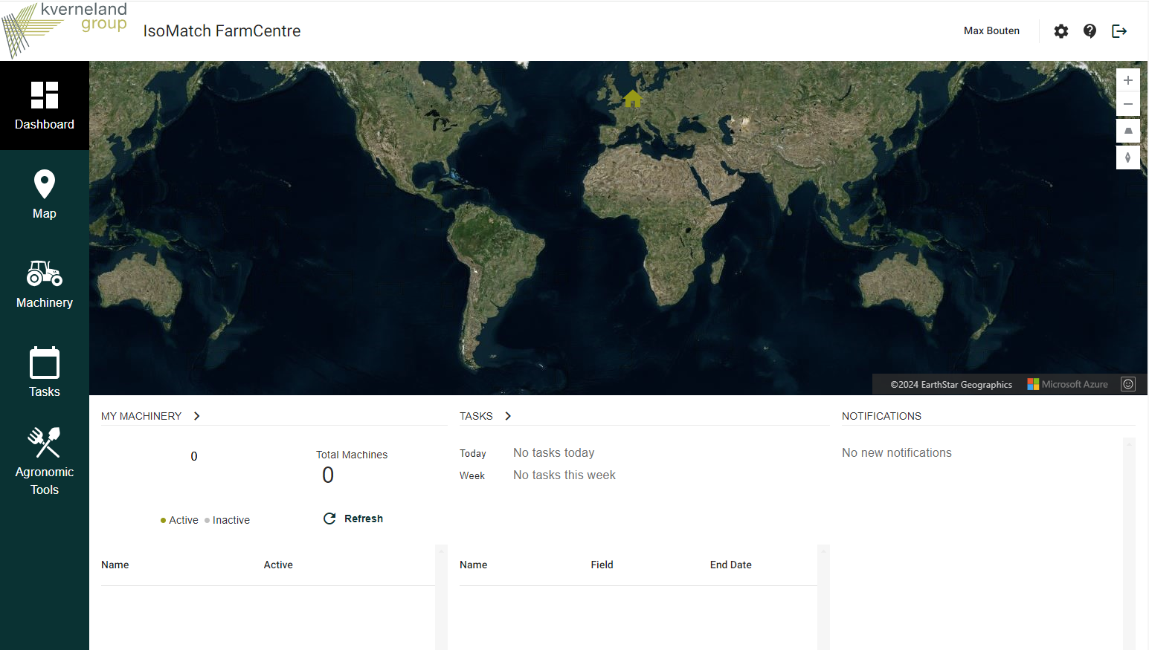
Add Implement to IsoMatch FarmCentre
Vicon Sync
1. Go settings on the top right of the page
2. Select “Gateways & Terminals” section
3. Select “+ Add Gateway” Note: There is no license key needed to add a Gateway
4. Add a Gateway name and the MAC Address of Vicon Sync
Note: It is possible to change the gateway name in settings
5. Confirm your input by “Add Gateway”
6. Go back to Dashboard
7. Find your Vicon Sync in the “Machinery” section Note: Implements connected to Vicon Sync will automatically be added and can be renamed in “Settings”
1

Slide 17
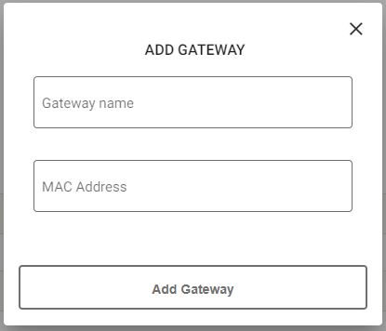
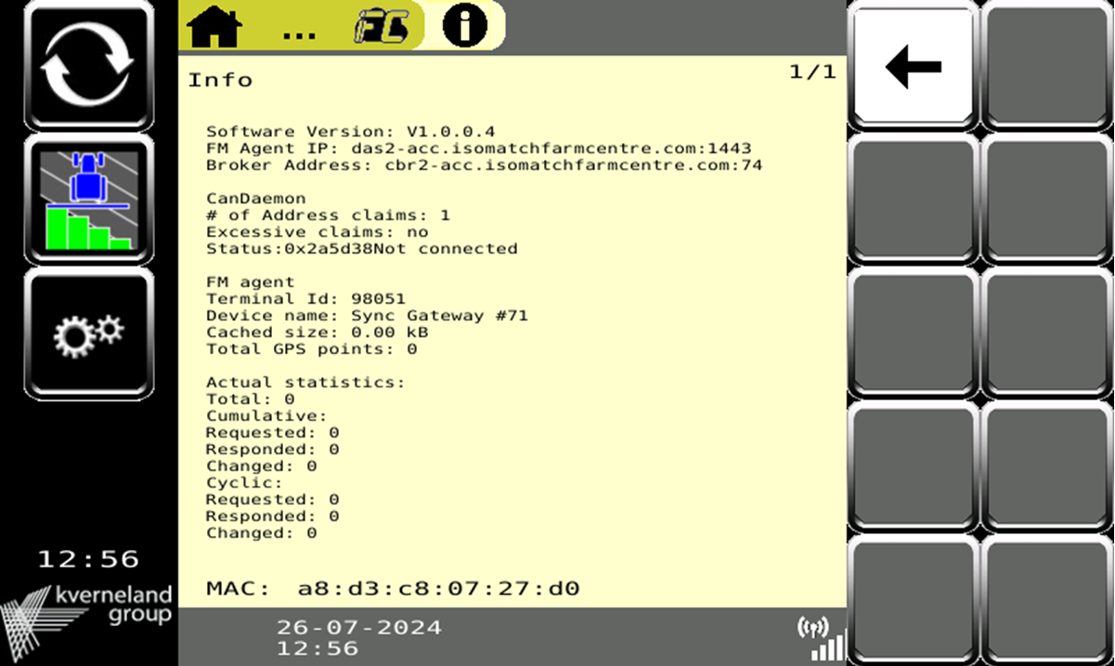
Add Implement to IsoMatch FarmCentre
Vicon Sync
6
1. Go settings on the top right of the page
2. Select “Gateways & Terminals” section
3. Select “+ Add Gateway” Note: There is no license key needed to add a Gateway
4. Add a Gateway name and the MAC Address of Sync
Note: It is possible to change the gateway name in settings
5. Confirm your input by “Add Gateway”
6. Go back to Dashboard
7. Find your Sync in the “Machinery” section Note: Implements connected to Sync will automatically be added and can be renamed in “Settings”
3
User manual
IsoMatch FarmCentre
2
4
5

Slide 18
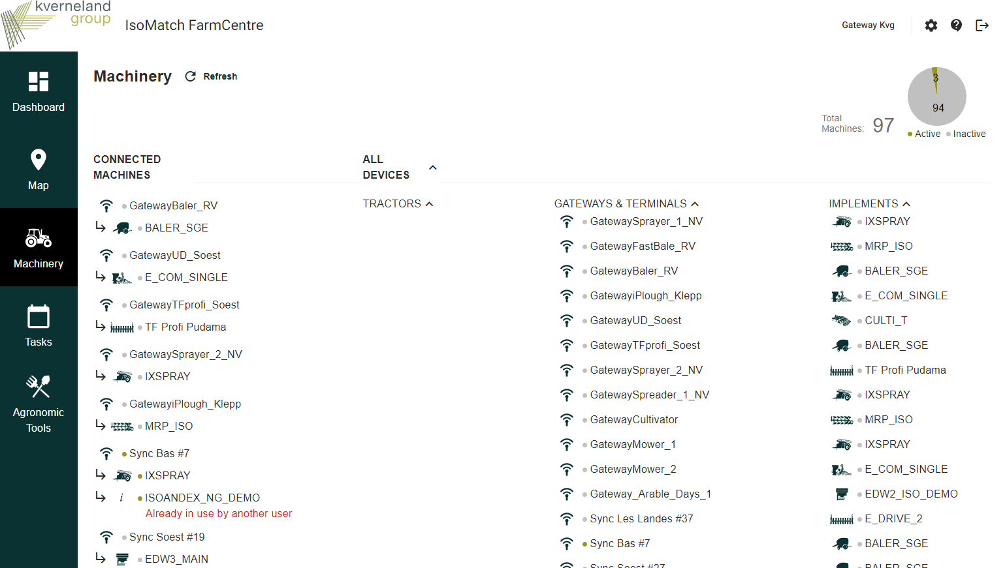
Add Implement to IsoMatch FarmCentre
Vicon Sync
1. Go settings on the top right of the page
2. Select “Gateways & Terminals” section
3. Select “+ Add Gateway” Note: There is no license key needed to add a Gateway
4. Add a Gateway name and the MAC Address of Vicon Sync
Note: It is possible to change the gateway name in settings
5. Confirm your input by “Add Gateway”
6. Go back to Dashboard
7. Find your Vicon Sync in the “Machinery” section Note: Implements connected to Vicon Sync will automatically be added and can be renamed in “Settings”
7

Slide 19
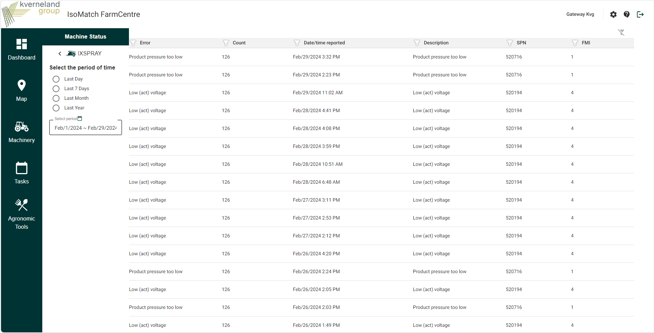
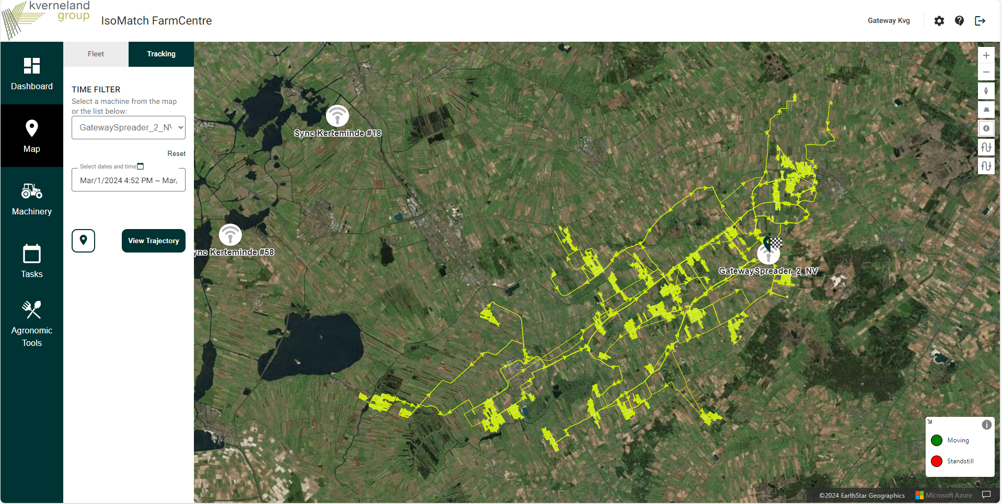
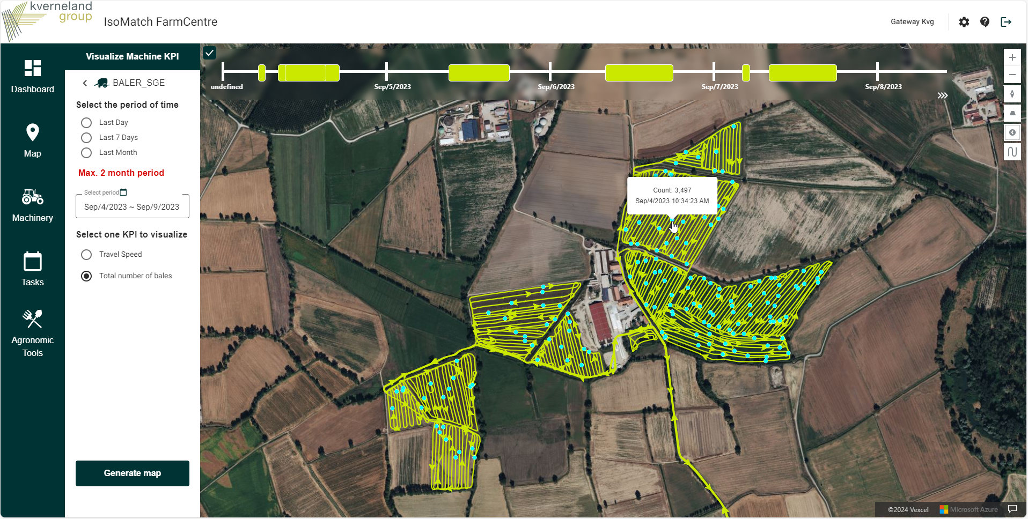
IsoMatch FarmCentre
Vicon Sync + Implement
When a customer has Implement + Vicon Sync, the information below is automatically created in IsoMatch FarmCentre:
Map tracking
Documentation
Machinery DTCs (Diagnostic Trouble Codes)

Slide 20
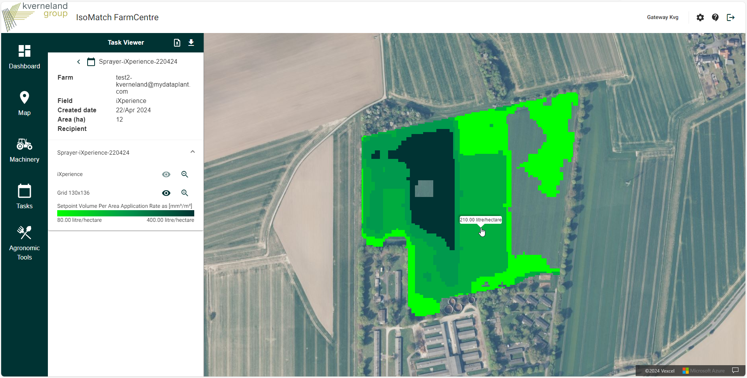
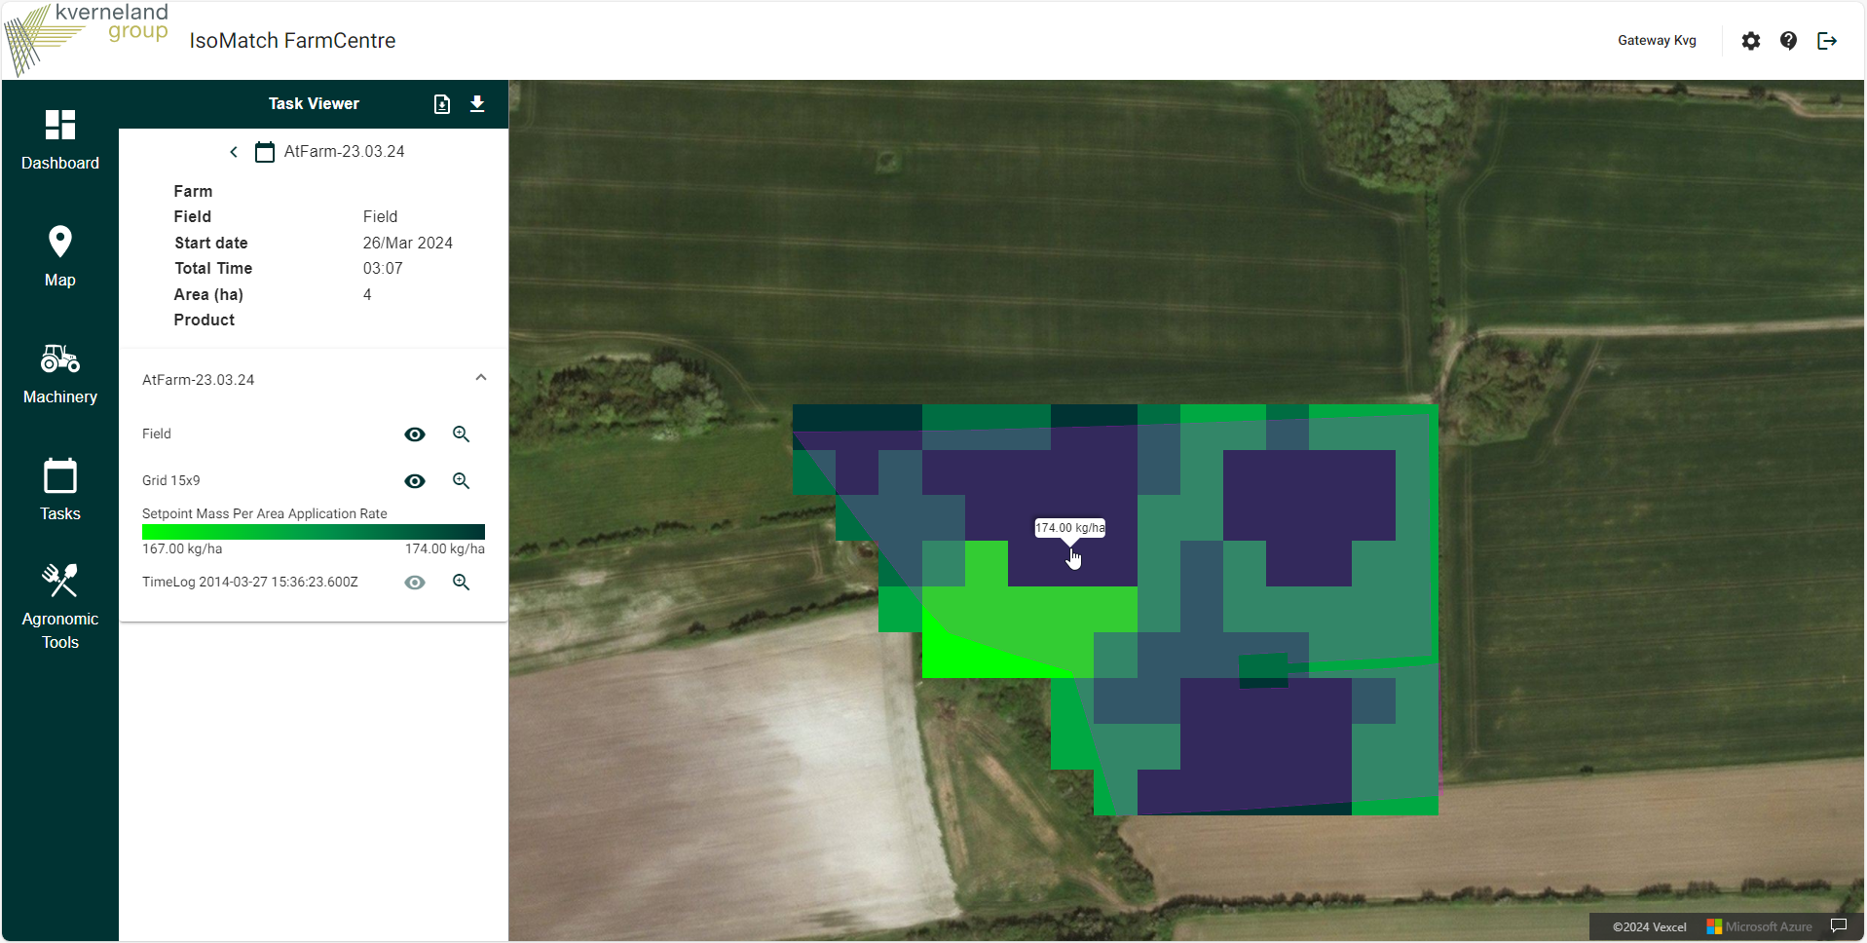
IsoMatch FarmCentre
Vicon Sync + Implement + KvG Terminal
When a customer has an Implement with Vicon Sync and a Vicon connected terminal, it is possible to also do:
Planned task data visualization and remote exchange to the connected terminal
As-applied task data visualization in map

Slide 21
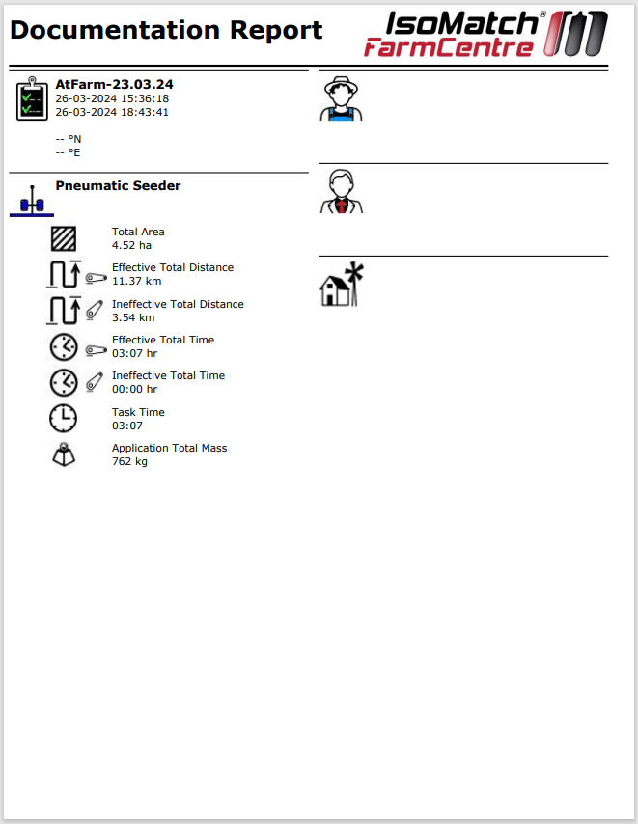
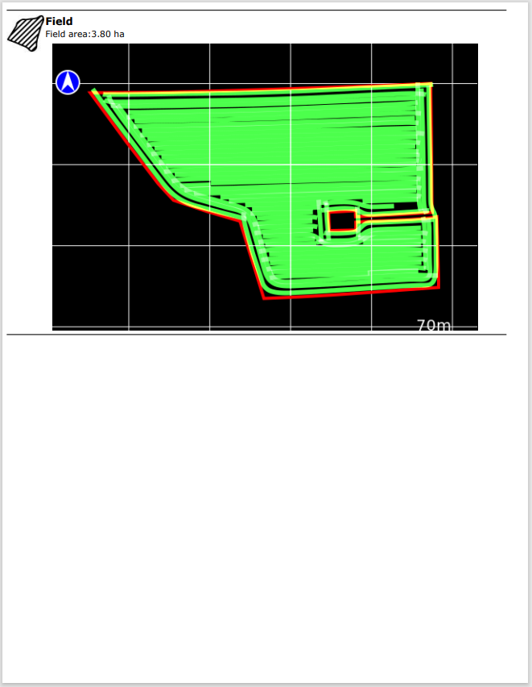
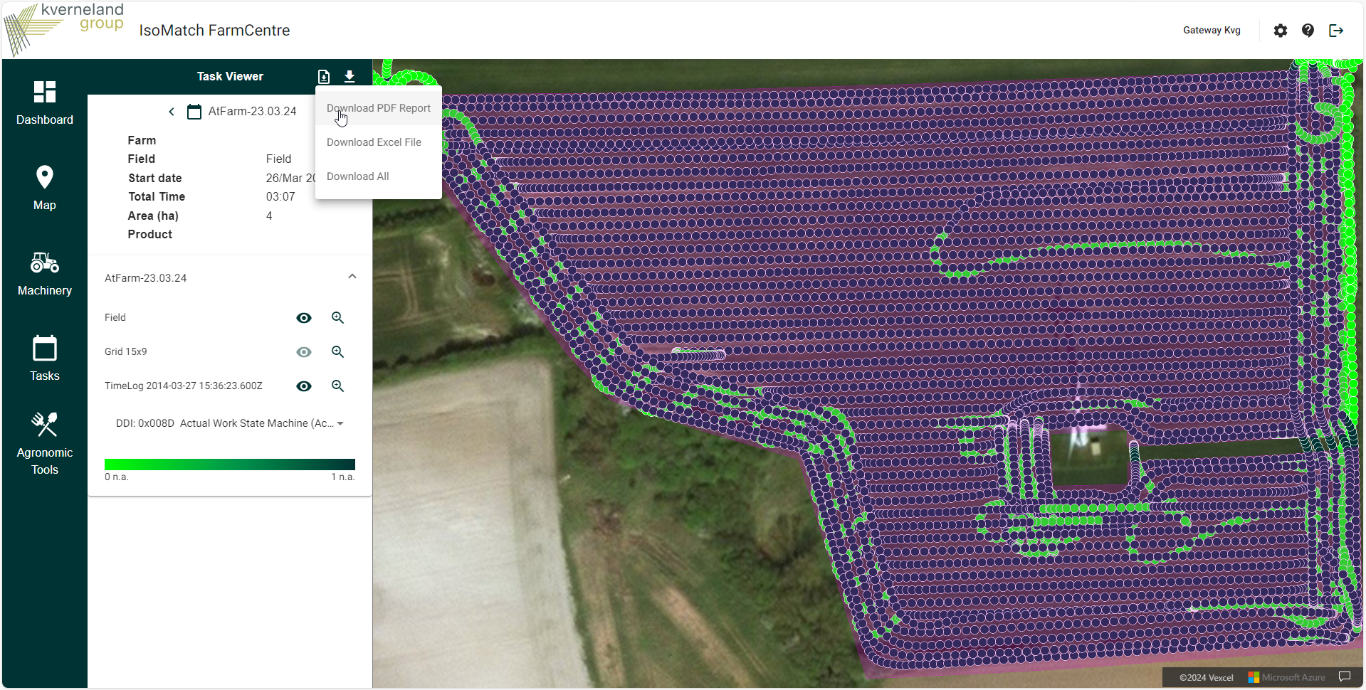
IsoMatch FarmCentre
Vicon Sync + Implement + KvG Terminal
Also PDF reports are available:
For performed task
Click on View task
Click on download PDF

Slide 22
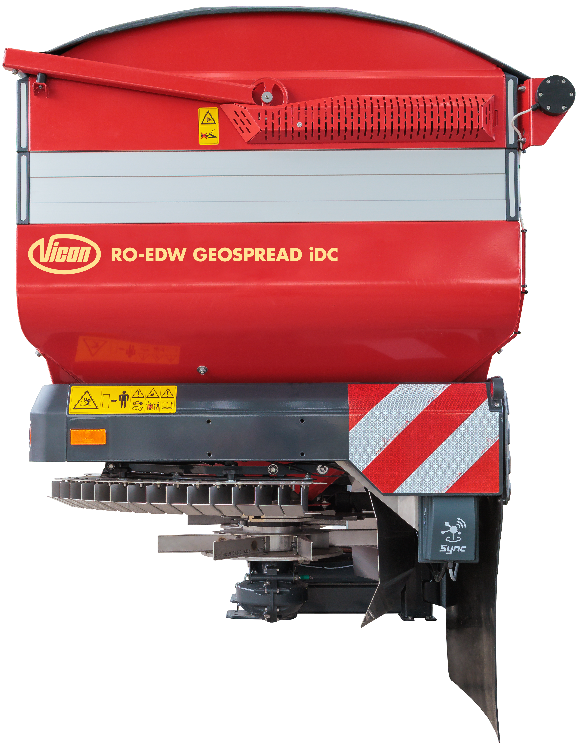
Remote Service
Vicon Sync
Any user with an implement equipped with Vicon Sync plus any brand ISOBUS terminal will be able to request remote support.
Customer side
Go to the Vicon Sync application, click Remote Service.
Share the code with the technician.
Accept the connection.
Technician side
Open the Vicon ServiceCentre app or page.
Click CONNECT REMOTELY on the left menu.
Type the code shared by the customer.

Slide 23
Remote Service – User Interface
Vicon Sync

Slide 24
Remote Service – User Interface
Vicon Sync

Slide 25
Remote Service – User
Vicon Sync

Slide 26
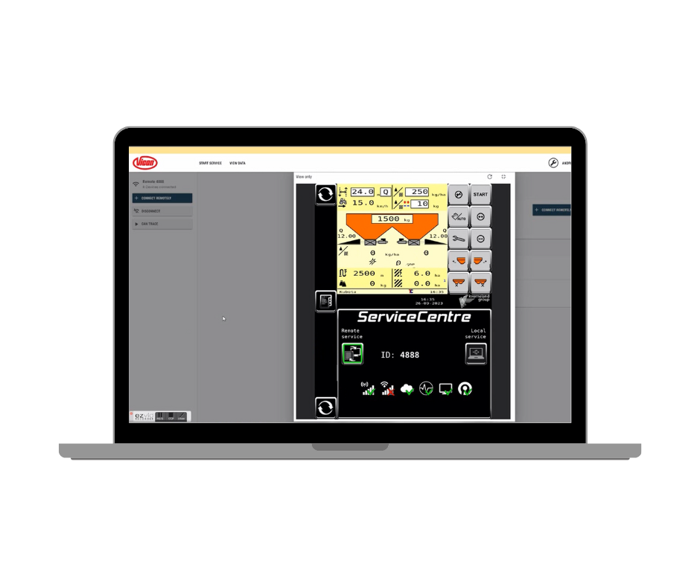
Remote Service – Dealer Interface
Vicon Sync

Slide 27
Remote Service – User
Vicon Sync

Slide 28
Market Introduction
Vicon Sync
The goal is to equip all Vicon ISOBUS implements with Vicon Sync as a standard by September 2025. It will be implemented in a ramp-up phase which started in September 2024.

Slide 29
Introduction plan – Phase 1
Vicon Sync
IMPLEMENT | MODEL | FACTORY | INTRODUCTION
SPREADERS | All EDW3 models | KvG Nieuw-Vennep | September 2024
SPRAYERS | T6 | KvG Nieuw-Vennep | September 2024
PRECISION SEEDER | Optima F | KvG Soest | September 2024
POWER HARROW | Rotago* | KvG Soest | September 2024
PLOUGH | i-Plogh | KvG Klepp | September 2024
DISC MOWER | EXTRA 7100 | KvG Kerteminde | October 2024*
BALE-WRAPER | FastBale Premium | KvG Ravenna | January 2025
BALER | VariBale / FixBale | KvG Ravenna | January 2025
*Availability in IsoMatch FarmCentre to be later.
Subject to Factory confirmation

Slide 30
Introduction plan – Phase 2
Vicon Sync
IMPLEMENT | MODEL | FACTORY | INTRODUCTION
SPRAYERS | iXdrive S6 iXter T3 / iXter T4 / iXter B | KvG Nieuw-Vennep | January 2025
PRECISION SEEDER | Optima V / Optima R / Optima TF Profi / Monopill / Unicorn | KvG Soest | January 2025
SEED DRILL | u-drill / e-drill* / Satio F* / f-drill* | KvG Soest | January 2025
CULTIVATOR | i-Tiller | KvG Les Landes | January 2025
PLOUGH | PW / RW | KvG Klepp | September 2025
*Availability in IsoMatch FarmCentre to be later.
Subject to Factory confirmation

Slide 31
Introduction plan – Phase 3
Vicon Sync
IMPLEMENT | MODEL | FACTORY | INTRODUCTION
SPRAYERS | iXtra Life iXtra A | KvG Nieuw-Vennep | September 2025
PRECISION SEEDER | Optima RS | KvG Soest | September 2025
SEED DRILL | TS-drill | KvG Soest | September 2025
MECHANICAL WEEDER | Onyx | KvG Les Landes | (TBC)
Subject to Factory confirmation

Slide 32
Market availability
Vicon Sync
Vicon Sync is available in all markets where the Kverneland Group distributes ISOBUS implements, except for the following:
America
Canada
United States
Mexico
Brazil
Paraguay
Chile
Uruguay
Argentina
CIS
Uzbekistan
Azerbaijan
Belarus
Russian Federation
Far East
Korea
Taiwan
Vietnam
India
Malaysia
Singapore
Thailand
China
Near East
Israel
United Arab Emirates
Saudi Arabia

