Slide 1
PRECISION FARMING REDEFINED
Product Launch of Tellus 1200 | Tellus 700
20th August 2025, Kverneland Group Mechatronics, Nieuw-Vennep

Slide 2

Precision Farming Redefined
Innovation
Ecosystem
Control
Needs
Development
Farmer
Seasonality
Digital Tools
Connectivity
Precision
Integration
Features
Features
History
Machine
Terminals
Evolution
Support
Rates
Customer
Future
Sections

Slide 3
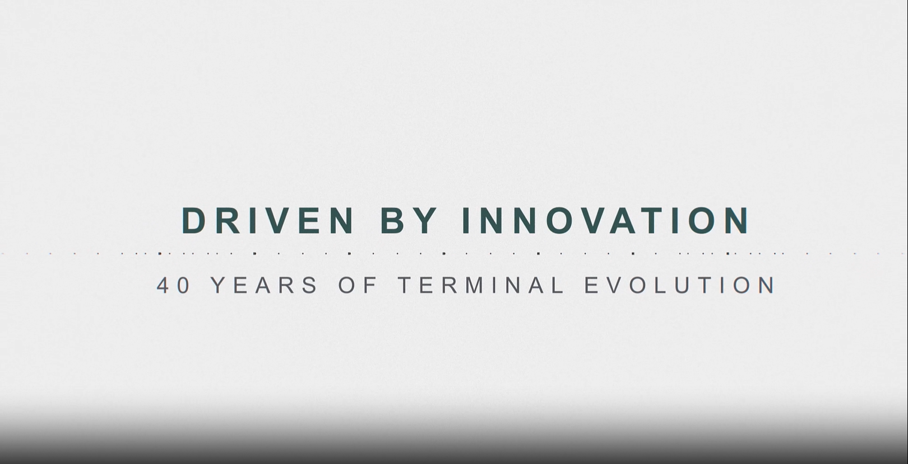
Download This Video Here

Slide 4

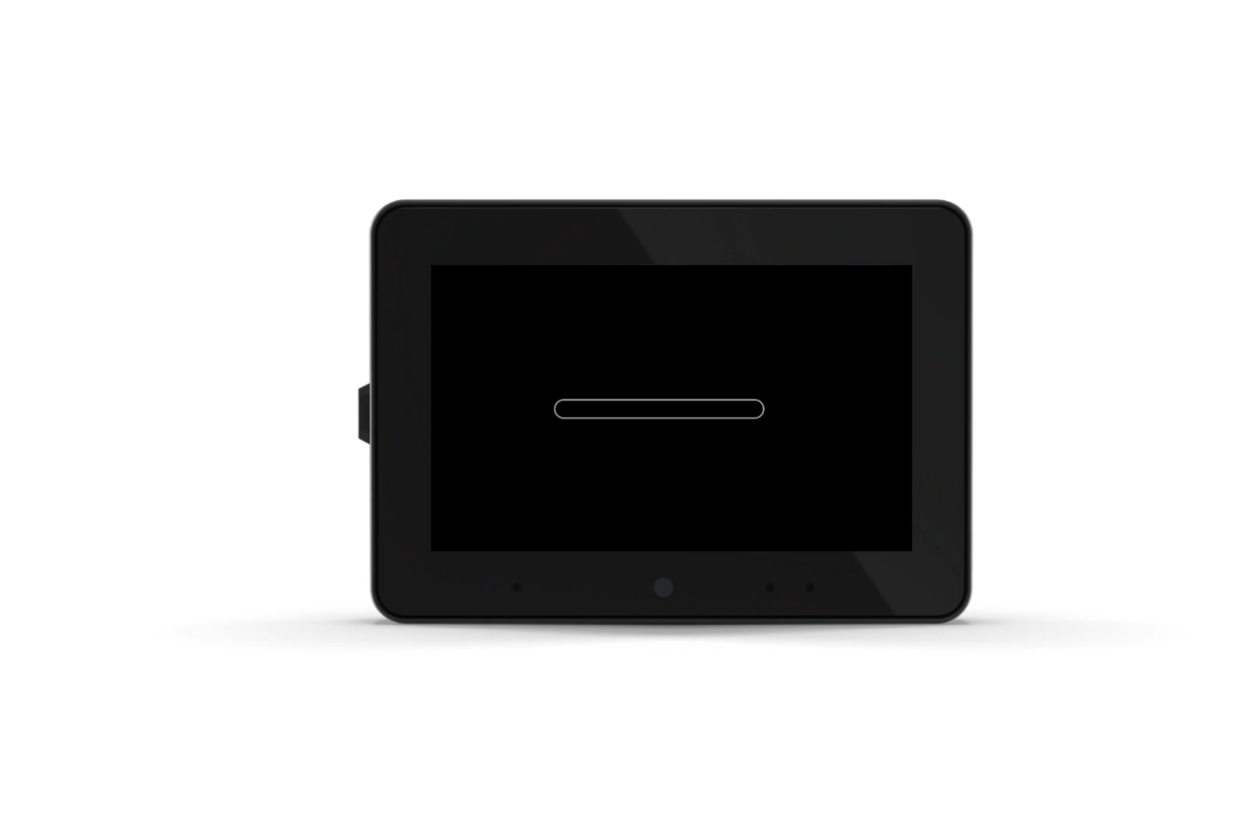
Generation 4
New Generation Universal Terminals
Modern Design For All Conditions
Simple and Scalable License Options
GEOCONTROL Basic, Advanced or Professional

Slide 5
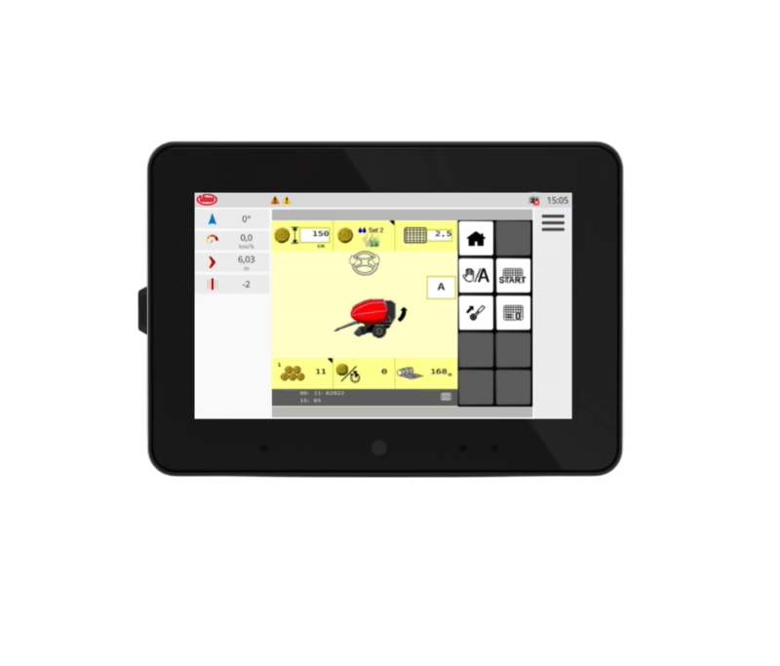
Precision Starts with the Perfect View
Intuitive Touchscreen
Flexible Layout Options
Configurable Dashboard
Excellent View at Day & Night

Slide 6
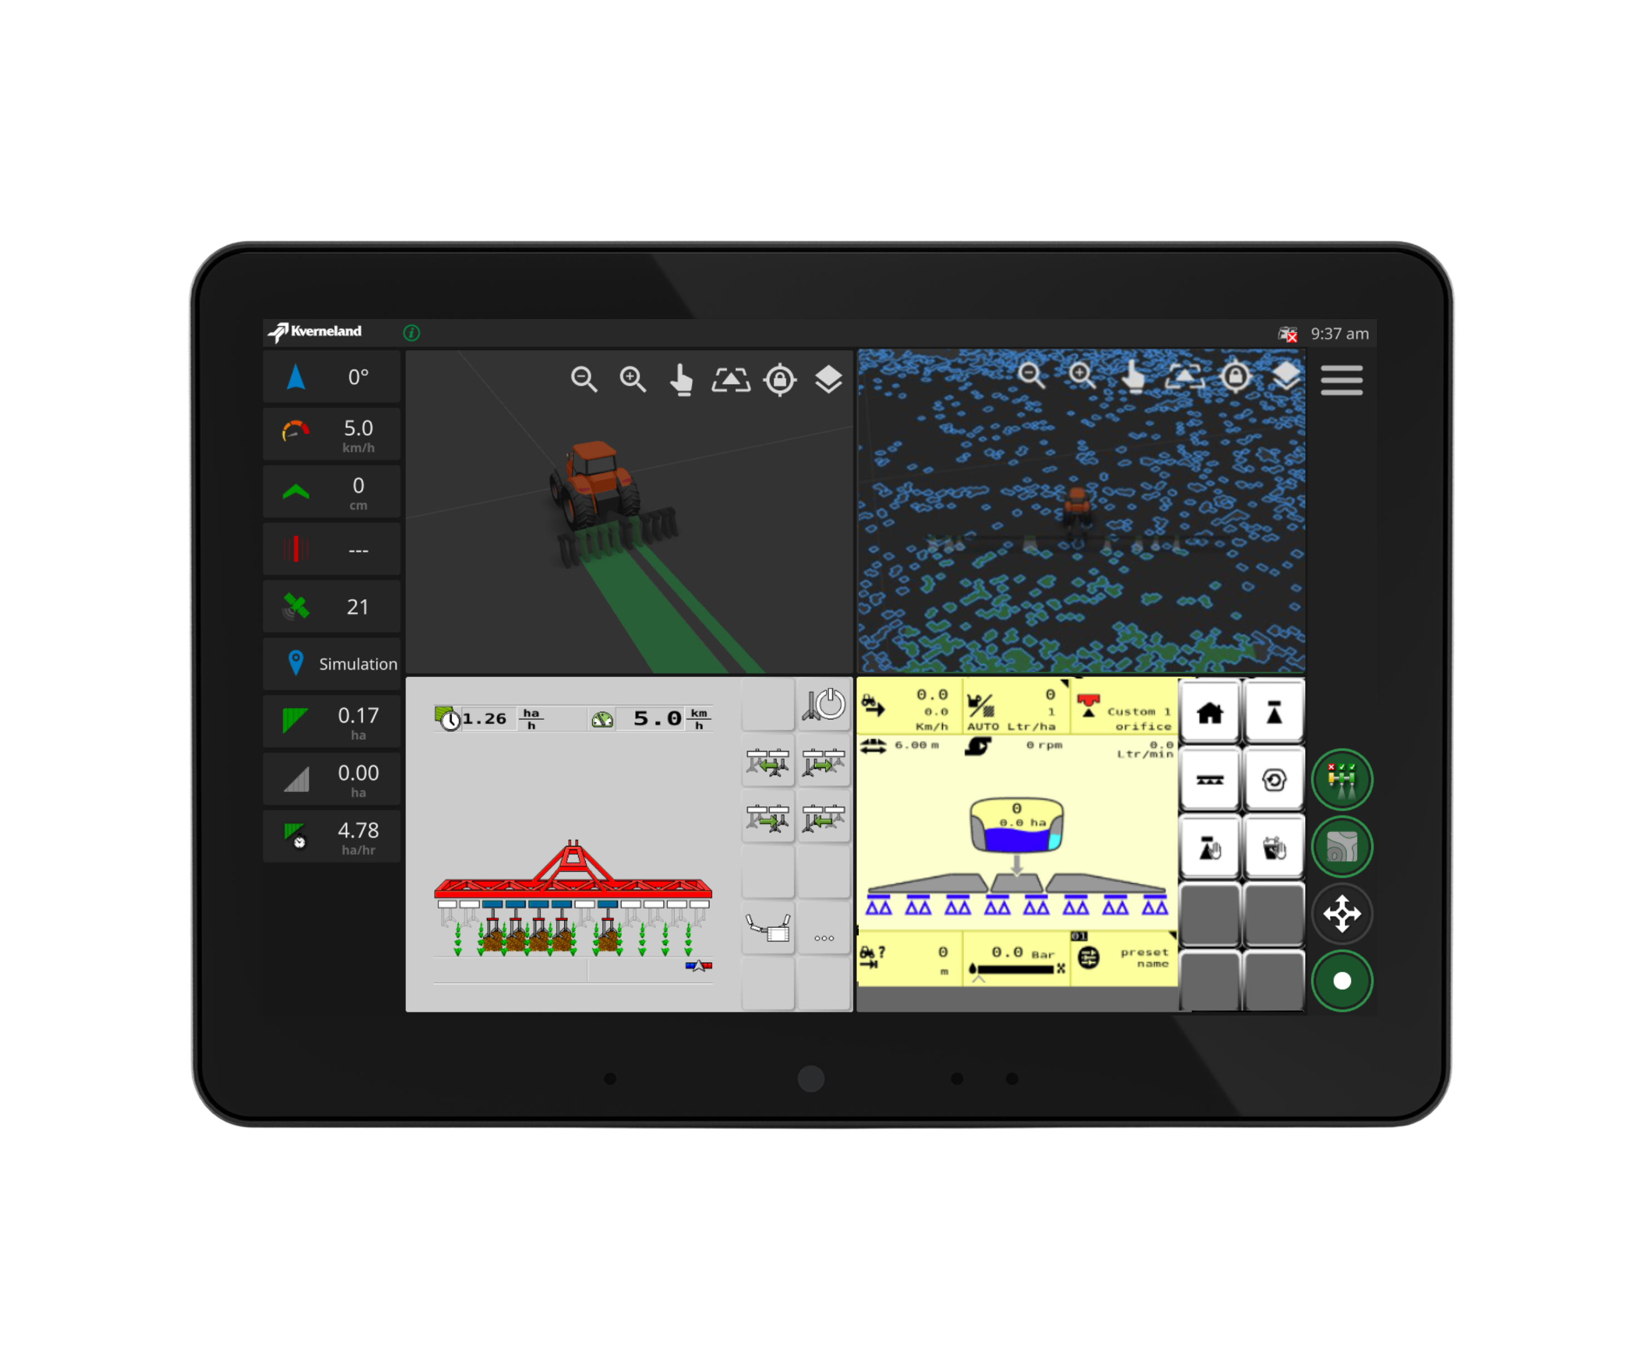
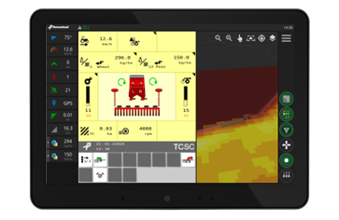
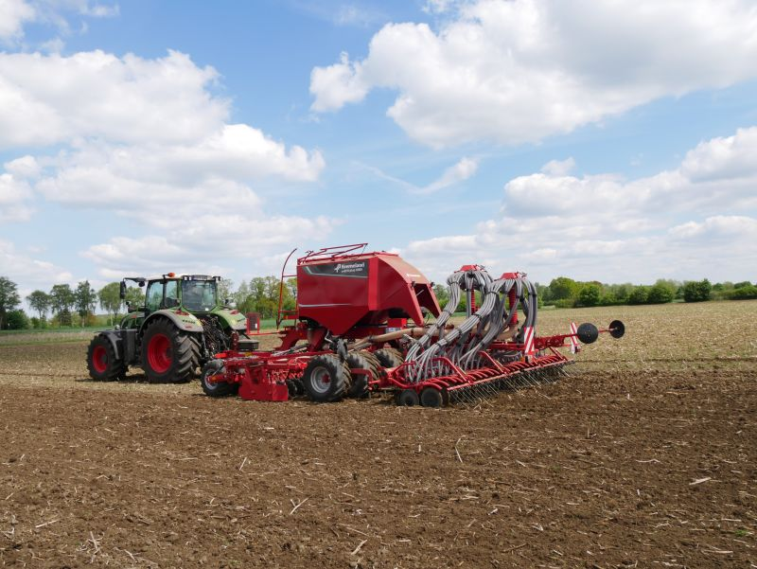
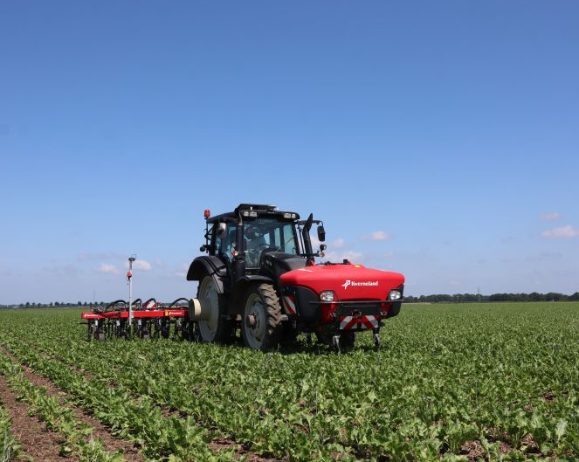
Combine to Achieve More
Ready for the most demanding jobs with up to 8 Bins and 8 Booms
Kverneland u-drill plus
Kverneland Onyx with iXtra LiFe

Slide 7
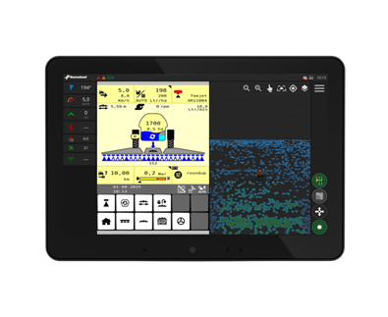
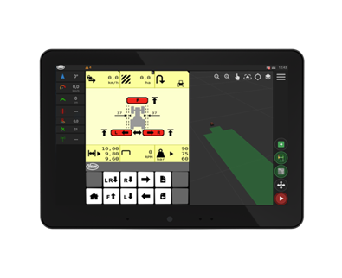
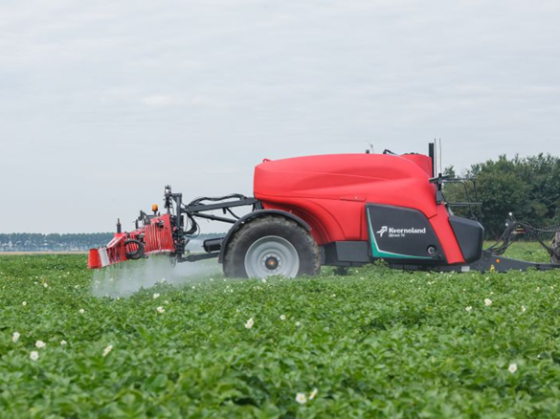
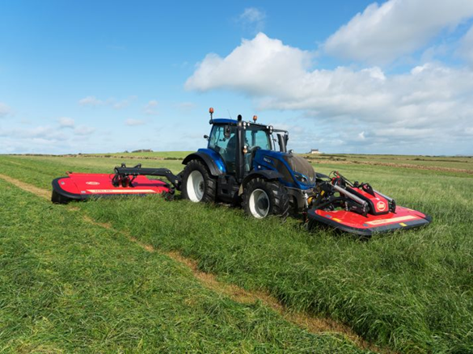
Precise in Everything You Do
Dynamic section layout with up to 255 Sections & 30 Rates
Kverneland iXtrack T6
Vicon EXTRA 7110 and EXTRA 700F

Slide 8
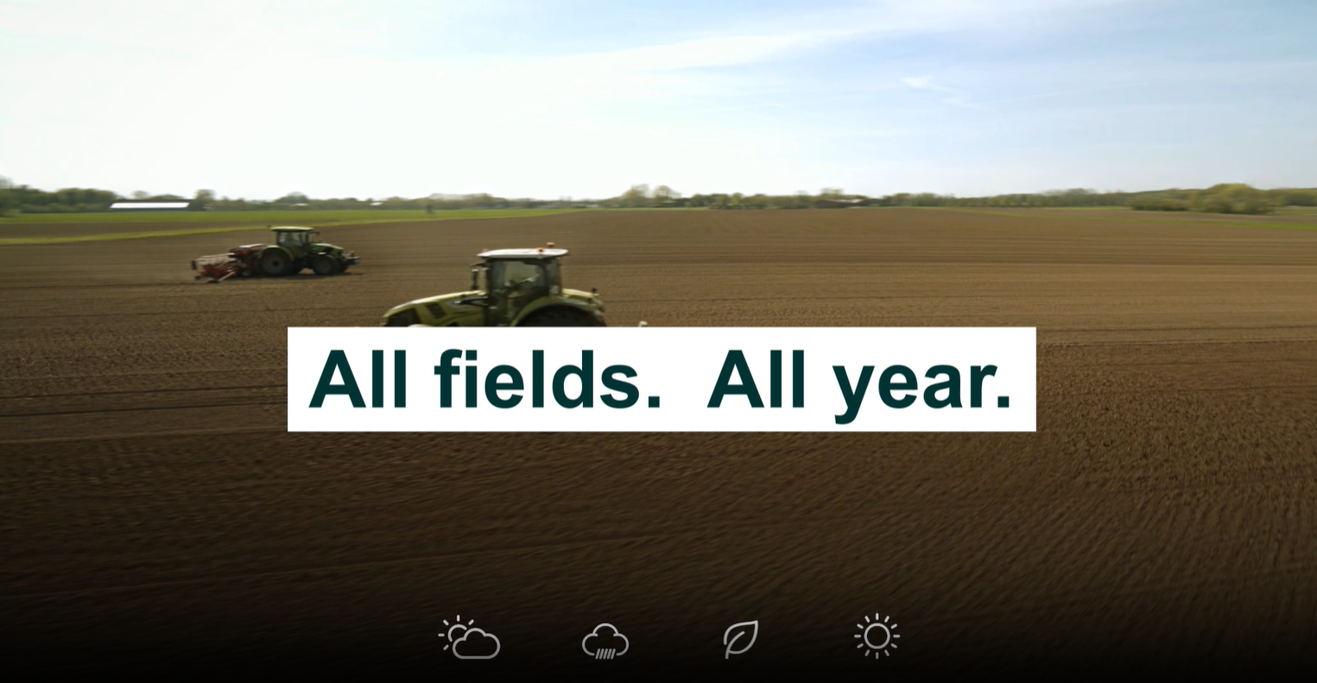
Download This Video Here

Slide 9
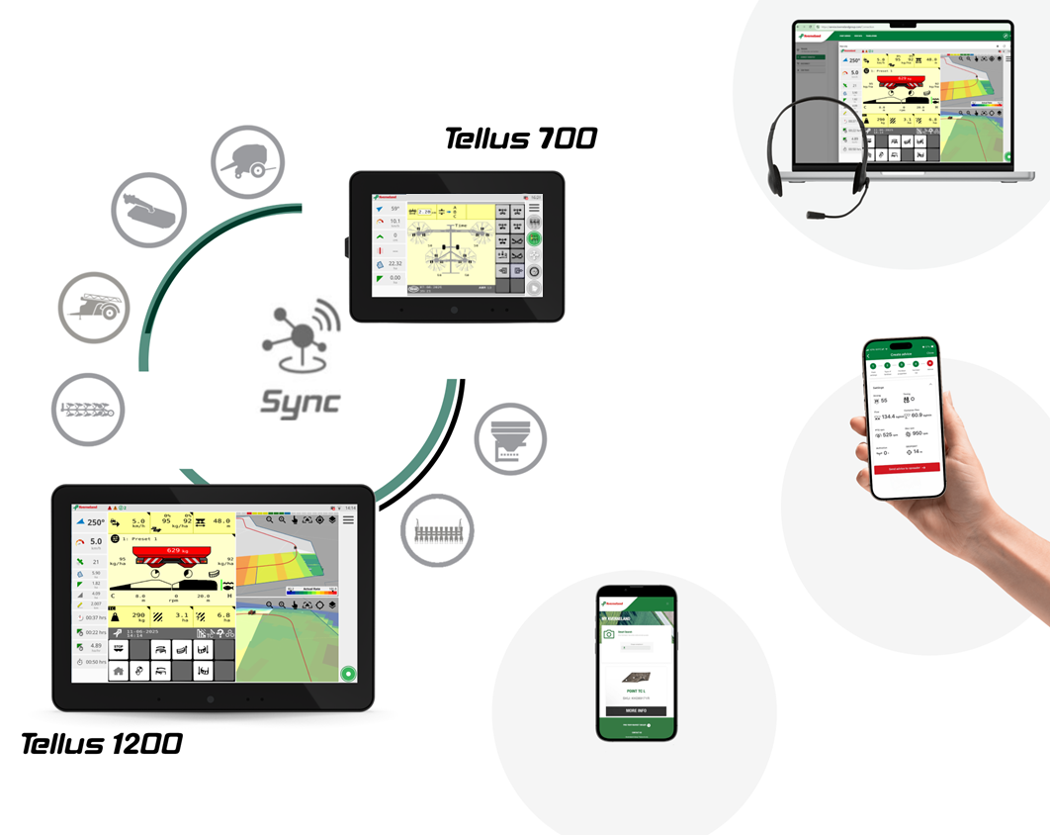
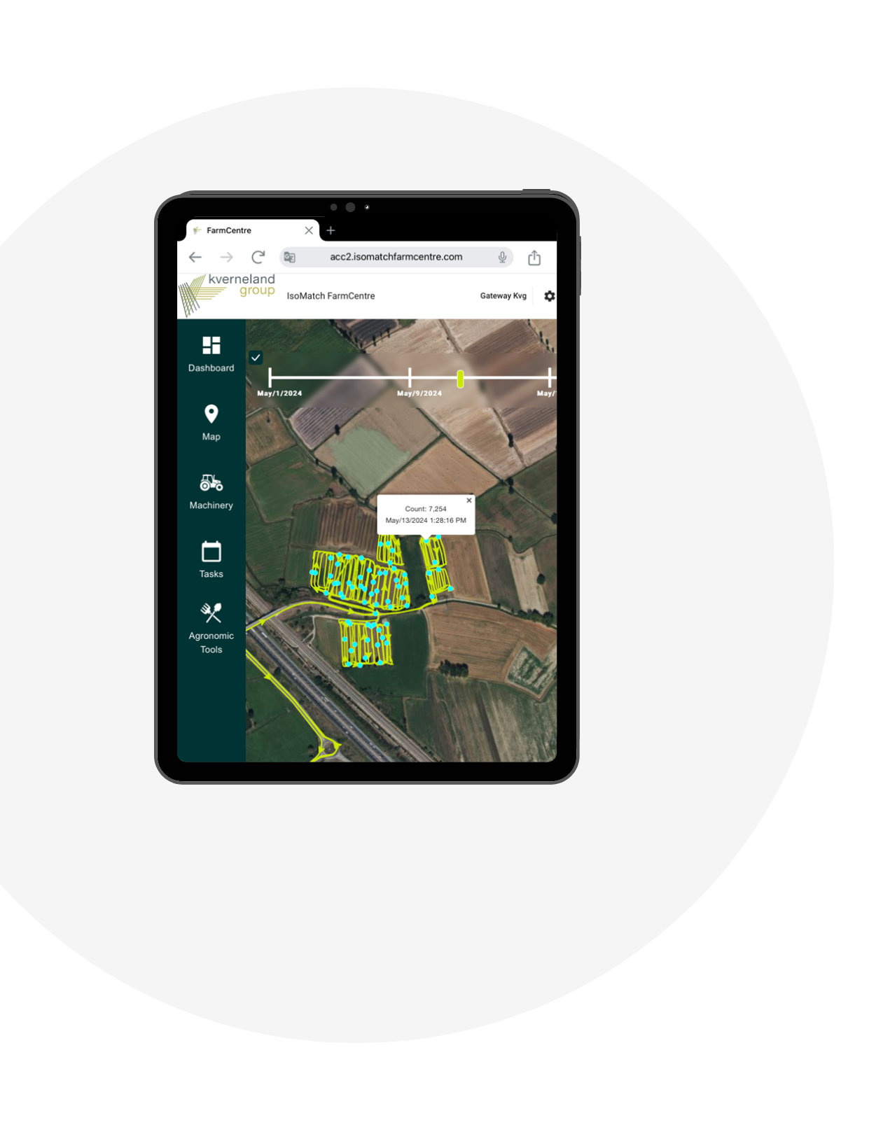
Smart farming starts here.
Remote Service
Implement Apps
IsoMatch FarmCentre
MyKverneland
MyVicon

Slide 10
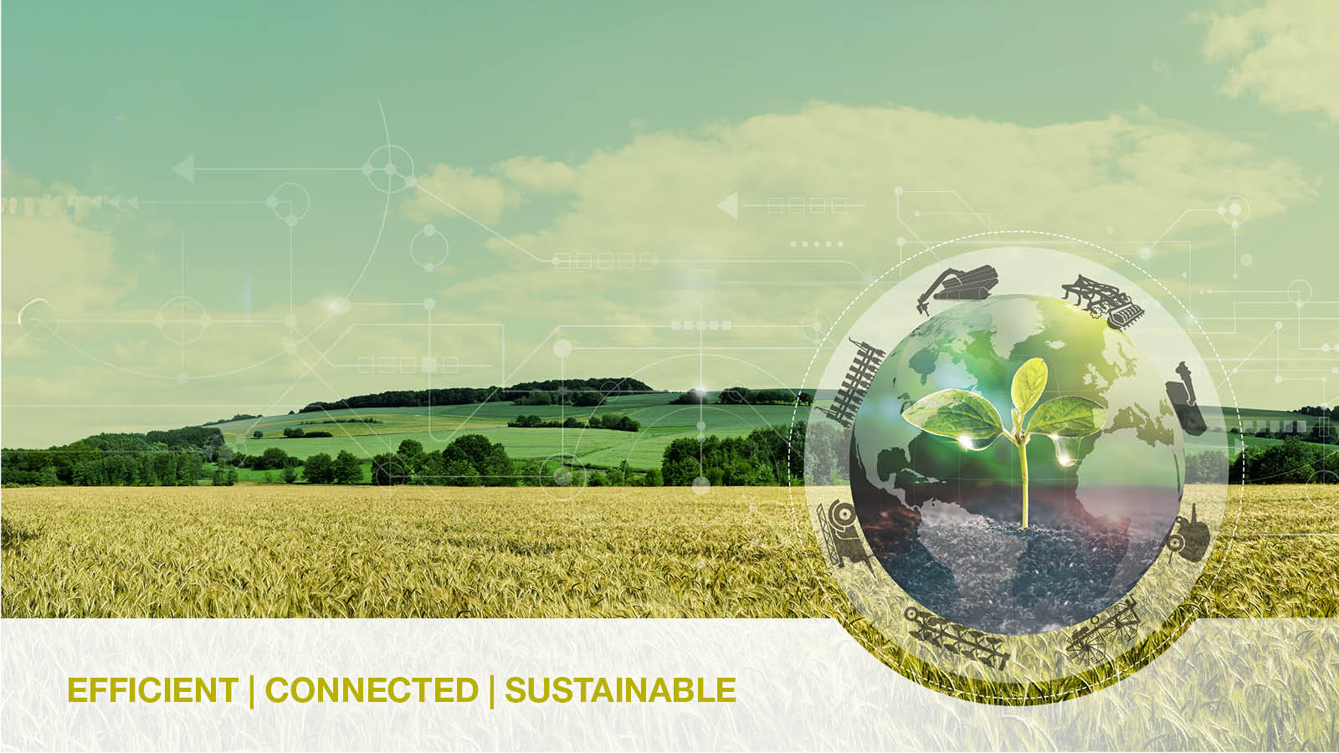
THANK
YOU

